Slide 1
Sustainability at PNU campus:
Water management
سورة الأنبياء (30)
Princess Norah bint abdulrahman University
April 2016

Slide 2
Content
Introduction
Sustainability Making an Impact
What Does A Green Campus mean to PNU
Sustainability In PNU Strategic Goals
PNU Commitment to Sustainability
Resource efficiency
PNU Water Management Program
Proposed Campus Sustainability Plan
Sustainability Making an Impact

Slide 3
Princess Norah Bint Abdulrahman University
Master Plan

Slide 4
Introduction

Slide 5
Introduction
PNU is one of the biggest female universities in the world and has the largest utilities plants over the Middle East. There is a need to have an efficient operation to save the campus assets and reduce costs.
The biggest university in the world to be dedicated for women only (60,000 students) that encompasses specialties ranging from liberal arts, science, medical faculties.
The campus is designed to have the most flexibility for ease of future adaptation
The project architectural character is design with a modernized Islamic vocabulary.
The project design utilizes the most up to date and state of the art technology for both educational spaces and facilities and for the systems used in the project.
The campus was designed according to the highest standards and taking into consideration sustainability and LEED requirements.
The campus has an Automated People Mover System (APM) serving most of the project components.

Slide 6
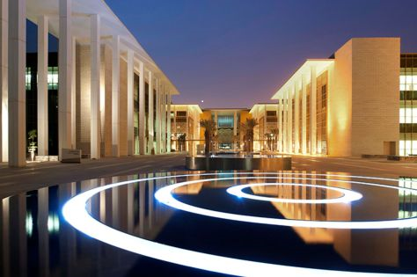
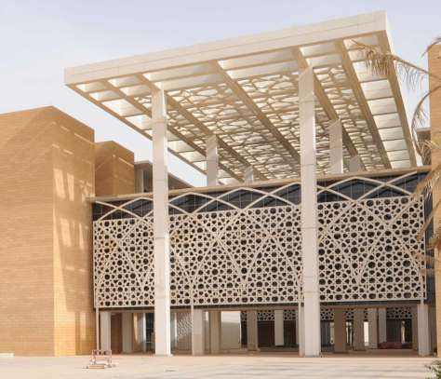
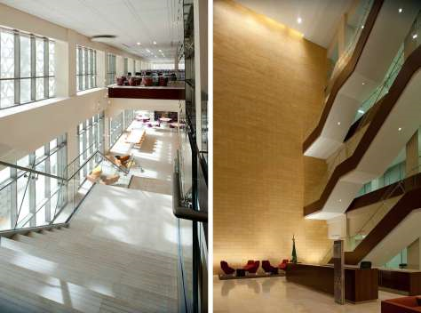
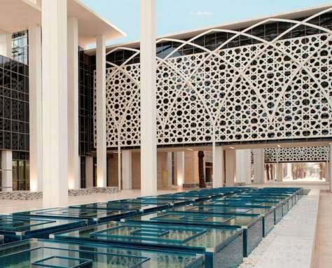
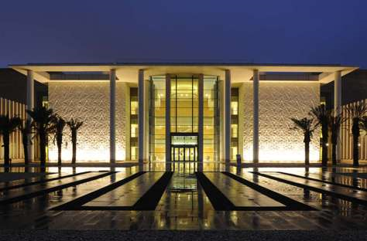
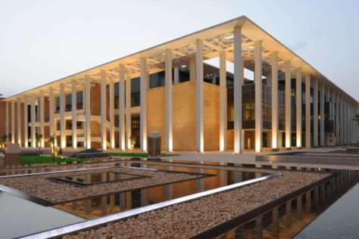
Building Designs at PNU

Slide 7
About PNU Campus
Description | Item | Quantities
General | Site Area (m²) | 8,000,000
 | Total Build up Area (m²) | 3,000,000
 | Number of Students | 60,000
Academic Colleges | Total number of Lecture Halls & Classrooms | 540
Health Schools | Total number of Lecture Halls & Classrooms | 174
Single Student Housing | Total number of rooms | 5,904
 | Total capacity for students | 12,148
Married Junior Staff Housing | Total number of apartments | 1,036
Married Senior Staff Housing | Total number of villas | 400
Main Mosque | Prayers capacity | 4000
Central Library | Books capacity | 5,000,000
Conference & Convention Center | Total number of Spectators (Main Theater) | 2850
Female Administration | Total number of rooms & offices | 478
Male Administration | Total number of rooms & offices | 61
Hospital | Total number of beds | 700
Student Stadium | Total number of seatings | 7000
Schools | Total number of classrooms (Boys) | 15
 | Total number of classrooms (Girls) | 15
 | Capacity of students (nb. Of students) | 720
Water Tanks Area | Capacity of irrigation tank (m³) | 41,000
 | Capacity of potable tank (m³) | 26,100

Slide 8
About PNU Campus
Description | Item | Quantities
Catering | Catering process (meals/day) | 60,000
Chillers | Chiller capacity (Tons) | 90,000
Boilers | Boiler capacity (kW heating) | 132,315
Electrical Power | Electrical power demand (MVA) | 320
Solar Panels | Total number of solar panels | 4,000
Utility Tunnel | Length of the Tunnel (m) | 3,465
Piping Network | Total length of Piping (km) | 625
Cable Network | Total length of Cables (km) | 1,048
Piping & Cable Network | Total length of Piping & Cables (km) | 1,700
Escalators & Elevators | Total number of Elevators | 498
 | Total number of Escalators | 149
Road Network | Total Length of Roads (Km) | 50
 | Total number of Parkings | 15,000
Design Drawings | Total number of drawings | 186,000
Concrete & Reinforcement | Total Quantity of concrete (m3) | 2,113,000
 | Total weight of steel structure & Reinforcement | 291,000
Solid Waste | Processing capacity (m3/day) | 10,000
Automated People Mover | Heading time bw two Vehicles (minutes) | 3-8
 | Capacity of vehicle (Passengers) | 143-224
 | Total number of stations | 14

Slide 9
What Does A Green Campus mean to PNU

Slide 10
What Does A Green Campus mean to PNU
For PNU to be a Truly Green University all three of the above functions need to be operating from the same Green Agenda, all feeding into each other creating a synergy of sustainable activity running through PNU.

Slide 11
PNU Sustainability Policy
Systematic Integration of Sustainability Principles
Master Planning
Design and Construction
Operations and Maintenance
Renewable Energy
Sustainable Transportation
Recycling and Waste Management
Environmentally Sensitive Policies

Slide 12
Sustainability In PNU Strategic Goals

Slide 13
Sustainability In PNU Strategic Goals
The PNU 10-year strategic plan has seven goals that emphasize sustainability in all aspects of university operations.
These goals can be achieved through the following strategic objectives:
Supporting projects for investing PNU resources and utilities.
Achieving sustainability through efficiency and effectiveness in operating PNU utilities and managing its resources.

Slide 14
PNU Commitment to Sustainability
PNU

Slide 15
PNU Commitment to Sustainability
PNU is playing a responsible role to implement sustainable best practices through various projects ranging from design to construction and during operation. These practices save energy, improve occupant comfort and environment, reduces carbon footprint that resulted into a better Sustainable environment and a Greener campus.
Notes:
15

Slide 16
Significance of Green Buildings
Profitable, Healthy, Environmental Friendly.
Green Buildings can produce the following effects:
24%-50% Energy Use reduction
33% - 39% CO2 Emissions reduction
40% Water Use reduction
70% Solid Waste reduction
13% Maintenance costs reduction
27% Higher levels of occupant satisfaction

Slide 17
Sustainable built environment - Sustainability In Deign
Capital Projects ….Building Design and Performance
Our Sustainability Framework ensures our built environment is resource efficient, operationally cost-effective and provides improved environmental, economic and social benefits to student, staff and surrounding communities.

Slide 18
Sustainability in Action
PNU commitment
Leadership to the Green Campus Programme
Management of Capital Programme
Commuting, energy, waste, landscape etc
Maintenance Upgrades, lifecycle approach
Promotion of Good Practices
Utilities Management (Polluter Pays)
Research opportunities.
Work with Student Body (Green Campus Programme)

Slide 19
Sustainable Design - Transport and mobility - Automated People Mover
To help reduce the impact of motor vehicles, we’re developing a transport and mobility plan to create a more accessible, and environment friendly .
The plan aims to promote walking, and public transport (APM ) to reduce single-occupancy car trips and the number of vehicles on our campus, and better manage car parking demand.

Slide 20
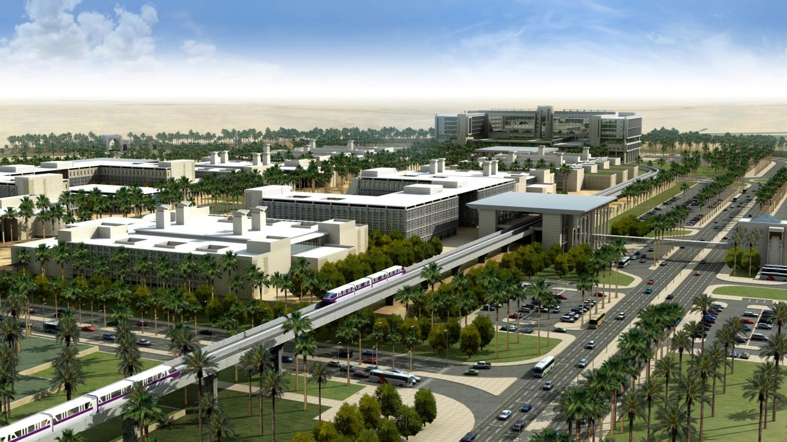
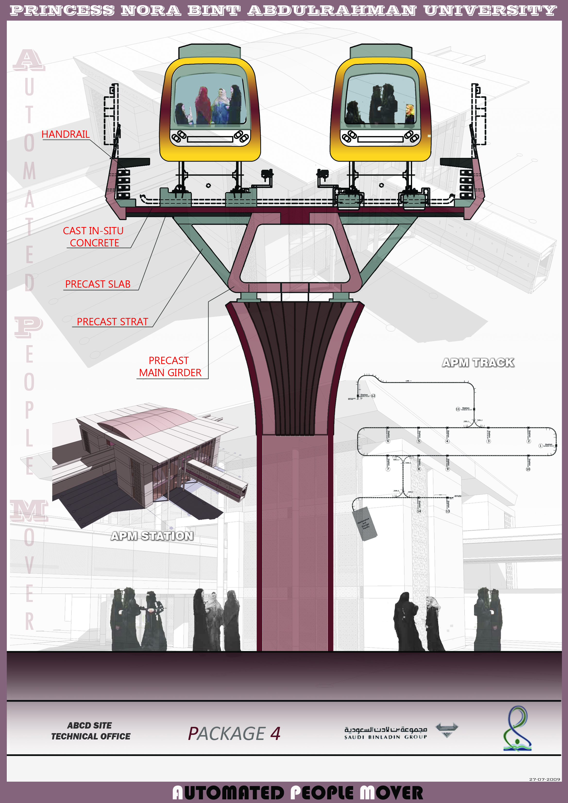
Automated People Mover (APM )

Slide 21
Sustainable Operation - Energy Management Program (EMC)
Energy management is the use of engineering and economic principles to control the cost of energy to provide needed services in buildings and industries
Approximately 14 percent of the costs of a building with an expected 40-year life span are in the building’s design and construction; the remaining 86 percent of costs is in operations and maintenance.
Technology alone does not ensure an energy efficiently operated building. Management and the operators can have the most significant impact on building energy use and cost.
Develop the preliminary Energy Strategy
Get buy in from Top Management
Organize administrative and management structure
Conduct Energy Cost and Use tracking
Conduct an energy audit
Identify, analyze, and prioritize opportunities
Implement energy projects, processes, and
training
Monitoring, targeting, and reporting
Notes:
21

Slide 22
Required involvement
Involved parties: Consultant, Contractor, & Occupant.
Implementing and encouraging best practices is a shared teamwork between all concerned parties.
To be successful and achieve required targets a joint effort should be performed by all.
Areas of concern:
Environmental awareness
Energy management
Water management
Waste management
Housekeeping management
Operation Automation/Optimization

Slide 23
Resource efficiency
To help us benchmark progress, we capture and report on our consumption, waste generation across our campuses. We are also implementing a system to monitor energy and water consumption across our buildings in real time.
Water is a precious resource and essential in maintaining our natural landscapes, which are an important part of our campuses.
Our water conservation initiatives include:
smart irrigation technologies
water-sensitive urban design to manage storm water
minimum water-efficiency standards for new buildings and refurbishments
rainwater harvesting systems
Notes:
23

Slide 24
PNU Water Management System
When it comes to water, every drop counts

Slide 25
Water Management System - Water Action Plan
PNU is developing a Water Action Plan to build on our water conservation achievements to date and guide the University’s water management activities in the future. The Plan will outline actions, strategies and targets to realize our vision of establishing a campus-wide closed loop water system.
Water Management System - Water Conservation
Water conservation is one of our key water management strategies. We’ve reduced our water use significantly through initiatives like PNU’s Water Conservation Program.

Slide 26
Water Management System -Water Conservation Techniques used in PNU
Using water-conservative low consuming type appliances and sensor-operated automatic faucets to reduce water consumption
Using Maximo program as a computerized maintenance management software to record any water losses and follow up the corrective actions
Full scale Sewage treatment Plant to treat sewage water and use it for irrigation
Reverse osmosis Plant to desalinate deep wells water and use it for irrigation
Automatic Irrigation system that depends on weather conditions to determine optimum time for the irrigation

Slide 27
Water Management System -Water Conservation Techniques used in PNU
Irrigation is taking place at early hours of the day to avoid evaporation due to high temperature and low humidity occurring during the day
Training is performed frequently by the contractors to enhance awareness of water conservation and apply water conservation measures
The Billing system reports monthly water consumption of each villa and apartment, to monitor tenants’ consumption rates and inform them about it.
Brochures were distributed to all tenants and users to conserve water in their daily use.

Slide 28
Water Management System - Sewage Treatment Plant (STP)
It is one of the unique sewage treatment plant in the region, with a current capacity range from 2,500 m3 – 3,000 m3 and a maximum capacity of 10,050 m3 per day
The treated water is used for irrigation (required is nearly 8,000m3 per day).
Water Management System - RO Plant
This plant treats deep wells water using the reverse osmosis technique to desalinate water and use it to make up irrigation needs.
This Plant produces nearly 5,000 m3 daily from two deep wells within PNU Campus.

Slide 29
Water Management System - Potable Water Consumption
Details | Jan | Feb | Mar | Apr | May | Jun | Jul | Aug | Sep | Oct | Nov | Dec | Total
Potable -2015 (Thousand m3) | 188 | 184 | 188 | 158 | 173 | 169 | 147 | 145 | 156 | 142 | 137 | 135 | 1,922
Potable -2014 (Thousand m3) | 128 | 127 | 152 | 166 | 169 | 147 | 145 | 156 | 202 | 134 | 155 | 181 | 1,861

Slide 30
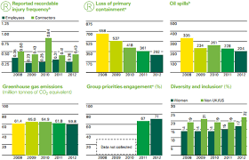
Water Management System - The Environmental KPI
Environmental KPI includes water management and conservation to evaluate contractors’ performance regarding actions taken in order to save water and reduce consumption.

Slide 31
Green Campus Results

Slide 32
Green Campus Results - Estimated Savings Value
Resource Type | Units/Yr | Rate (SAR) | Annual Expense (SAR) | 5% Annual Saving Value (SAR) | 10% Annual Saving Value (SAR)
Electrical E (MWh) | 468,000 | (MWh/yr*260)+7560 | 121,687,560 | 6,084,378 | 12,168,756
Diesel (m³) | 9,600 | 262.5 | 2,520,000 | 126,000 | 252,000
LPG (m³) | 600 | 756 | 453,600 | 22,680 | 45,360
Potable Water (m³) | 1,636,000 | 9.975 | 16,319,100 | 815,955 | 1,631,910
Irrigation Water (m³) | 2,274,000 | 7.875 | 17,907,750 | 895,388 | 1,790,775
Total |  |  | 158,888,000 | 7,944,401 | 15,888,800

Slide 33
Green Campus Results - Savings in 2016
* Electrical saving Percentage:
January 2016 = 4 %
February 2016 = 13 %
* Potable water Savings Amounts:
January 2016 = 52,440 m3 = 34%
February 2016 = 38,292 m3 = 20%
Note: Occupancy has increased in several locations as well as the number of students in Campus.
Notes:
33

Slide 34
Green Campus Results - Recommendations
In order to increase water savings this year, the following actions are highly recommended:
Charging overspending users in villas and apartments
Aggressive water conservation awareness campaigns
BMS training and enhancement of operating schedules and set points
Improve the efficiency of plants (STP, water treatment, ….)
Contractors to follow all recommended water management techniques on a daily basis
Reduce consumption during low occupancy periods such as: weekends, semester breaks, holydays, and summer break.
Notes:
34

Slide 35
Proposed Campus Sustainability Plan

Slide 36
Proposed Campus Sustainability Plan-
TOP down commitment
Bottom up support and enthusiasm
Lead Green team and set goals & priorities
Development of Green policy
Benchmark all operations on campus
Behavior and cultural change awareness and practices
Sustainability in core curriculum and academic affairs
TRACK, IMPROVE AND MOVE ON!

Slide 37
Objectives of PNU Energy Management System - Summary
Reduce energy and water usage.
Educate our staff and students on energy and water management.
Document and publish all information to achieve improvements.
Uphold legal requirements regarding energy & water usage.
Continuously improve our performance and systems,
Effectively utilise energy efficient products and services.
R P
E N
D U
U 1
C
E
R P
E N
D U
U 1
C 7
E
R P
E N
D U
U 1
C 7
E 9
We’re keen to operate sustainably through a range of practical strategies. We have prioritized energy and water consumption, waste management, recycling and transport as key areas for improvement.
Notes:
37

Slide 38
Questions ?
Princess Norah bint abdulrahman University

