Slide 1
The 2nd International Workshop on UI GreenMetric
The Margo Hotel Depok, West Java, Indonesia, 21 April 2016
The Future Challenge for the Implementation of Eco-Campus Programme at ITS Surabaya
Joni Hermana*^{1, a} and IDAA Warmadewanthi^{2,b}
Teknologi Sepuluh Nopember, Surabaya-60111, Indonesia
ªrektor@its.ac.id, ^{b}warma@its.ac.id

Slide 2
Introduction
Institut Teknologi Sepuluh Nopember (ITS) has a mission to produce graduates who have the main competency in science and technology with environmentally friendly vision in the future
The challenge is how to shift the mind-set of ITS academic community to be more concern and responsible to their environment

Slide 3
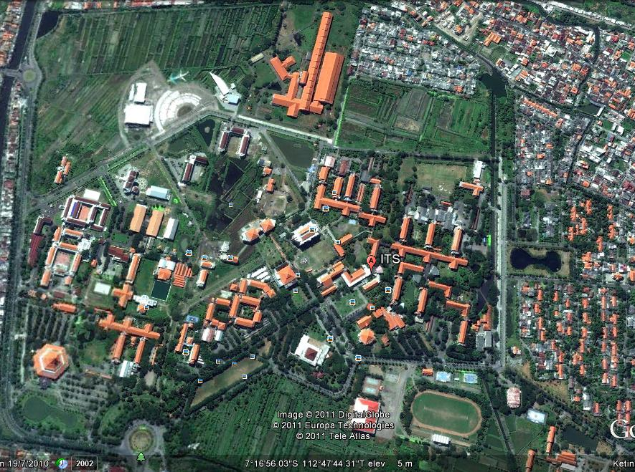
ITS.
ITS.
ITS.
AREA of 187 Ha
ONE OF THE BEST SCIENCE AND TECHNOLOGICAL UNIVERSITY IN INDONESIA

Slide 4
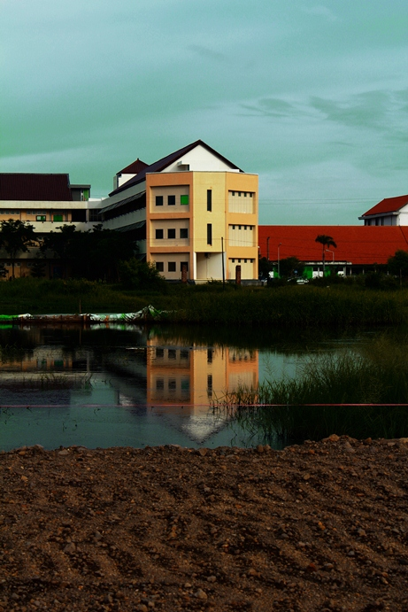
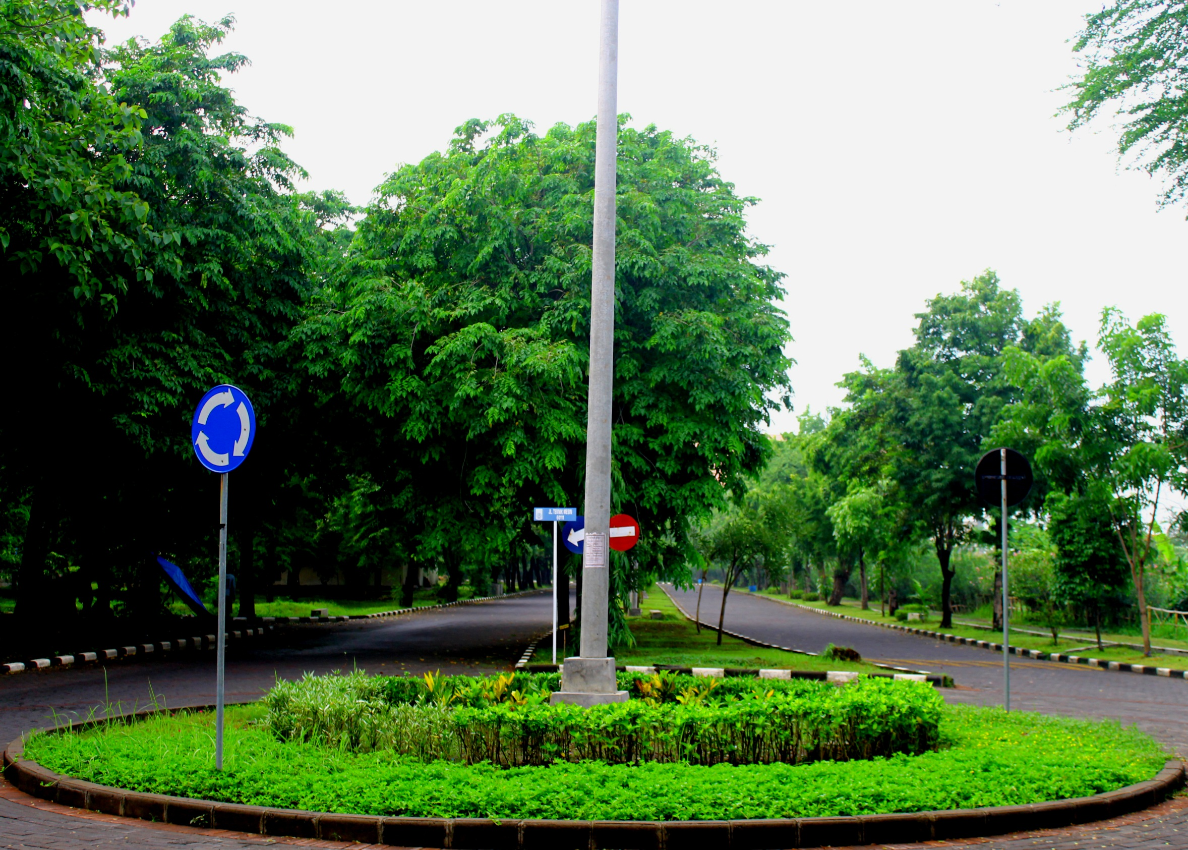
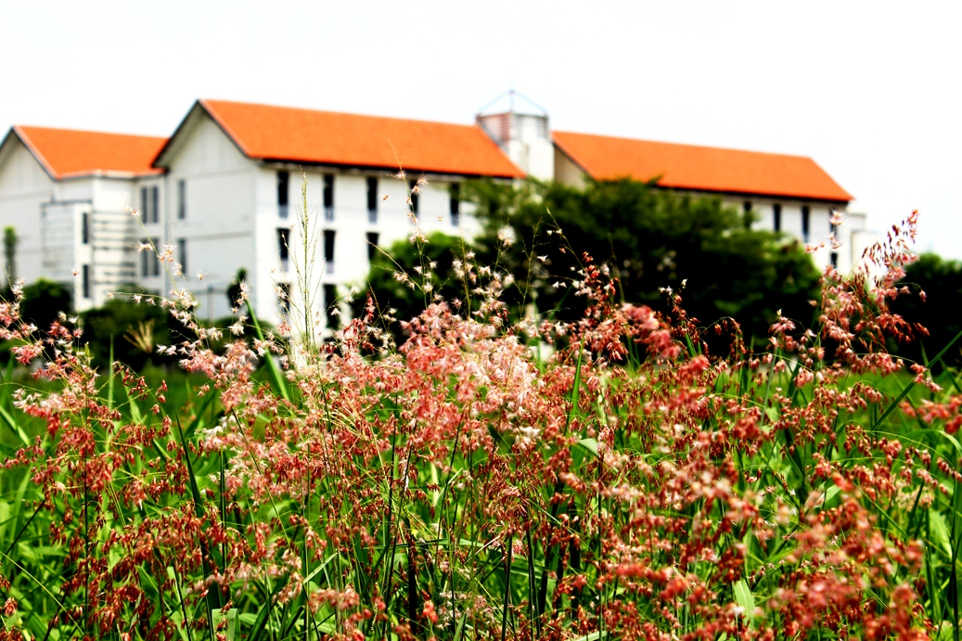
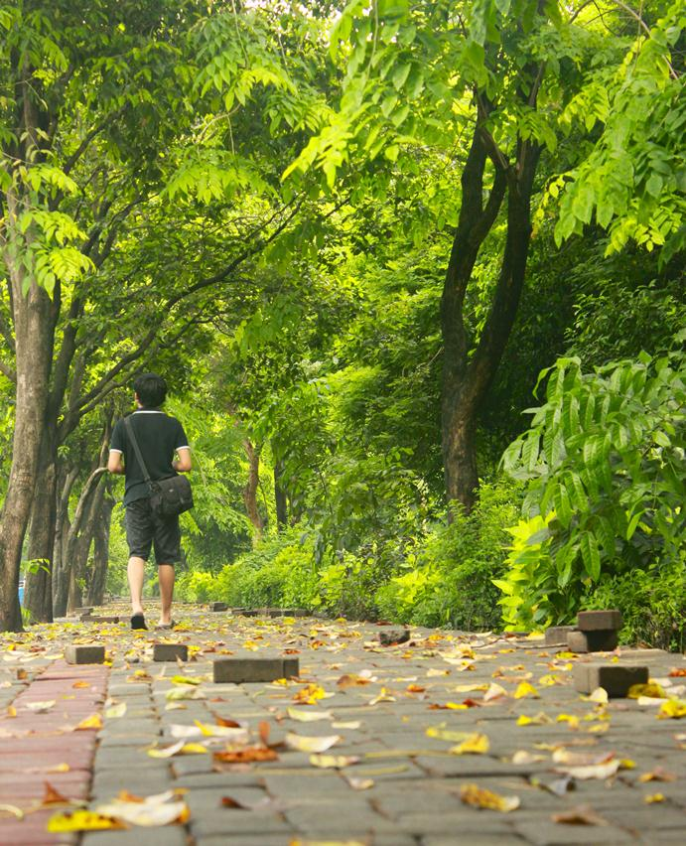
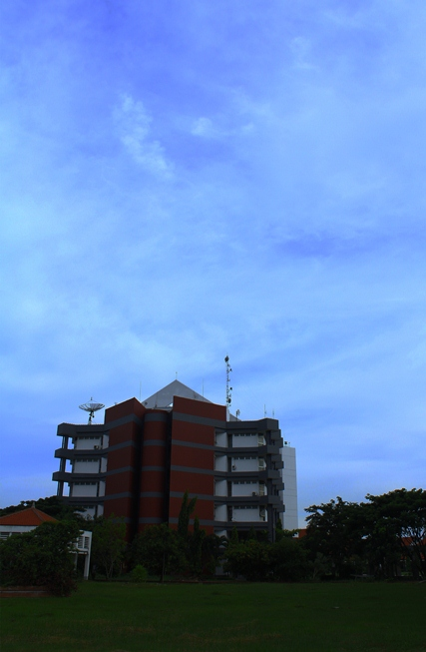
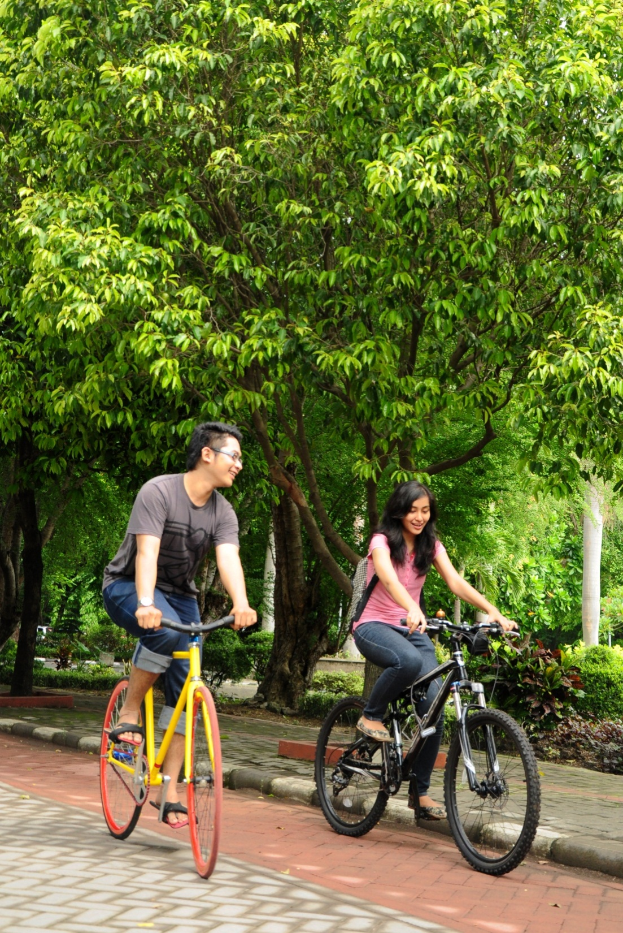
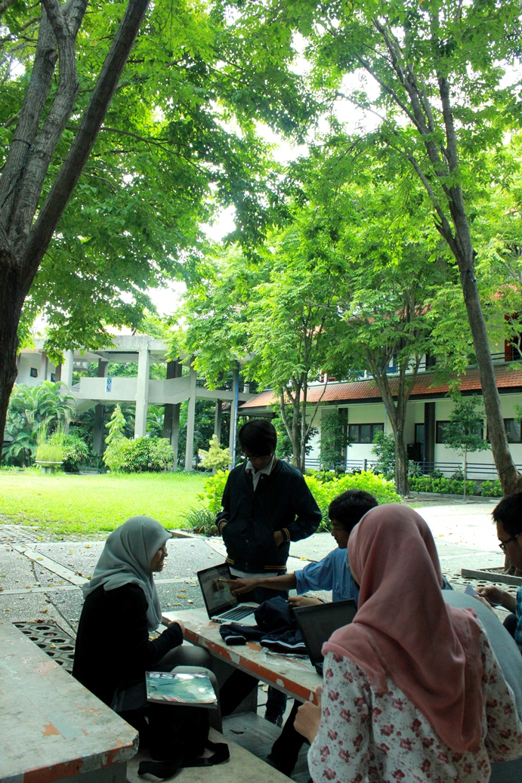
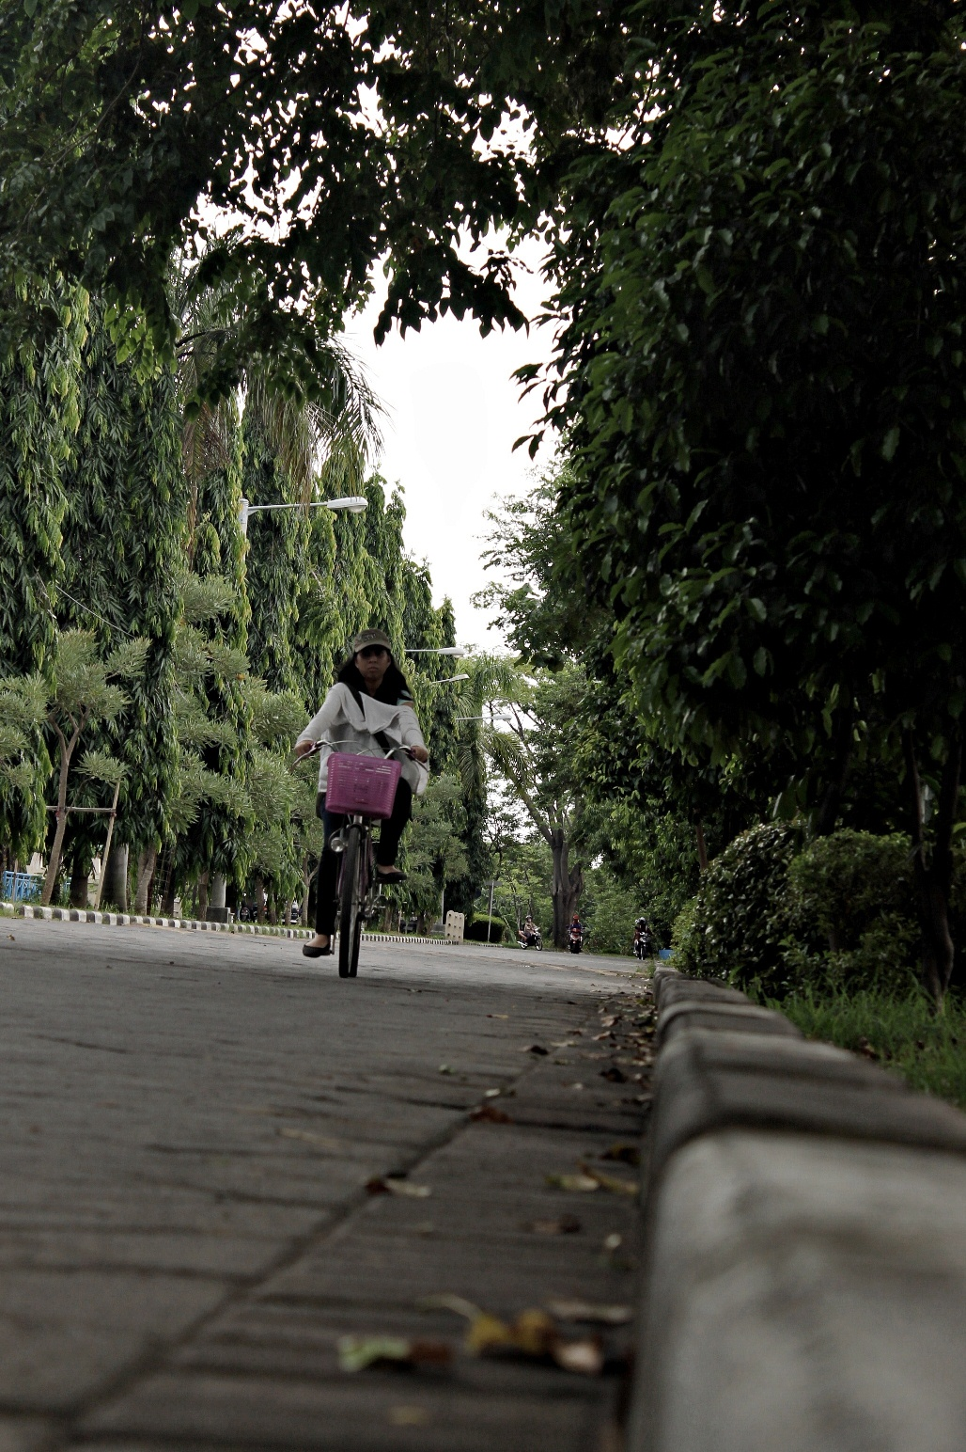
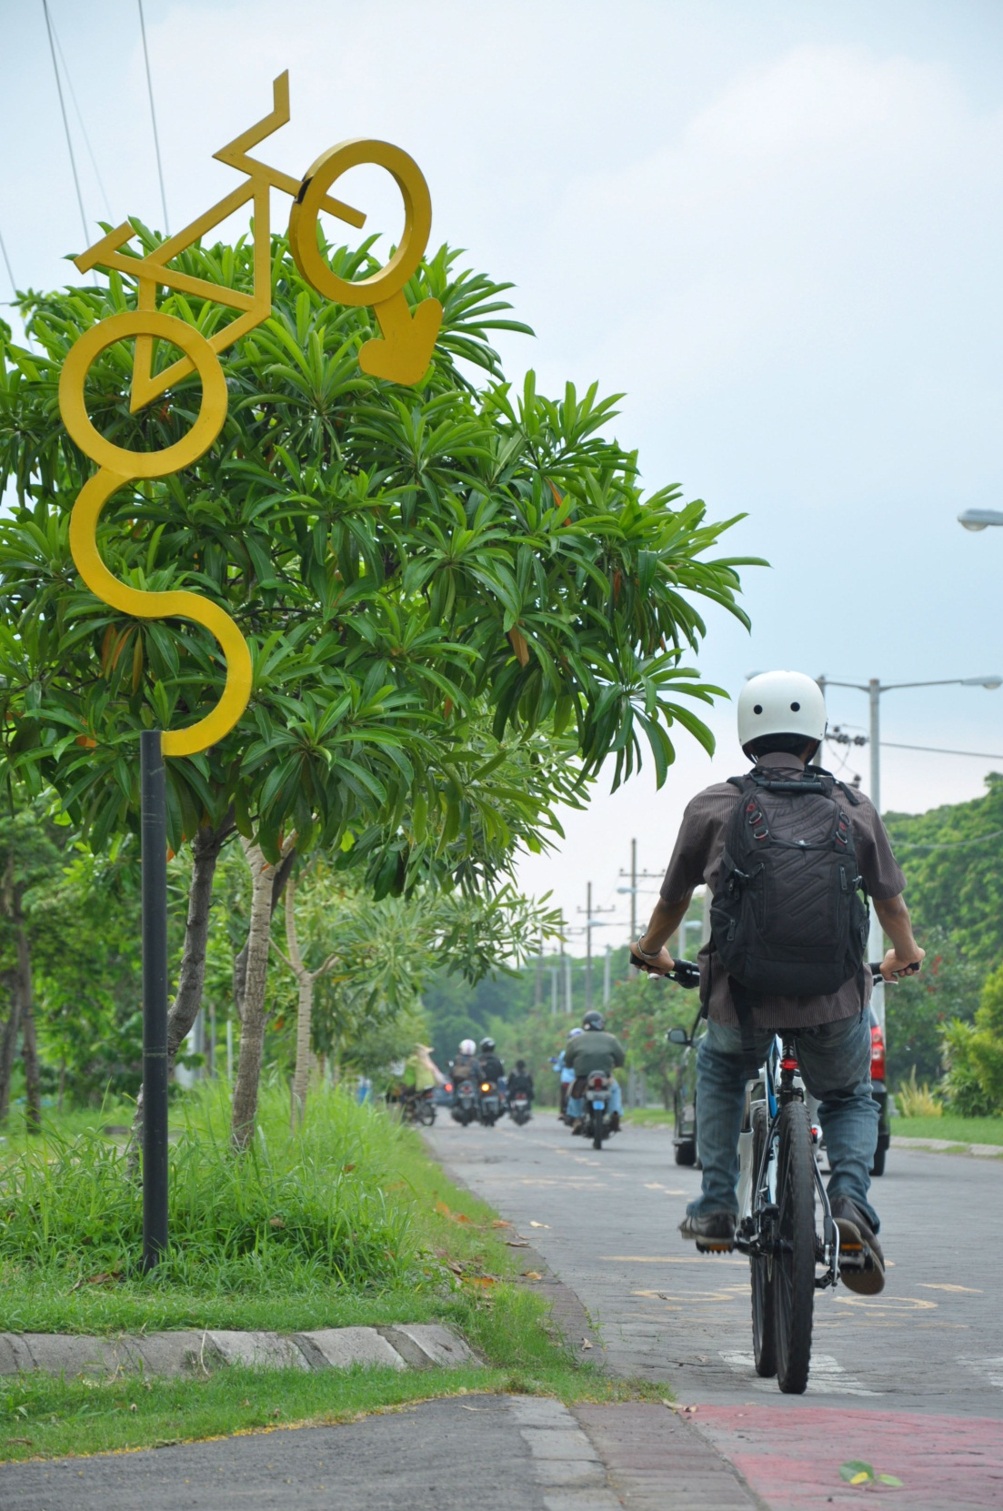
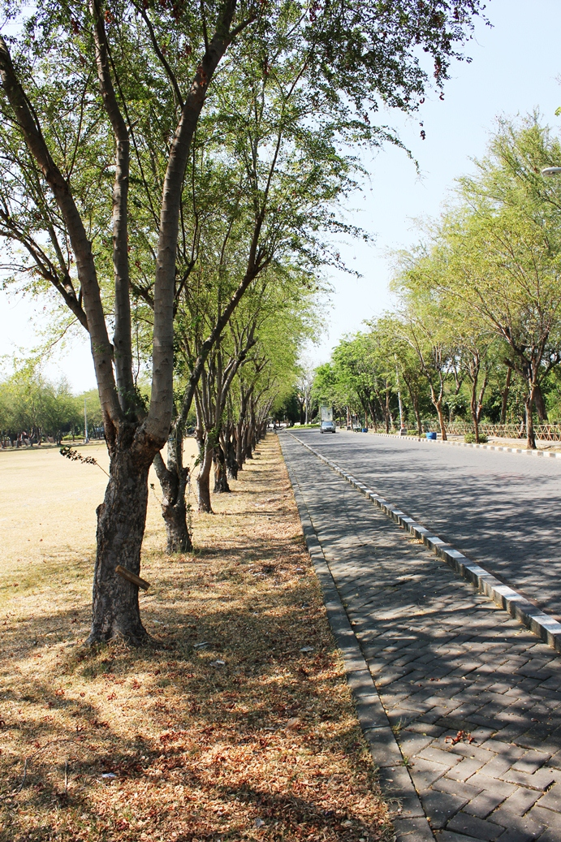
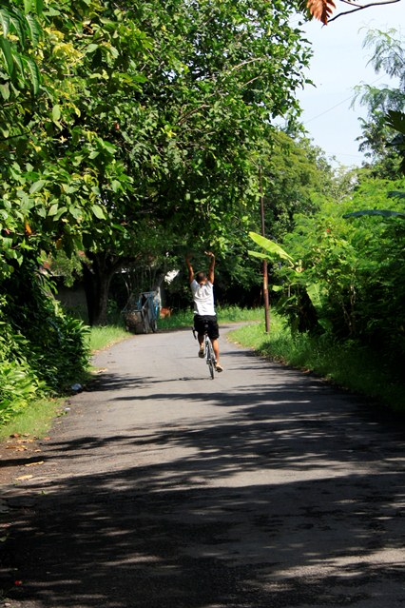
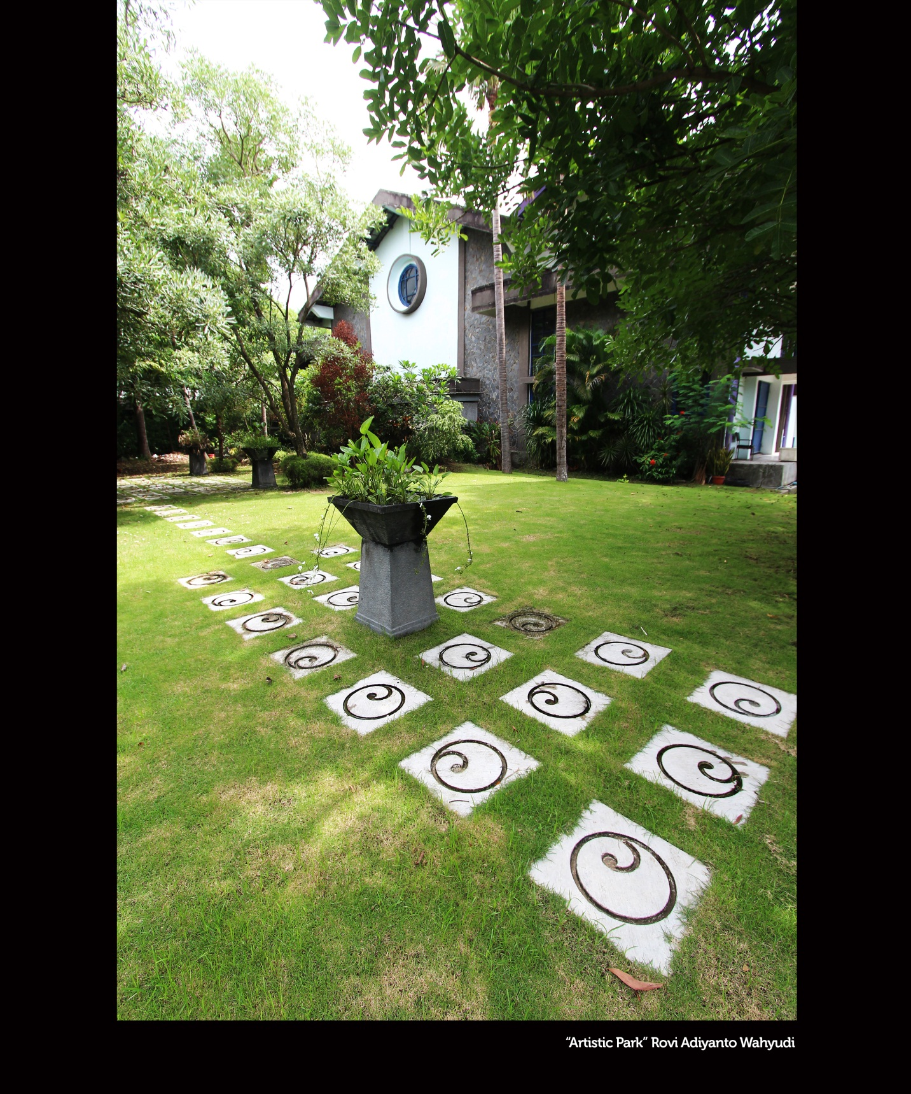
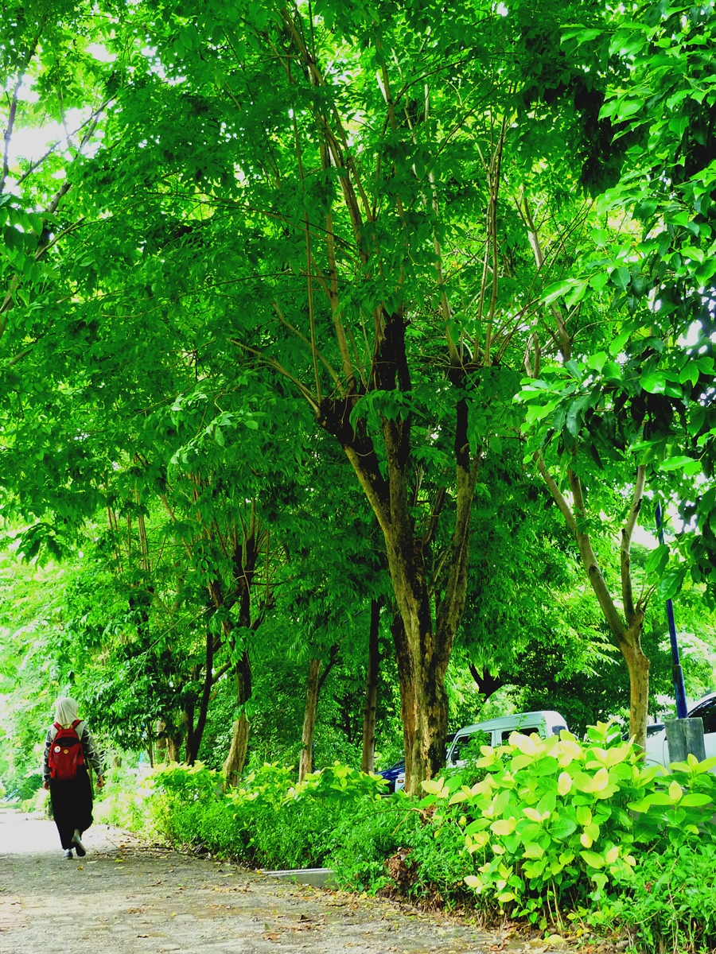
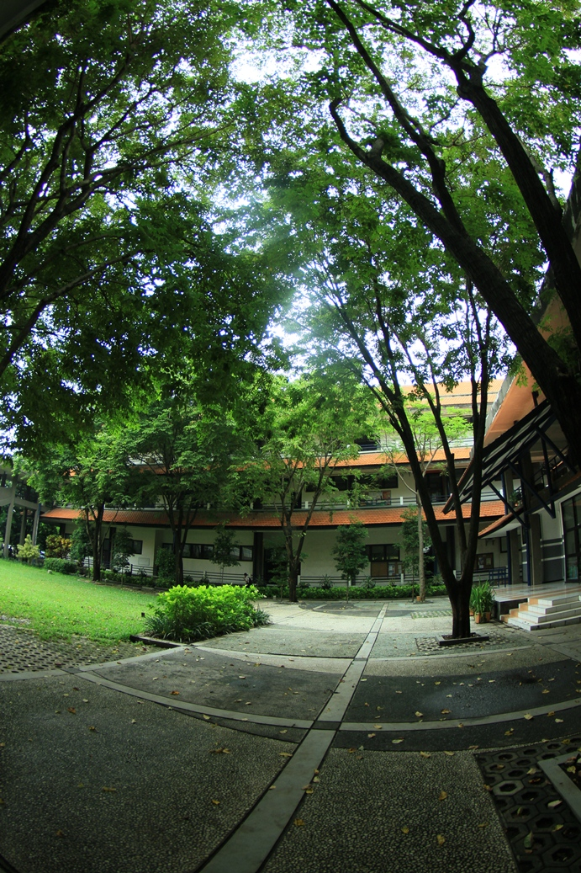
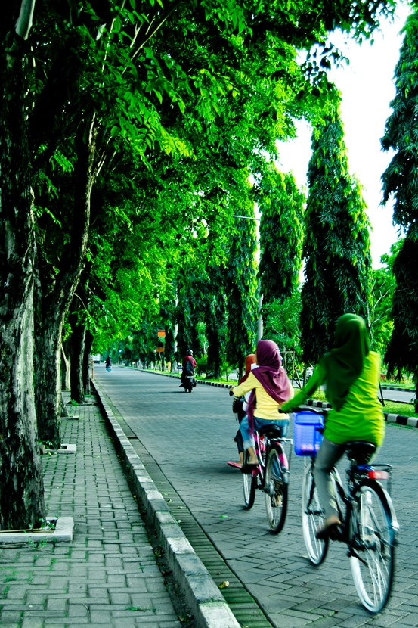
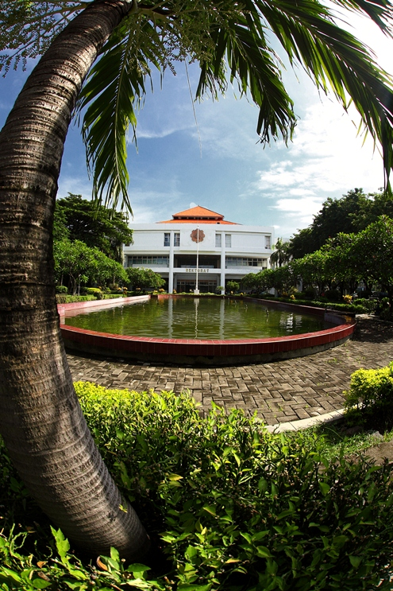
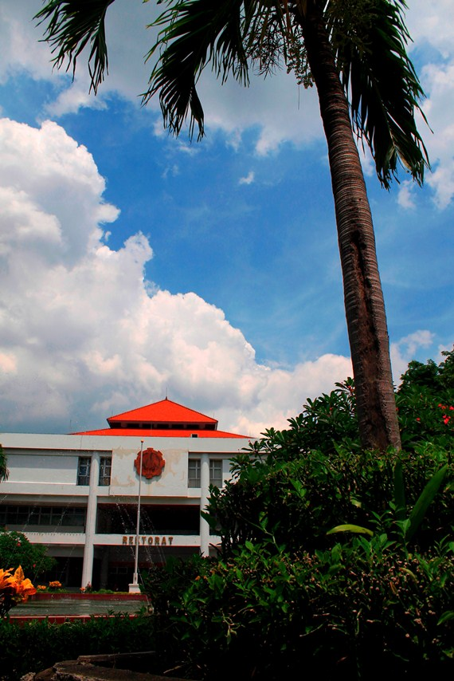
OUR ITS Campus….

Slide 5
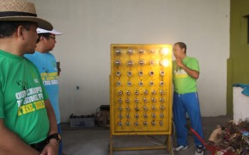
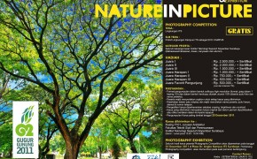
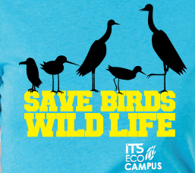
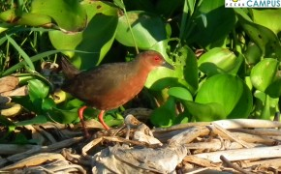
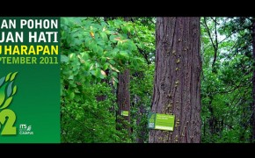
ITS.
ITS.
Ecocampaign
Waste Generated Electricity
ITS.
Save Birds
Green campus
ITS ECO CAMPUS

Slide 6
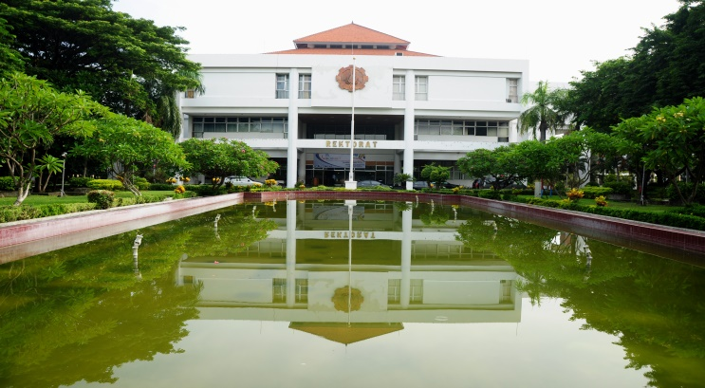
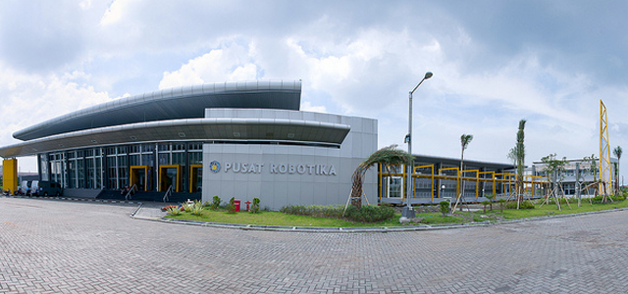
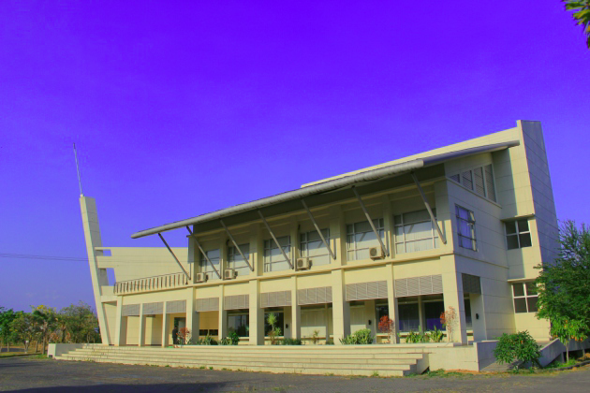
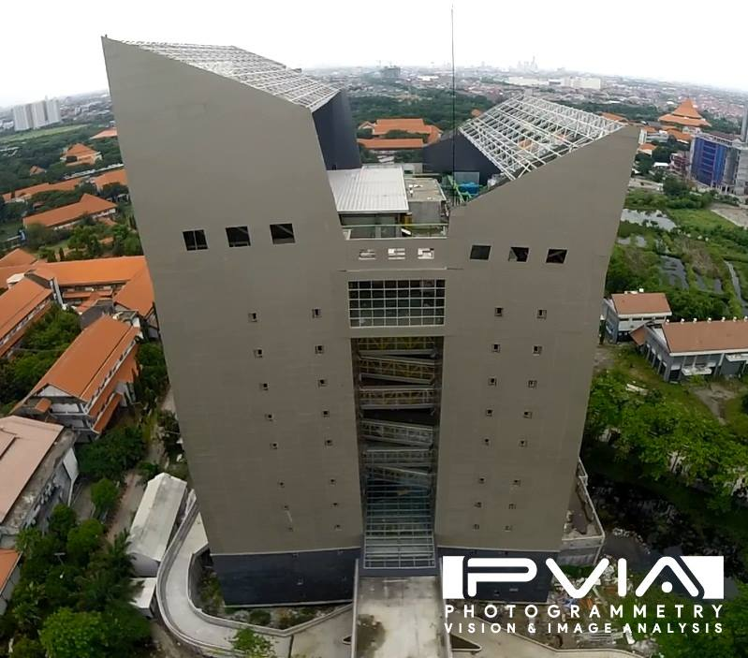
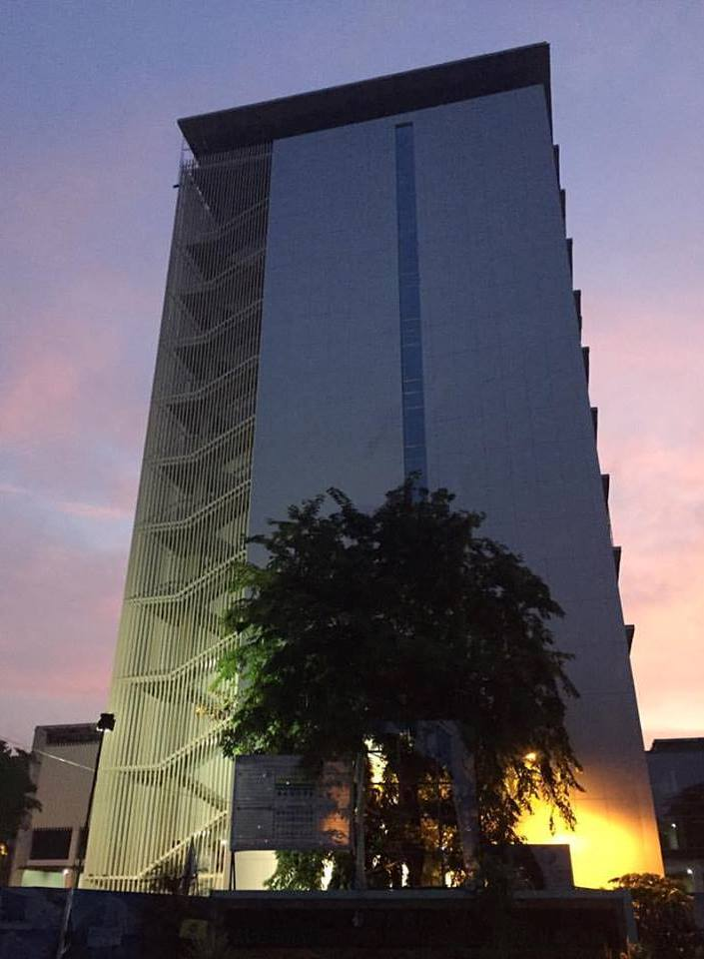
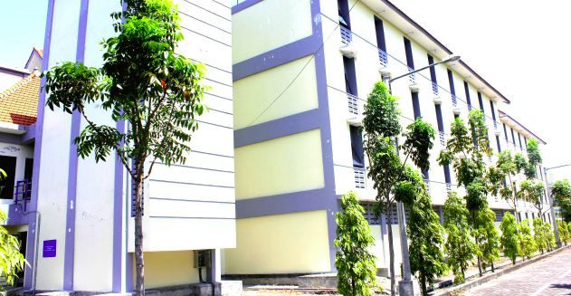
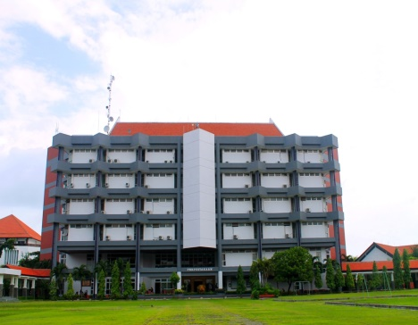
Integrating Facility
Rectorate
Robotics
Nasdec
Student Dorms
Reseach Center
MIPA Tower
Library

Slide 7
Campus Facts
ITS was established in 1960, and is located in Surabaya, East Java
The area of ± 186 Hectares, which includes approximately 40% building area.
Five faculties and 28 departments in science and with approximately 20,000 students in total, with nearly 1,000 lecturers and 700 of permanent non-academic staffs.

Slide 8
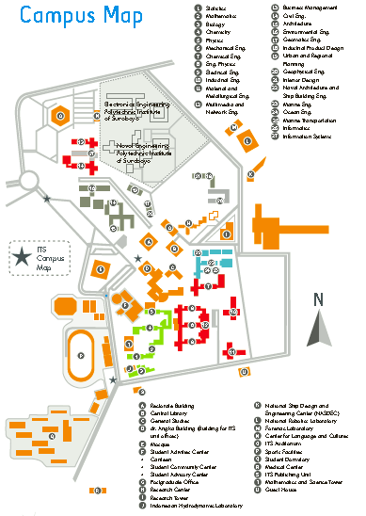
ZONATION :
RECTORATE
F. MATHs N SCIENCE
F. INDUSTRIAL ENG
F. CIVIL N PLANNING
F. MARINE ENG
F. INFORMATICS

Slide 9
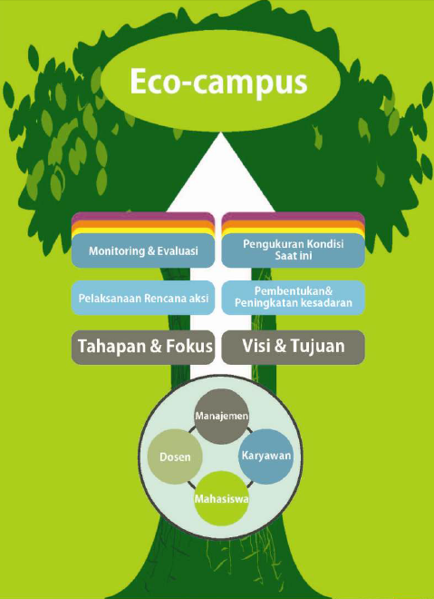
OUR STRATEGY (Smart Eco-Campus)
Change of behavior (socio engineering)
Efficiency (water, electricity, paper consumption),
Green campus (Gardens, Urban Farming, Campus Forrest),
Carbon Emission Reduction (Campus bikes),
Managing billboards and promotion system,
Biodiversity program,
Dissemination and socialization of Ecocampus,

Slide 10
ITS SMART ECO-CAMPUS
Focussing on Five Different Programs:
the Efficiency of Water Consumption and Enhance the Quality of Water,
Energy Efficiency Improvement Programme,
Integrated Waste Management Programme,
Sustainable Transportation Programme, and
Green Campus Programme.

Slide 11
Socio-Engineering Approach
Aims
Change of behavior and attitudes
create awareness and active participations from all relevant stakeholders, as well as to ensure the consistency of the implementation of the programme and also the related regulations about Eco-Campus that have been made by ITS management by adopting Plan-Do-Check-Act (PDCA) concept.
Activities:
Gugur Gunung.
Implementation of 4R

Slide 12
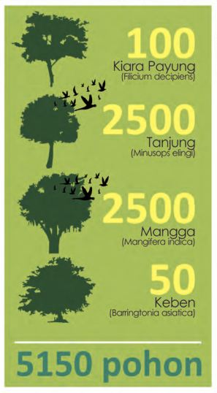
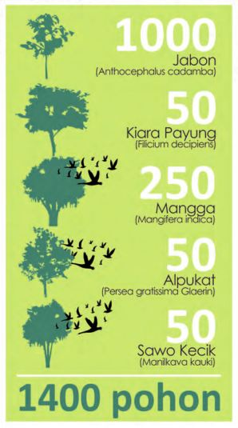
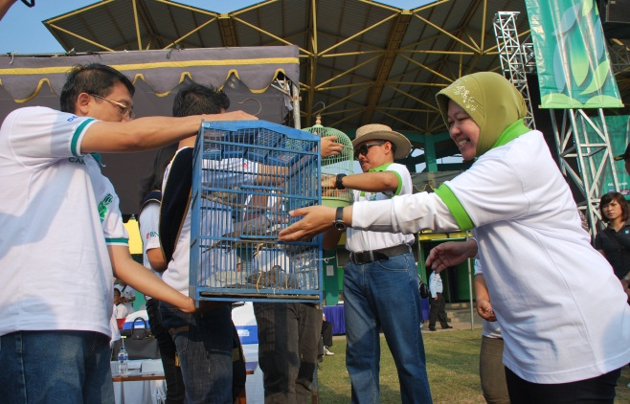
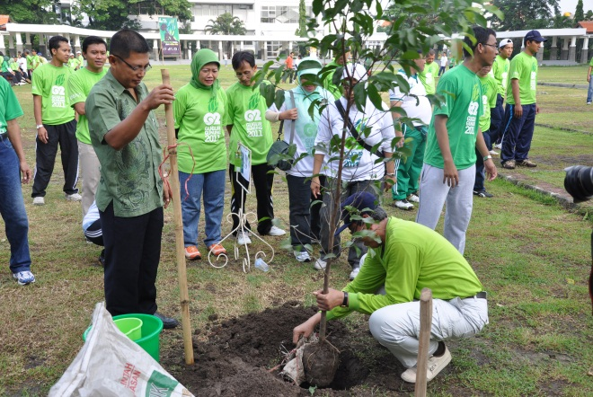
Year 2011
Gugur Gunung 1.0 (G2.1)
Trees are planted: 5.150 trees.
Birds conservation programs
Introducing the Environmental Course
Re-evaluation of ITS Master Plan
Gugur Gunung 2.0 (G2.2)
Morning gyms at campus
Trees planted 1.400 trees.
Campus cleansing campaign
Introduction e-learning by Shared-ITS

Slide 13
Several Studies on ITS Ecocampus
The study on Efficient Use of Air Conditioner (AC) at ITS with the Approach of Life Cycle Assessment (LCA) and Life Cycle Cost (LCC);
Design Cycles Routes in ITS Campus;
Development of Energy Saving Car as a Tool for Transportation System in ITS Campus;
Alternative Treatments of Laboratory Waste and Domestic Waste at ITS;
Evaluation of Drainage System at ITS;
Alternative Management of Water;
Mapping the Adequacy of Vegetation for Reducing the CO₂Concentration at ITS;
Mapping the CO₂ Distribution Concentration Contributed by Motor Vehicles at ITS Campus; and
The study of CO₂ Emissions based on the Carbon Footprints from Secondary Academic and Non-Academic Activities at ITS Surabaya.

Slide 14
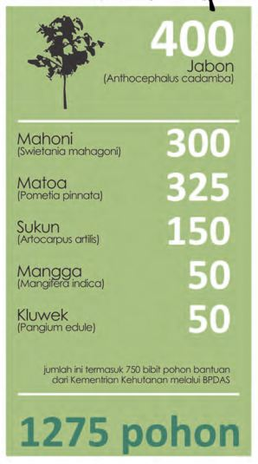
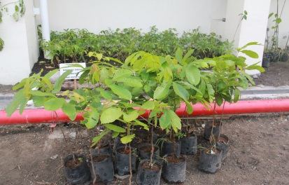
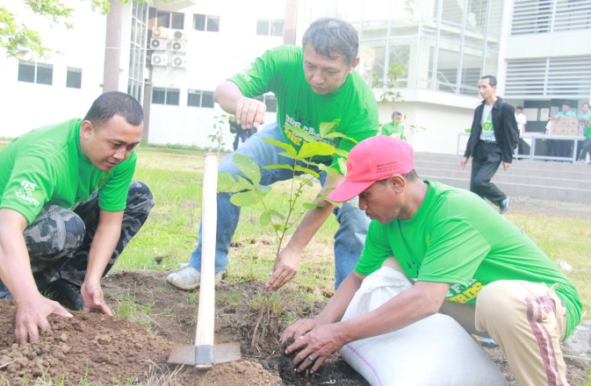
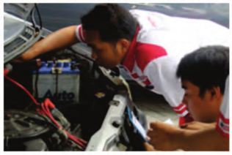
Year 2012
Gugur Gunung 3.0 (G2.3)
Launching waste electric generator
Vehicle emission tests.
Photo exhibition G2.1 and G2.2.
Plant and trees identification.
Planted trees 1.275
Bird voting.

Slide 15
Establishing ITS Research Groups
Centre for Sustainability (CFS) at the Department of Industrial Engineering;
Research Group of Solid and Hazardous Waste, Water Pollution Control, Water and Wastewater Purification in the Department of Environmental Engineering; and
Research Group of Energy in various departments at ITS.

Slide 16
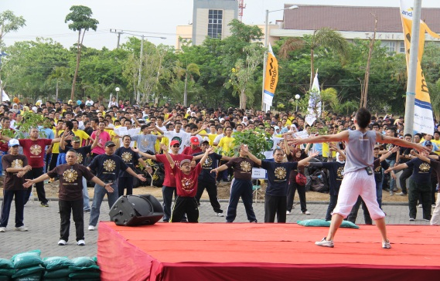
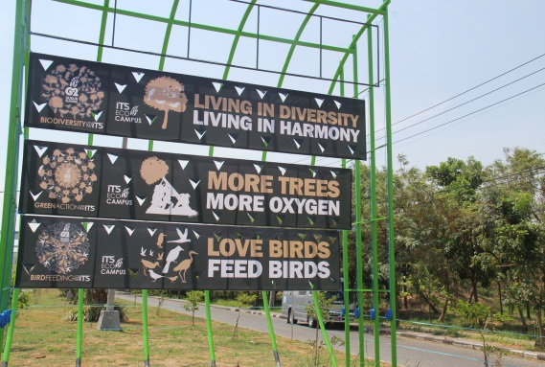
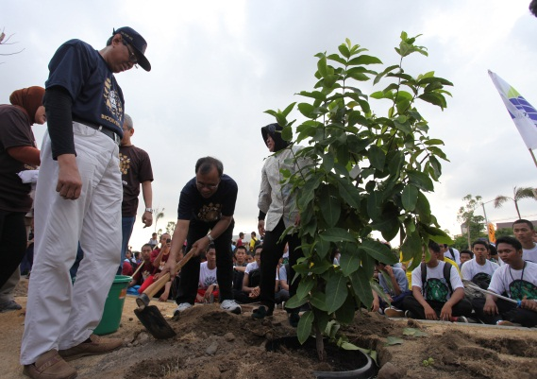
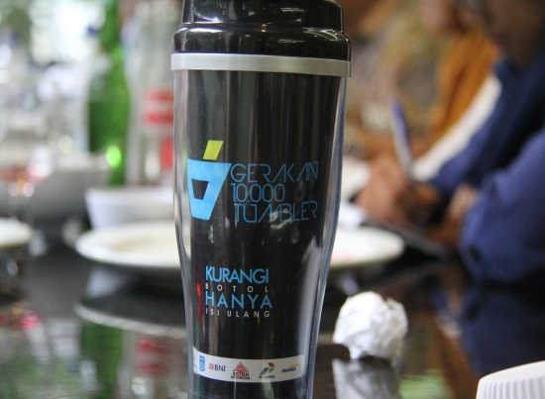
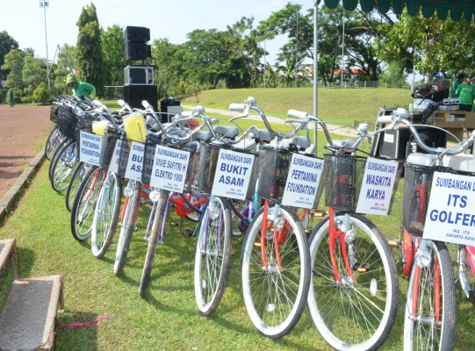
Year 2013
Gugur Gunung 4.0 (G2.4)
Launching ITS Campus Biodiversity Book .
Trees planted 3.150
Gugur Gunung 5.0 (G2.5)
Mangrove planted 1.500 trees in eastern part Surabaya (Kenjeran).
Coastal cleaning movement.
Talk show for community development
Gugur Gunung 6.0 (G2.6)
Workshop of Urbang Farming.
Creative Urban Farming Competition
10.000 Tumblers Movement at ITS

Slide 17
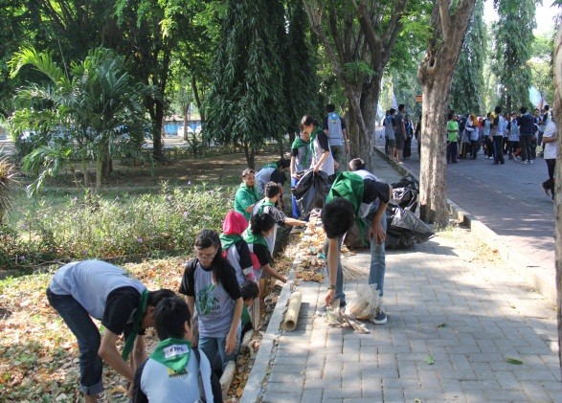
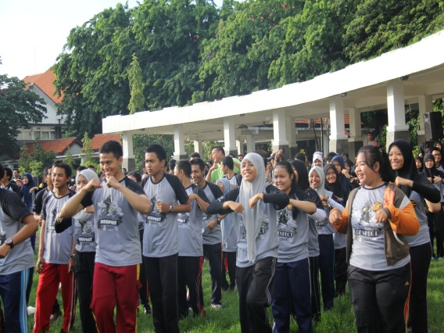
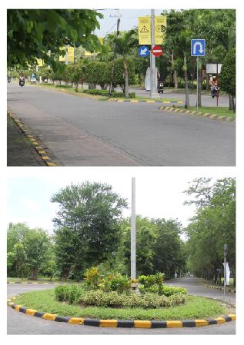
Year 2014
Gugur Gunung 7.0 (G2.7)
The successful achievement of Eco-Campus programme is not only indicated by its physical achievement, but also shown from the span of changes in attitude and mind-set of all elements of ITS academic community in having more environmentally-friendly lifestyle.

Slide 18
Activities in the socio engineering programme include:
Socialization and campaign of eco-campus;
Design of learning materials for students of S1-S2-S3 regarding the environment, eco-campus, and sustainability;
Implementation of seminars about environment and sustainability;
Campaigns on waste separation;
Competition of ideas and innovation in saving water, electricity, and paper in all departments at the ITS; and
Other competitions such as eco-quote race that intends to increase the participation of all elements of the academic community in the implementation of eco-campus.

Slide 19
Efficiency Program
Paper Usage
Being enforced until department levels
Waste Management
Reduce, reuse and recycle
Green and Open Space
Redesign the plantation species and garden arrangement
Urban farming and Organic Vegetables (SayOr)
Electricity Usage and Consumption
The minimum temperature control of air conditioning systems, which should not be lower than 25⁰C.
Gradual replacement of electrical appliances with energy-efficient appliances.
Water Usage
Minimising the water leakage, reuse and recycled water at several places.
Natural resources usage
establishment of the cycles-routes, construction of convenient and integrated pedestrian; the installation of informative signs with great aesthetic pleasure; the management of bike shares or bike along the campus; the improvement of roads infrastructures
Establising ecocampus movement
Safe, Comfortable, Healthy and Humane Internal Movement System

Slide 20
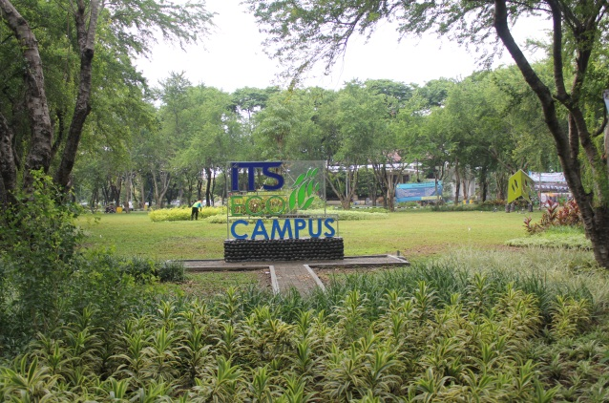
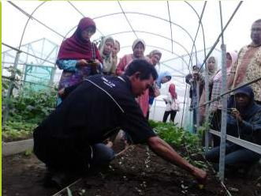
Eco Urban Farming ITS

Slide 21
Greening Movement
Sport Facilities
Roundabout at ITS
Garden

Slide 22
Organic Vegetables by Eco-Urban Farming ITS (SayOr ITS)

Slide 23
d. Pengurangan polusi udara (penyediaan sepeda kampus),
Mengadakan program sepeda kampus ITS guna pengurangan penggunaan kendaraan bermotor di dalam kampus serta pembuatan jalur dan shelter sepeda sehingga menimbulkan rasa aman dan nyaman bagi pengguna sepeda.

Slide 24
Campus Bike
Campus Bike

Slide 25
Rearrangement of ITS billboards

Slide 26
ITS Biodiversity Book

Slide 27
ITS Website for Eco-Campus
www.ecocampus.its.ac.id

Slide 28
Drainage System and Wastewater Treatment Plant
WWTP
Drainage

Slide 29
ITS Waste Management
Komposter
Energi/listrik

Slide 30
ZONING SYSTEM
Zona I
Bundaran Utama ke selatan, taman alumni, rektorat sampai bundaran dekat SCC, Taman KPA
Zona II
Dari bundaran dekat SCC ke selatan sampai pintu Masuk Selatan, Parkir Kantin, Halaman K-P-Y.
Zona III
Depan K1 sampai dengan BPPT (selatan)
Zona IV
BPPT, LPPM, sampai Gerbang Utara
Zona V
Sungai Kampus

Slide 31
DEPARTMENT ZONING

Slide 32
Challenge for the Eco-Campus Implementation
Sustainability of the programme depends on commitment and attitudes Increasing burden of academic community (2025 will reach 25.350)
Maintenance of environmental-friendly infrastructure..
Supported institution rules and regulation.
Involvement of research in the development of environment-based infrastructure such as the electric cars, electric buses, etc

Slide 33
Closures
Eco-campus is an important part in the management of activities within a university. ITS has proven that with science and technology approach can be developed to create environmentally friendly technologies.
The main challenge for its implementation is how to ensure the sustainability of the programmes.
The change of the mindset and attitude is the main targets in the future as well as the challenge of creating various environmentally friendly technologies breakthrough.

Slide 34
ITS Eco-Campus: Think-Green Action-Sustain THANK YOU

