Slide 1
UUM EXPERIENCE SHARING: UI GREEN METRICS WORLD UNIVERSITY RANKINGS
Presented by
PROFESSOR DATO’ SERI DR. MOHAMED MUSTAFA ISHAK
Vice Chancellor, Universiti Utara Malaysia
Universitas Indonesia, Jakarta on April 28, 2016

Slide 2

We do not inherit the earth from our ancestors; we borrow it from
our children.


Slide 3
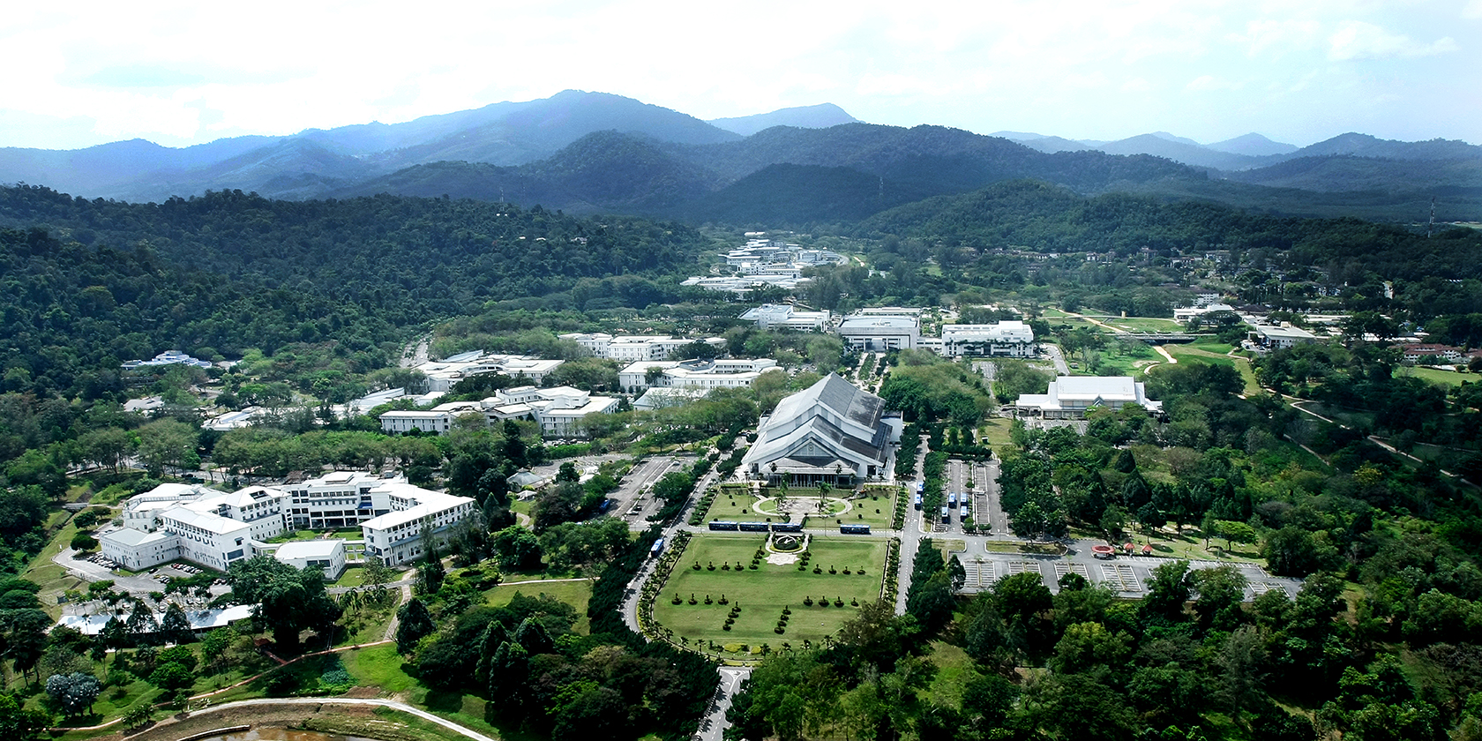
INTRODUCTION
Universiti Utara Malaysia (UUM) was
officially established on 16 February 1984.
The main campus is located in
the state of Kedah (North of Malaysia)
The campus encompasses an area of 1,061 hectares of lush tropical forest and to-date, only 107 hectares out of the campus area has been developed into various university facilities
This year, UUM organizes the “Discover UUM 2016” programme

Slide 4
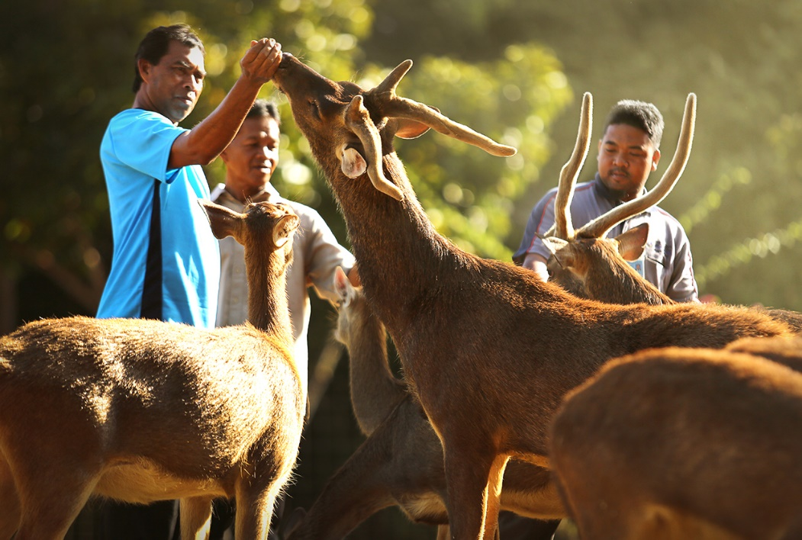
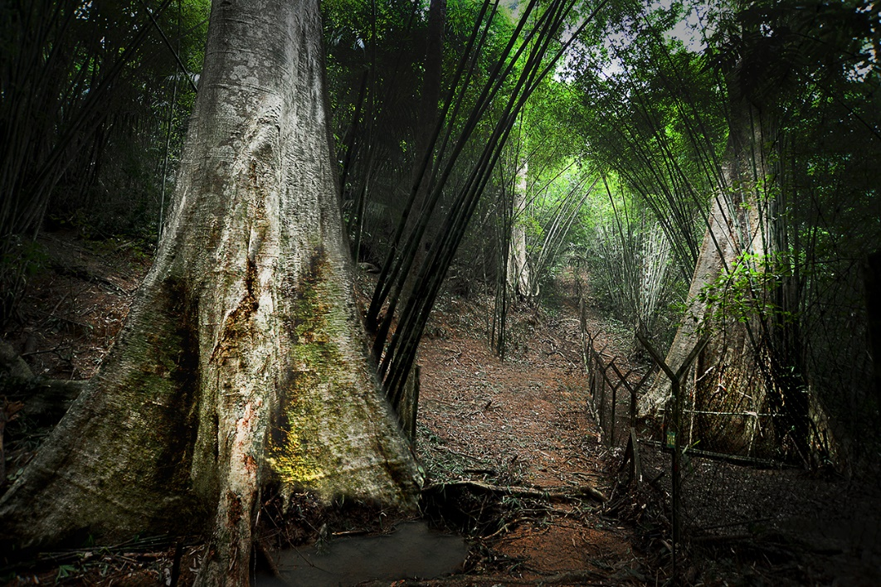
Discover UUM 2016- Deer Park and Three-Siblings Tree (Tetrameles Nudiflora)
a. UUM Deer Park offers the unique opportunity to explore, enjoy & feed over 100 deer
b. The diameter of each tree is said to be about 10 hugs

Slide 5
The University
in a Green Forest
60%
Green areas

Slide 6
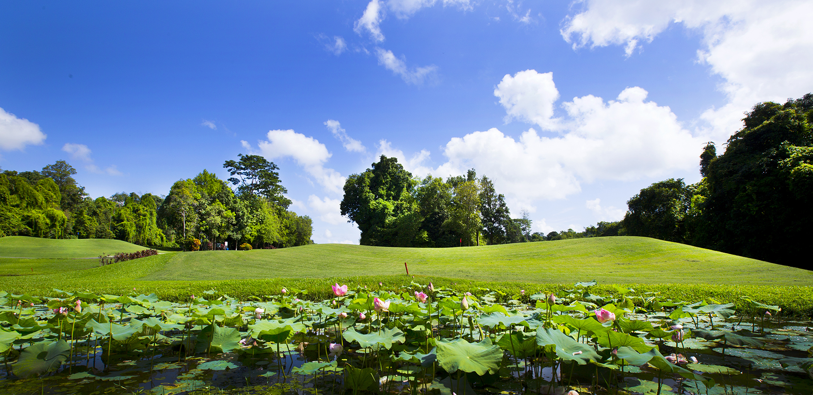
3. Green Initiatives
3.1Green Community Engagement Activities
Mangrove Clean-up which includes the S.O.S.-Save Our Shores series
More than 600 mangrove seedlings were planted along the coast of Kuala Ibus.
3R programme (Reuse, Reduce, Recycle)- run by Students Consumer Movement

Slide 7
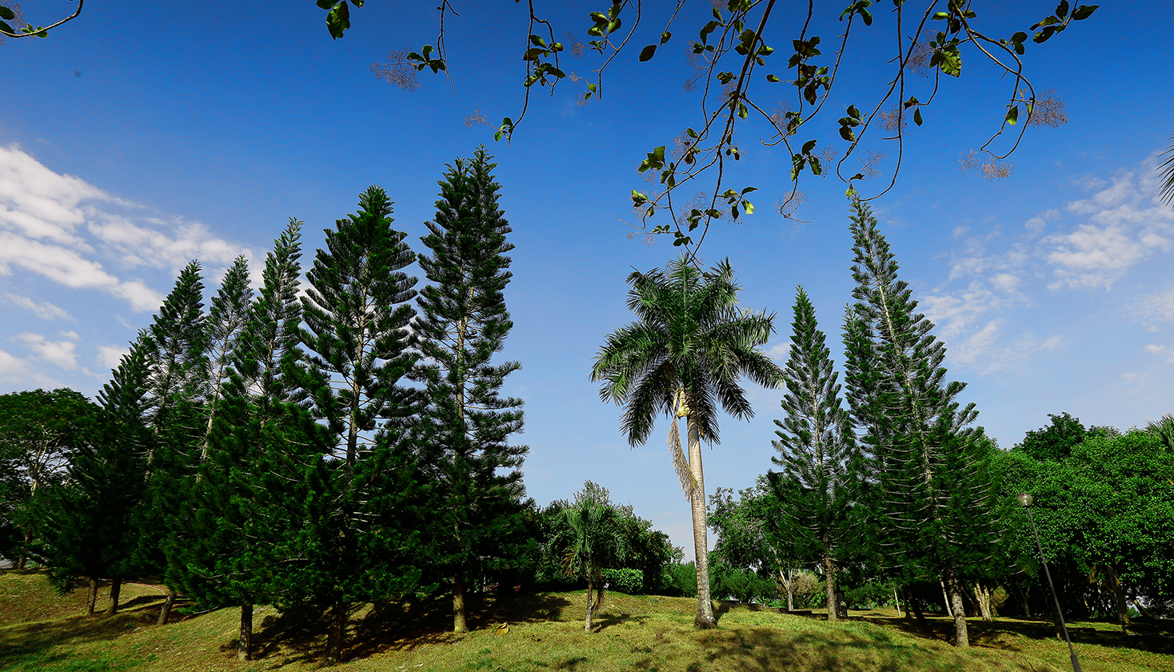
3.2 Green Research
Development of a model for Sustainable Agriculture in Rural Area: A Case of Agropolitan Project in an Abandoned Area.
Developing a Total Economic Evaluation (TEV) and Management Effectiveness model for Marine Area Protection (MAPs) in Malaysia.
Organising the Symposium on Technology Management, Operations and Logistics (SIPTIK) every single semester since 2012 up to the present time.

Slide 8
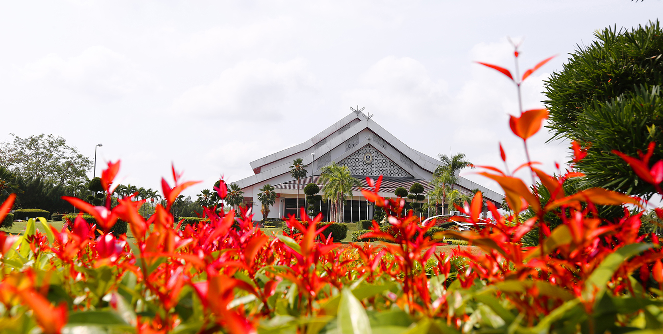
3.3 Green Energy Saving
Retrofitting the fluorescent tubes (T8) to (T5) and LED tubes
Replacing the (SON) street light to LED fittings
Lighting management system at lecture theatres
Building automation system for air-conditioning operation system in administration, academic buildings and lecture halls
Utilisation of natural ventilation, natural lighting
Application of solar panels for mini golf lighting system
A policy to reduce the Greenhouse gas emission

Slide 9
5%
Performance Indicators are directly related to UI Green Metric World University Rankings

Slide 10
Percentage of courses offered are related to environment & sustainability
26.7%

Slide 11
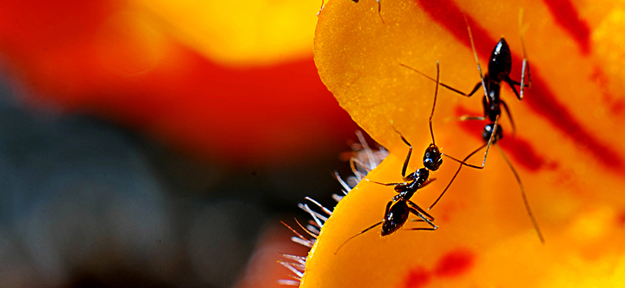
27.3%
research funds for the previous 3 years were allocated for environment and sustainability research

Slide 12
Scholarly publication on environment & sustainability published for the past three years
265

Slide 13
373
Total number of scholarly events hosted for the past 3 years were related to environment and sustainability

Slide 14
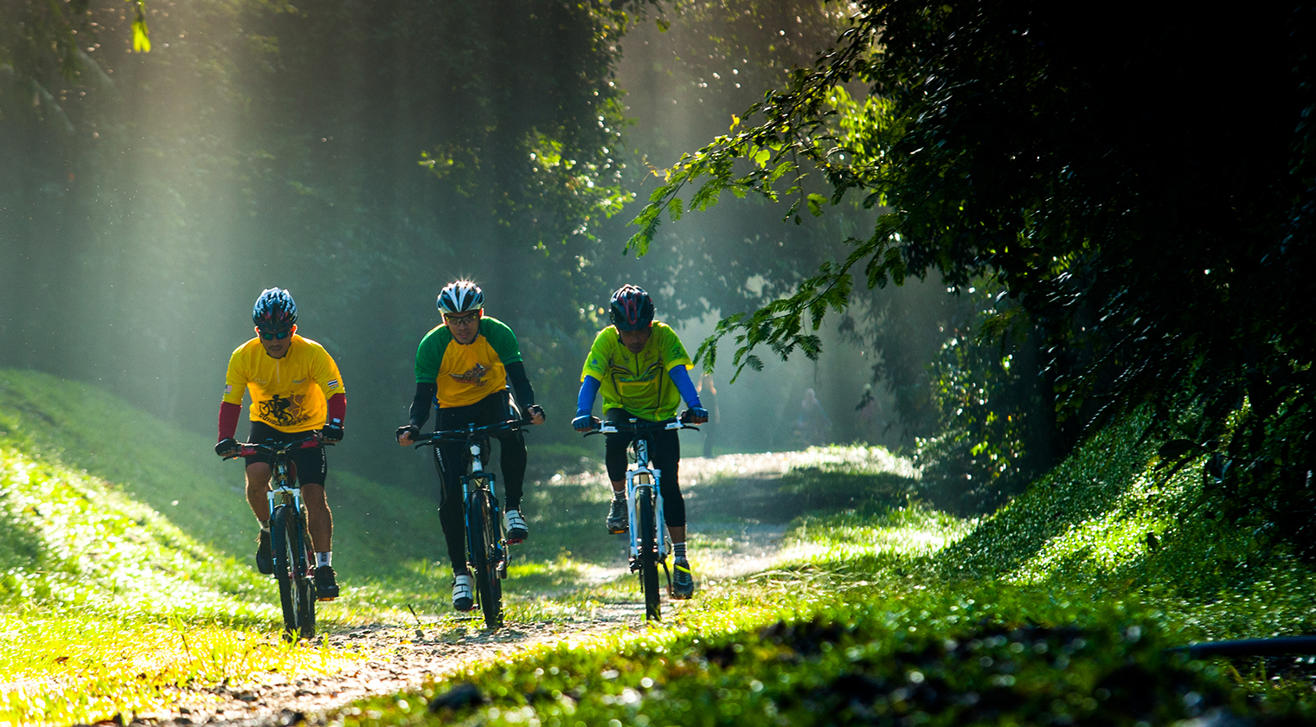
4. Summary
UUM is seriously committed to contribute towards the green agenda
Committed to producing graduates who care about the environment
Striking an effective balance between achieving academic excellence as well as preserving the beauty of mother nature.

Slide 15
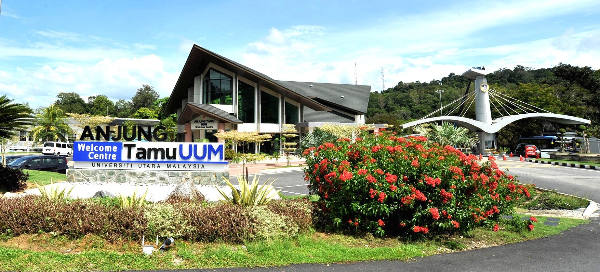
UNIVERSITI PENGURUSAN TERKEMUKA
THE EMINENT MANAGEMENT UNIVERSITY
Thank you

