Slide 1
Energy and Climate Change policies at universities
and BOKU in particular
International Workshop on UI GreenMetric
April 21, 2016
Dominik Schmitz
University of Natural Resources and Life Sciences

Slide 2
Paris Agreement
What does this really mean?
Austrias share of „budget“ to stay within 2°C:
80 Mio. tons (average annual emissions) can be emitted no longer than 12 more years.
Then 0 emission! Or balance between emissions and offsetting or sinks.

Slide 3
CO₂ Accounting and Climate Change Policy
BOKU CO₂ emissions of roughly 9,000 tons/a
Climate policy currently developed:
Consitent accounting and CO₂ methodology
Define proper system boundaries (energy, transport, food, consumption….)
Establish clear baseline szenario e.g. 2050
Reduction strategy of -90% until 2050
World‘s unique carbon offsetting system since 2012
Notes:
Reduction policy not very ambitious as it seams, but like this directorat buys in
Conneticut also carbon neutral by 2050

Slide 4
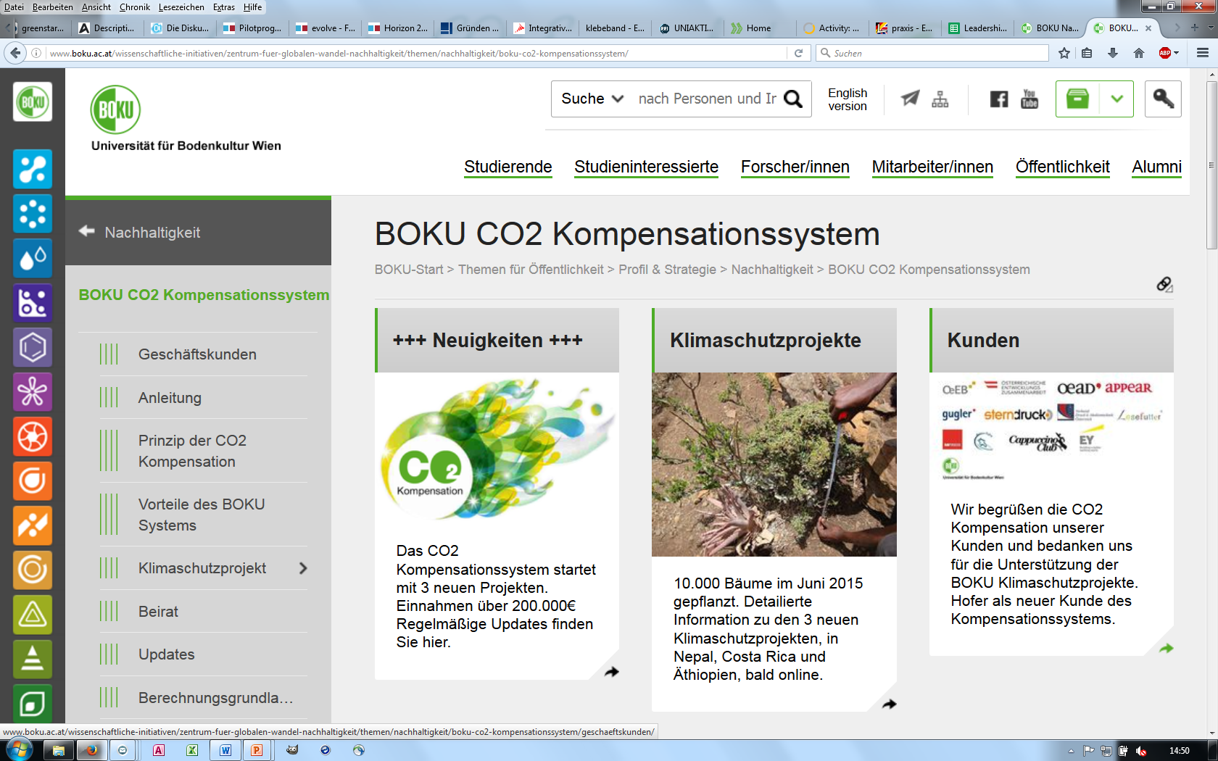
Offsetting CO₂ Emissions
Offset flights or company emissions: http://www.boku.ac.at/co2-kompensation.html
Since 2012 more than 250.000 € generated
Notes:
Flight emissions are increasing.

Slide 5
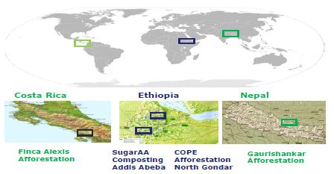
Funding mitigation projects
Currently 4 Projects, strong links to local partners
Co-benefits: inclusion of ecological, social and economic sustainability aspects
Multiple impacts: stimulation of research and or teaching/training (multiplier effect)
Notes:
Our university has a carbon footprint of about 9000 Tonns CO2 per year. Flight emissions are increasing.
All 4 projects cost about 800.000 €

Slide 6
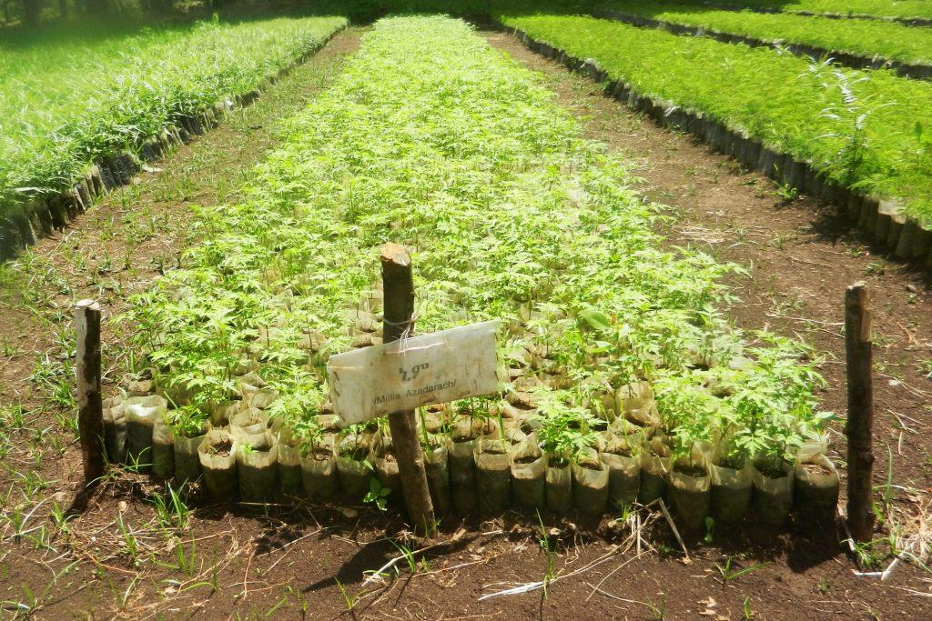
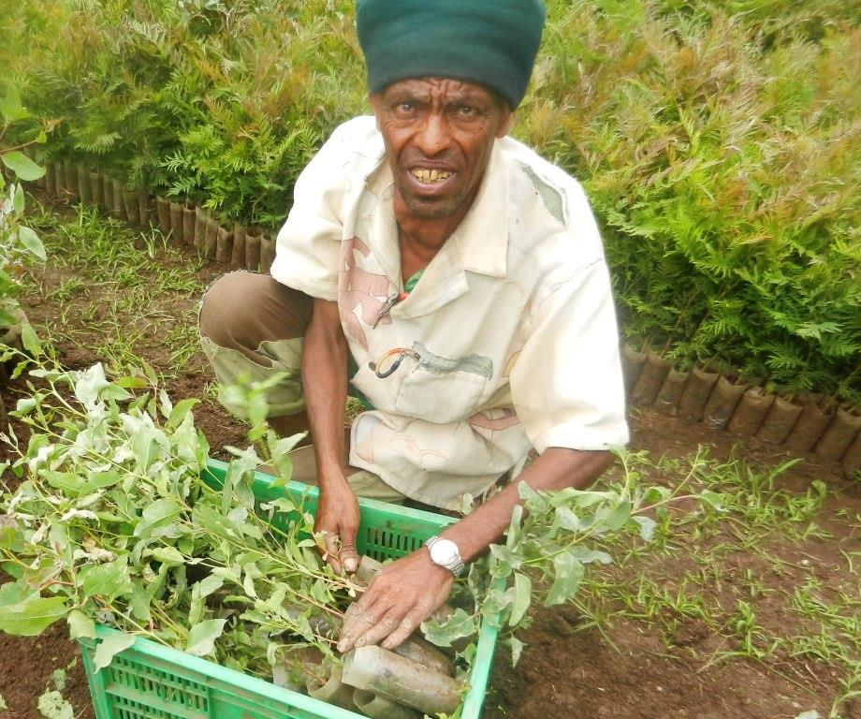
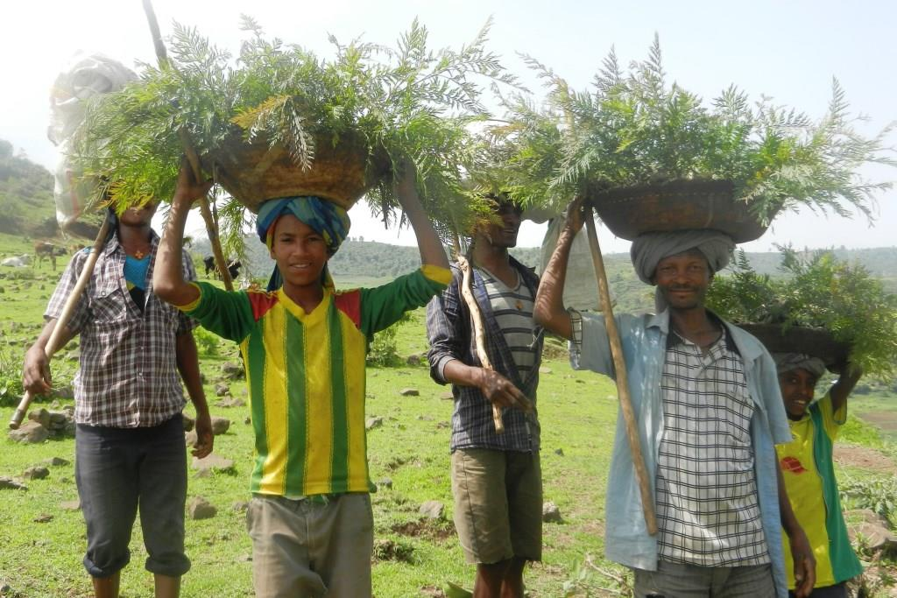
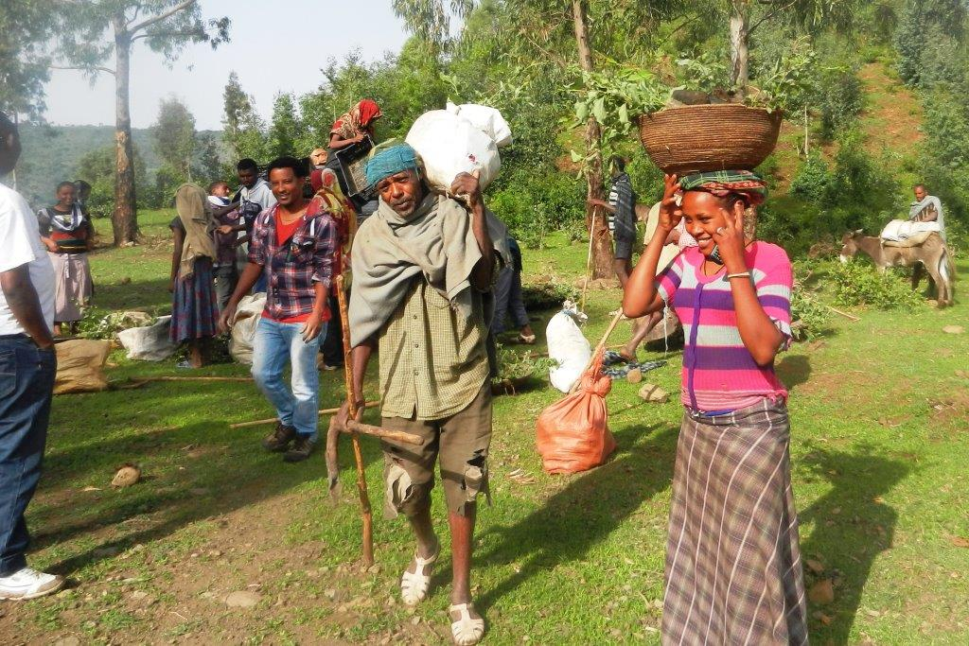
Afforestation, July 2015
6
Notes:
6

Slide 7
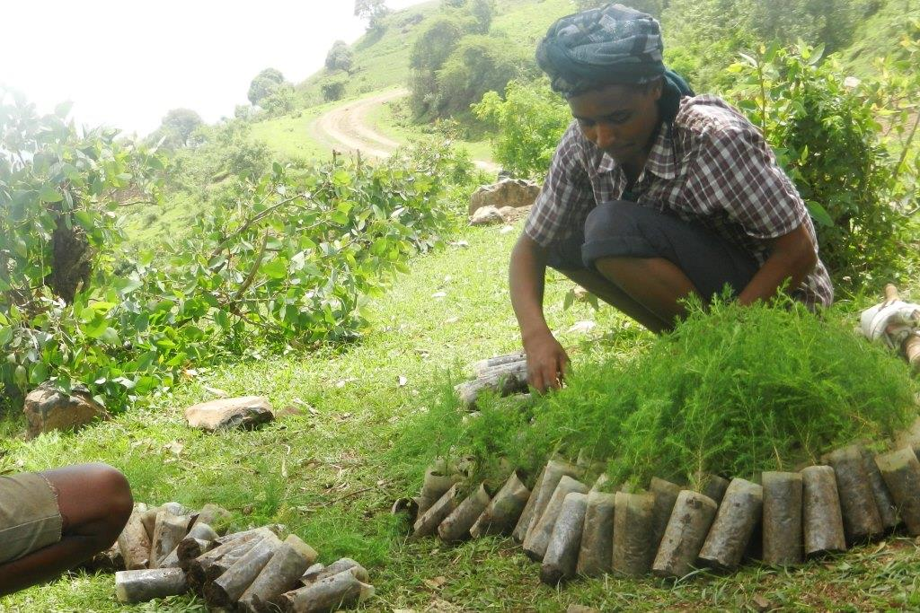
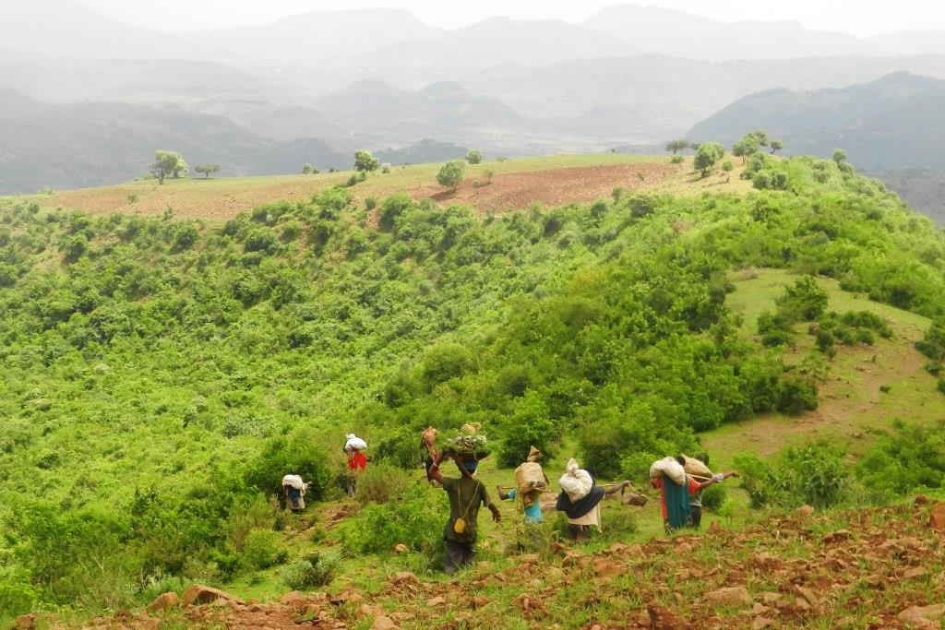
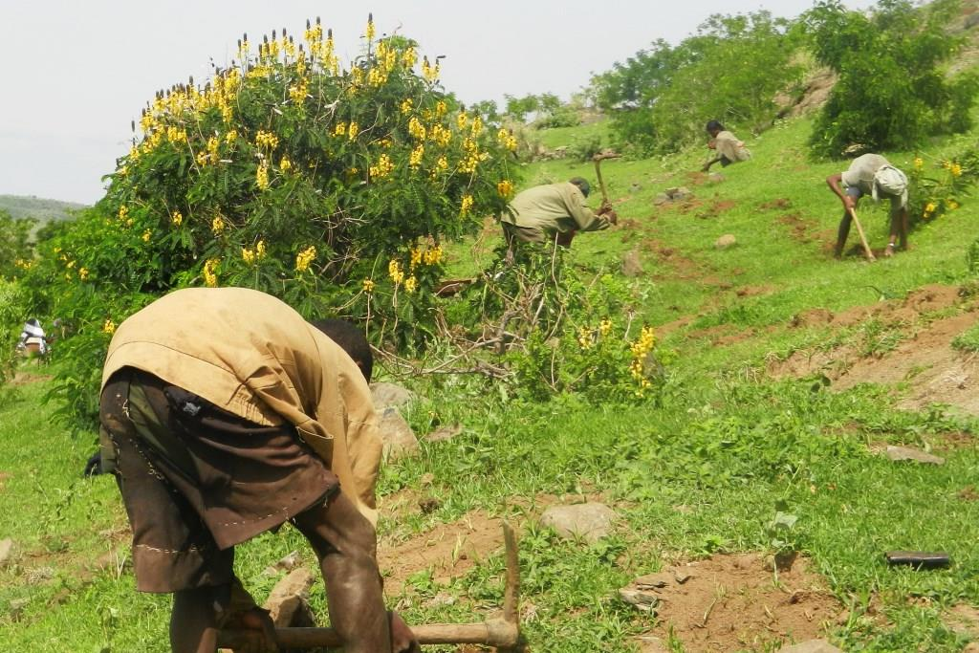
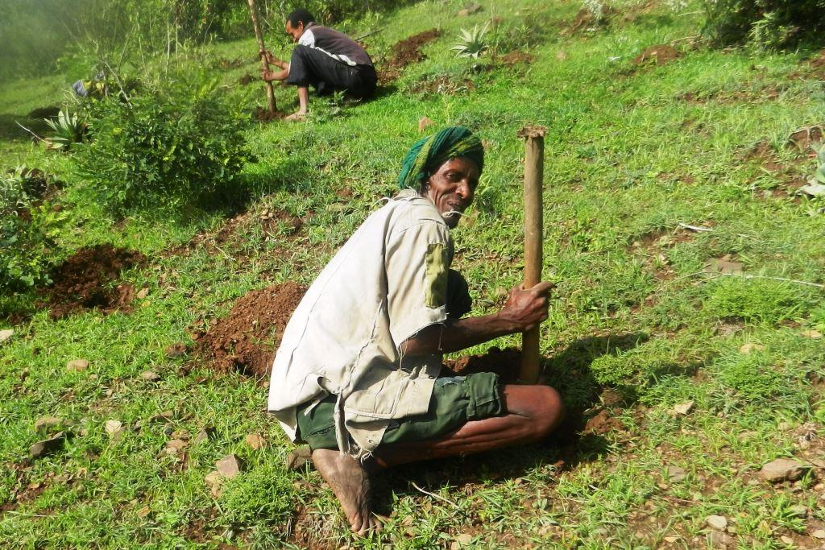
7

Slide 8
Is this enough?

Slide 9
Support Students to become climate changemakers
Image © Shutterstock
BOKU supports sustainable entrepreneurship ideas, initiatives in teaching courses
Notes:
A share of the 600 gradutes can be climate changemakers.
Many students having „semi-commercial“ start up ideas but a big step to start social/sustainable entreprise.
Solar PV through crowdfunding at university
Wind power installations do it yourself courses

Slide 10
Is this enough??

Slide 11
Develop and share a joint vision on climate mitigation
With partner universities
With external stakeholders, e.g. research funds, institutions
Notes:
In the voluntary market.
Copernicus Alliance in Europe

Slide 12
Is this enough?

Slide 13
Outreach, involve stakeholders
and share CO₂ mititgatin vision
Alumni
Companies
And share your CO₂ reduction goals

Slide 14
Way towards a climate changemaker university
Reduce CO₂
offset CO₂
Students to changemakers
Develop joint vision
Involve stakeholders
Alumni, companies….
With other universities
Solar PV Start up‘s
DIY wind power installation
Develop own climate mitigation projects
Account emissions
Implement ambitious mitigation policy
Notes:
many students benefit of it and become multipliactors themselfes

Slide 15
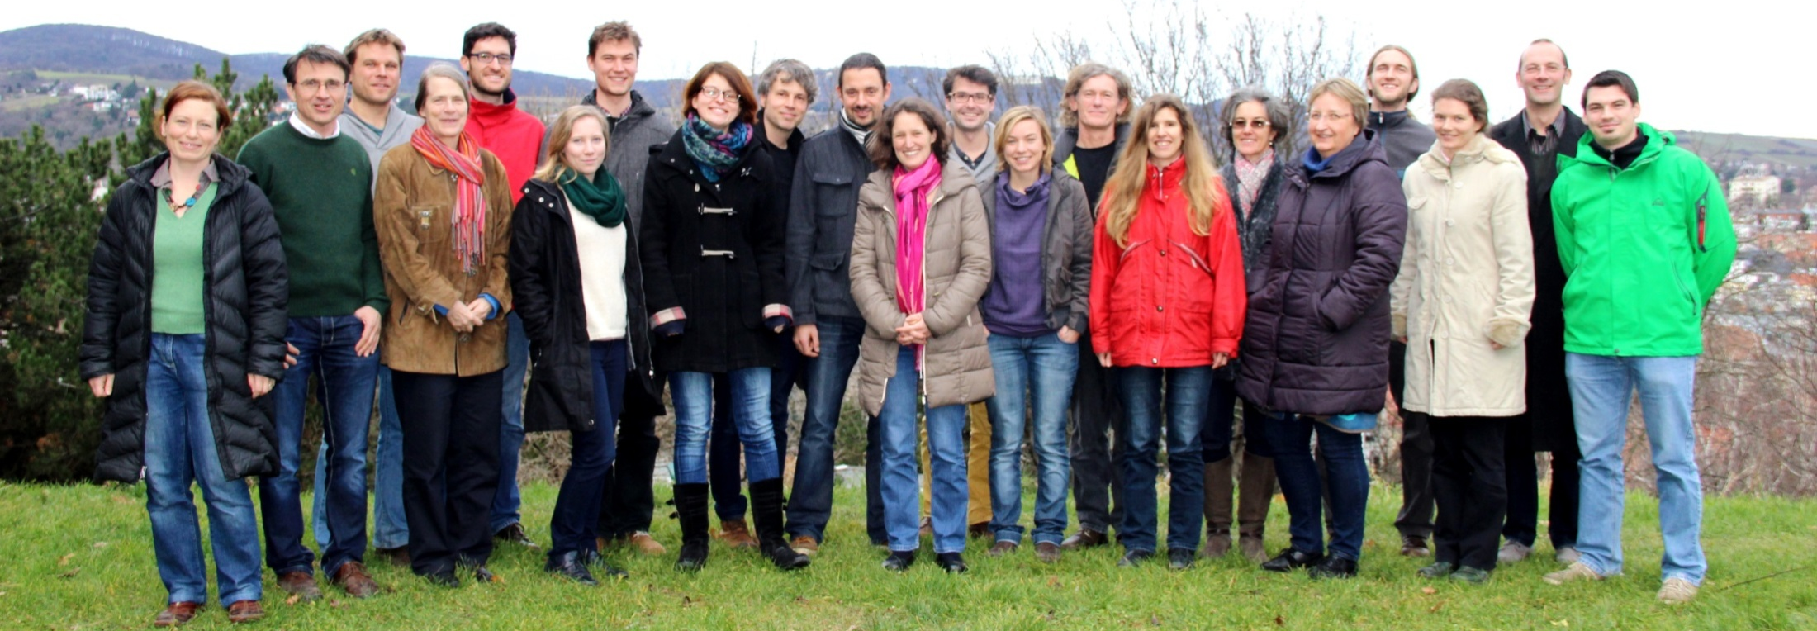
BOKU and gW/N
University of Natural Resources and Life Sciences, Vienna (BOKU)
12.000 students (20% international)
Centre for Global Change and Sustainability (gW/N)
transfer knowledge of climate change, sustainability
Contact point for sustainable projects, initiatives and people. Supporting projects with teaching, expertise, development, contacts, visibility ...
Thank you very much for your attention
Notes:
Only Austrian university

Slide 16
Back up

Slide 17
Boku Sustainability Strategy
BOKU Sustainability Strategy
Research
Teaching
Univ. management
Knowledge exchange
2013/14 4 Working groups, rektorship, reflection group
Reflection and
process accompainment
Goals for
Measures
Implementation
Responsible per measure, coordination by gW/N
Notes:
Universitites „third mission“

Slide 18
Goals, Measures, Implementation
Teaching: Support students to become changemakers.
→ start-up Collective Energy → students’ innovation centre [sic!]
Research: Develop courses for changemakers and include them in curricula. → CASE Project
University Management: Greening the research system → CO₂ compensation

