Slide 1


The 2nd International Workshop on UI GreenMetric
The Margo Hotel Depok, West Java, Indonesia, 21 April 2016
The Strategic Environmental Plan of Federal University of Lavras, Brazil Who We Are, Where We Came From, Where We Want to Go
José Roberto Soares Scolforo¹, Zuy Maria Magriotis², Ana Carla Marques Pinheiro³, José Maria de Lima⁴, Cibele Maria Garcia de Aguiar⁵, Luiz Roberto Guimarães Guilherme^{*6}
¹Office of the Rector / Department of Forestry, Federal University of Lavras (UFLA) 37200-000 Lavras (MG), Brazil,
² Office of Environment / Department of Engineering, UFLA
³ Office of the Chief of Staff / Department of Food Science, UFLA
⁴ Office of Research / Department of Soil Science, UFLA
⁵Office of the Rector / Social Communication, UFLA
⁶ Office of International Affairs / Department of Soil Science, UFLA

Slide 2
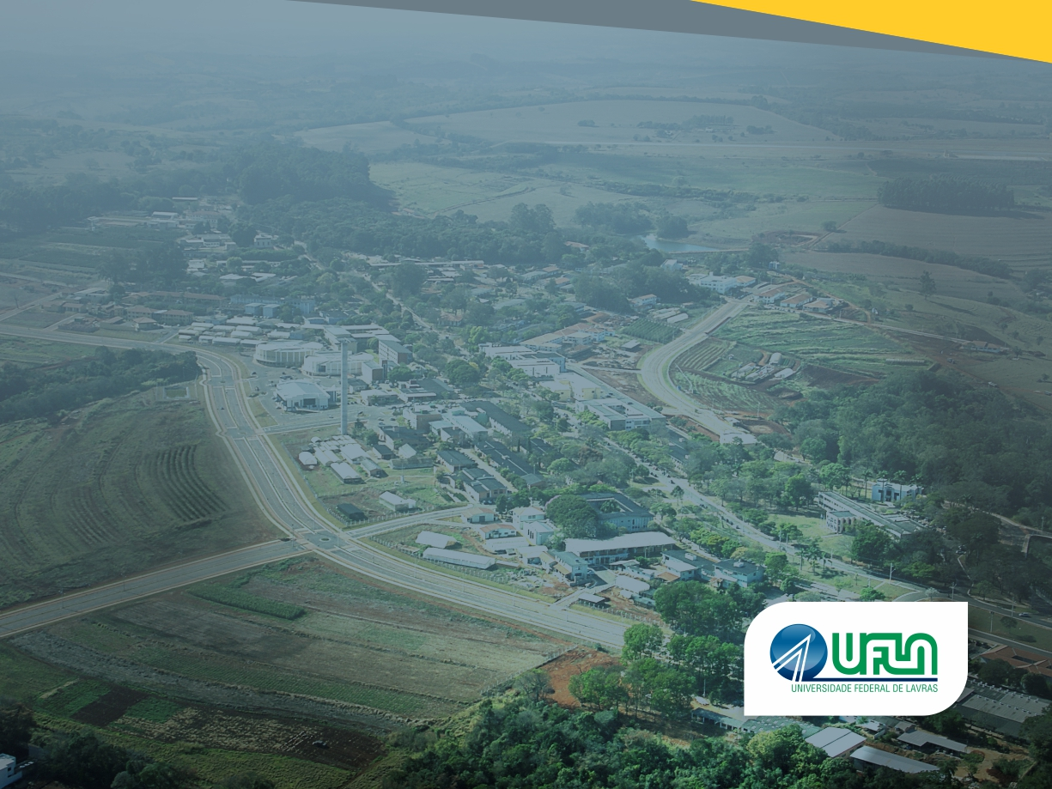
  OUTLINE
Who We Are
Where We Came From
  Strategic Enviromental Plan – UFLA
    Setting and Infrastructure
    Energy and climate change
    Waste management
    Water usage
    Transportation
    Environmental Education
  Main Achievements
Where We Want To Go
Who We Are
Where We Came From
  Strategic Enviromental Plan – UFLA
    Setting and Infrastructure
    Energy and climate change
    Waste management
    Water usage
    Transportation
    Environmental Education
  Main Achievements
Where We Want To Go

Slide 3



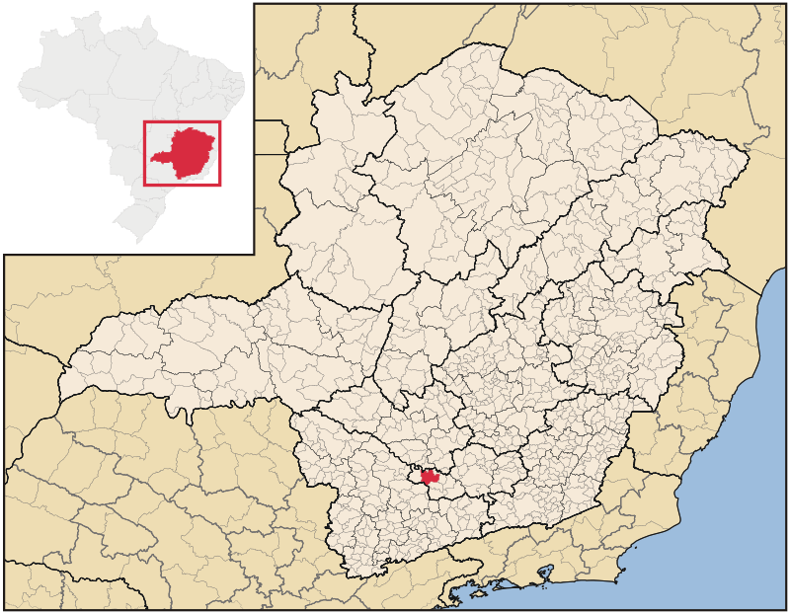
1908
TECHNICAL
HIGH SCHOLL
OF AGRICULTURE
1963
FEDERAL SCHOOL OF AGRICULTURE
1994
FEDERAL UNIVERSITY OF LAVRAS
1938
AGRICULTURE COLLEGE
2016
Undergraduate | 11,607
Graduate | 2,738
Total Students | 14,345
Faculty | 692
Administrative Staff | 1,212
Total People | 16,249
Who We Are
Where We Came From
Lavras
~100,000 inhabitants

Slide 4
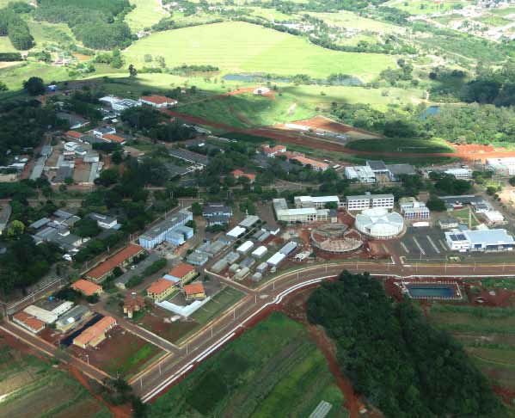

Office of Environment
(created in 2009)
Coordinating Bodies
Sanitation
Waste
Endemic Disease Prevention
Natural Resources
Energy Management
Fire Prevention
Sewage Treatment
Water Treatment
Fire Brigade
Chemical Residues
Biological Residues
Recycling Office

Slide 5
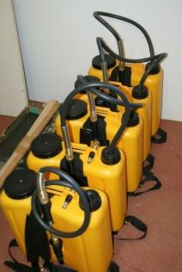
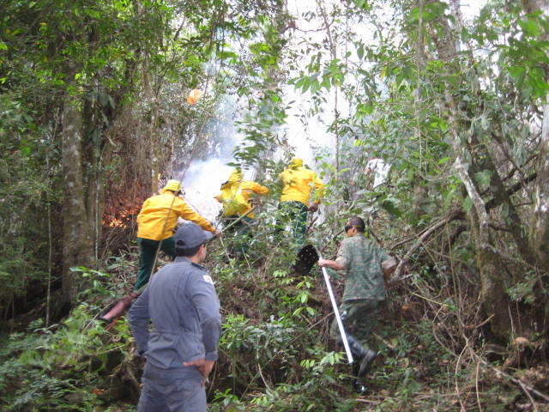
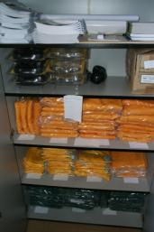
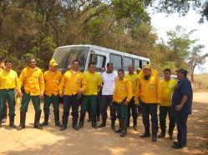
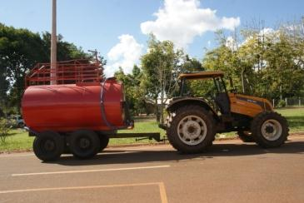
Fire-prevention

Slide 6
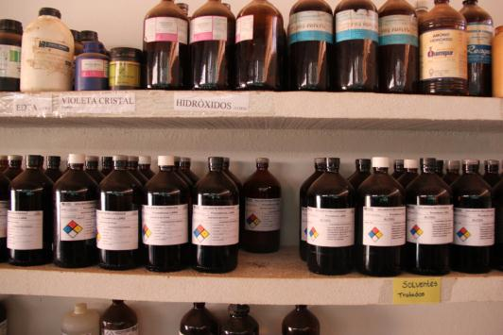
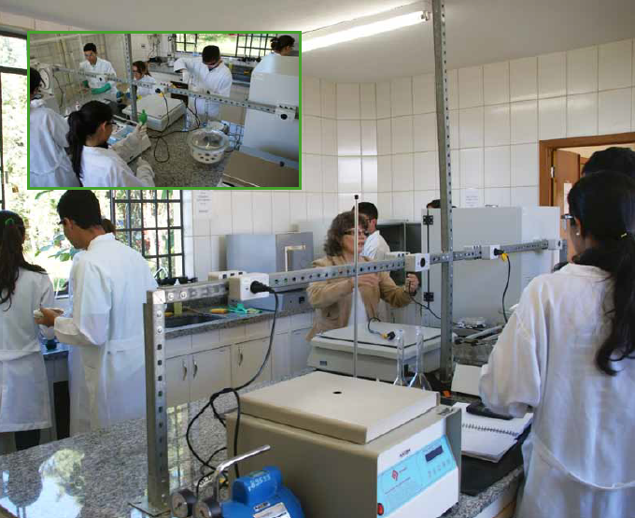
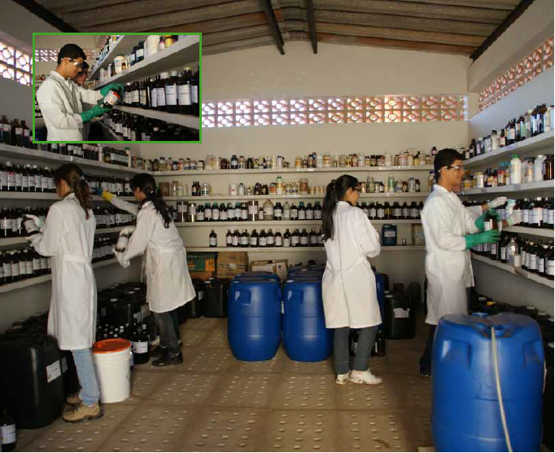
Chemical Waste Management Laboratory

Slide 7
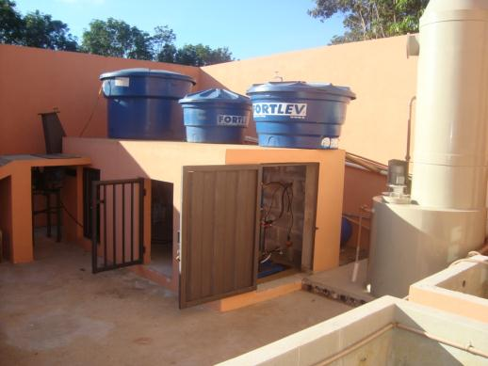
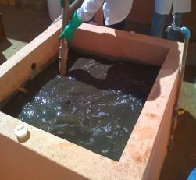
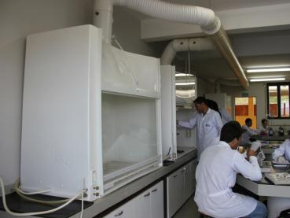
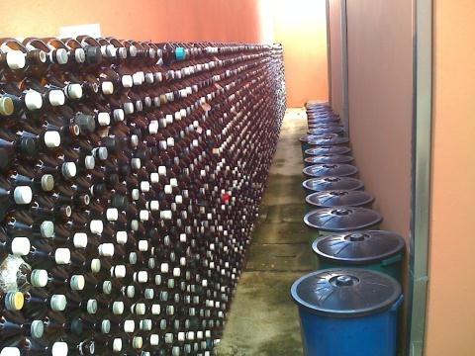
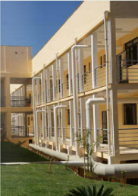

Slide 8
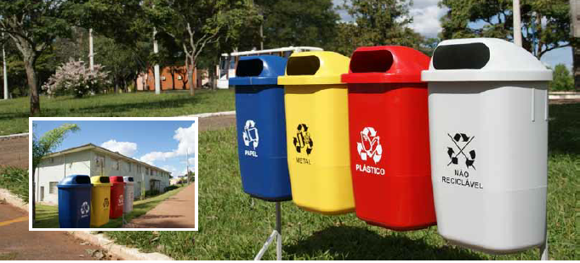
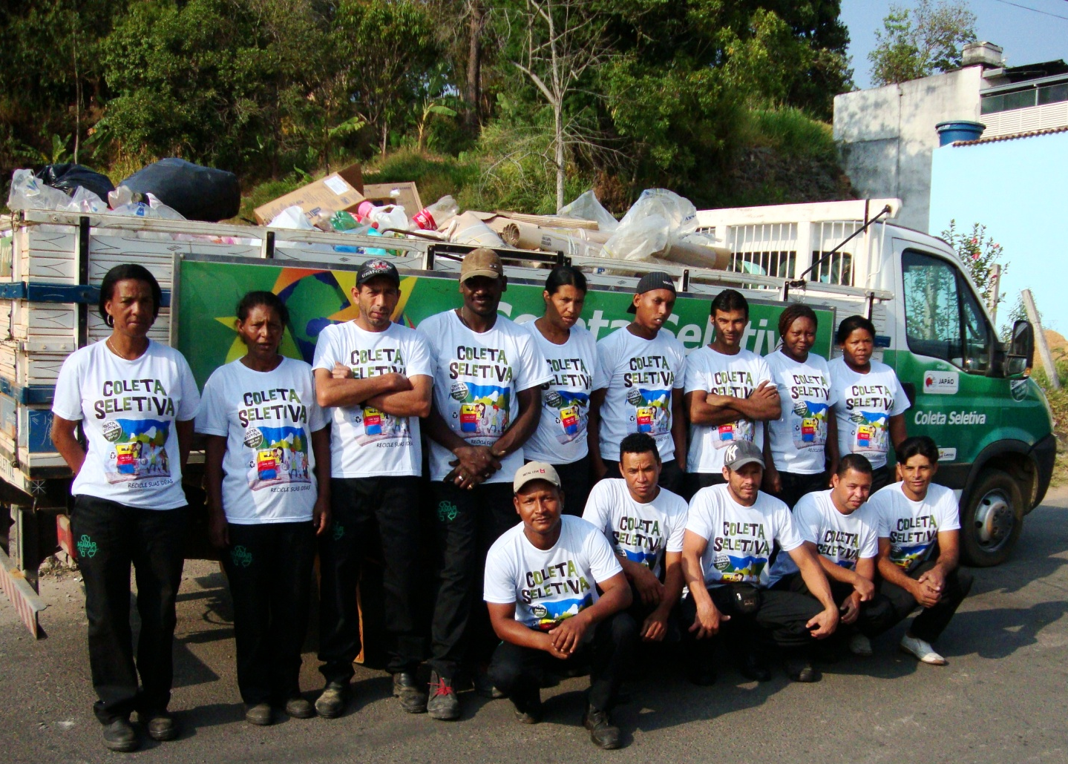
Waste recycling

Slide 9
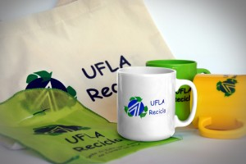
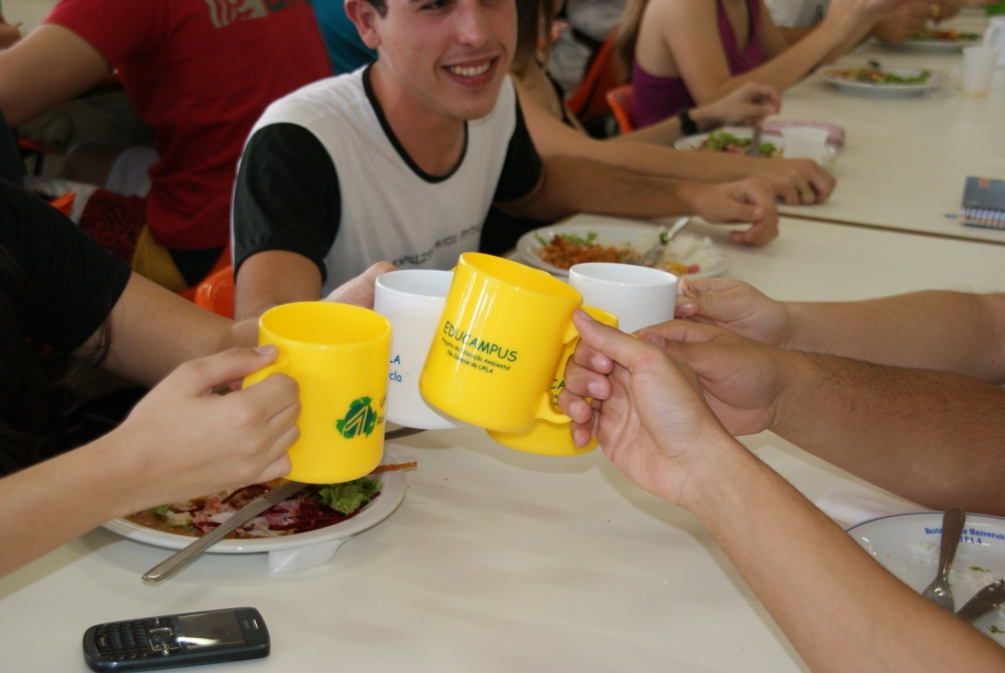
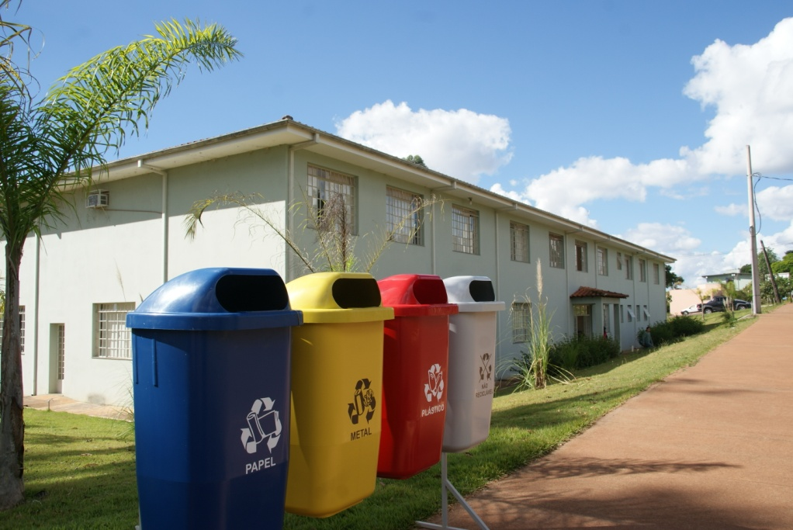
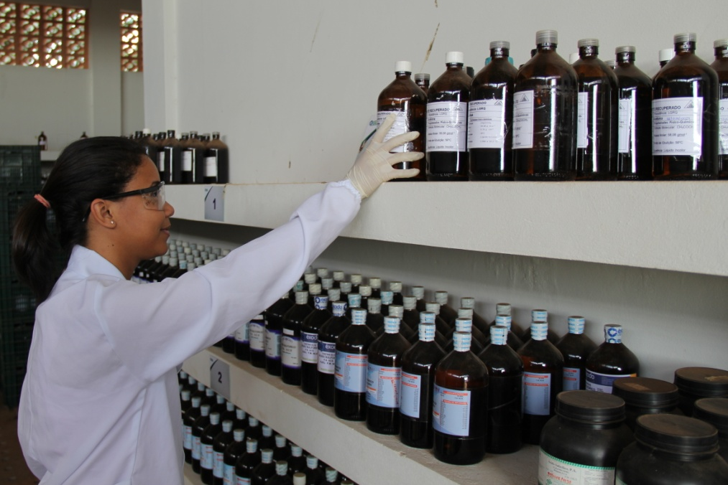

Slide 10
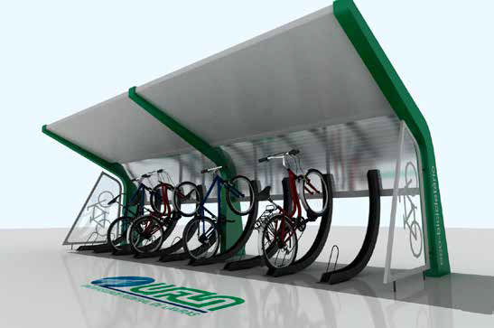
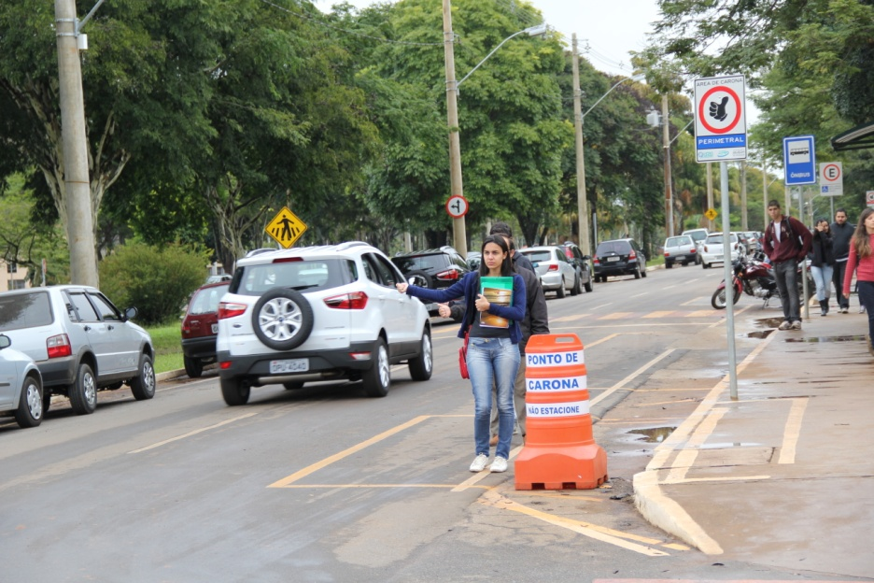
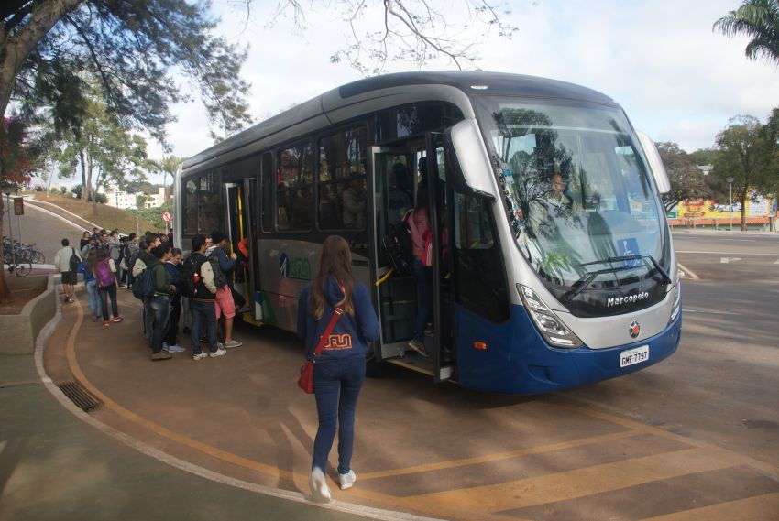
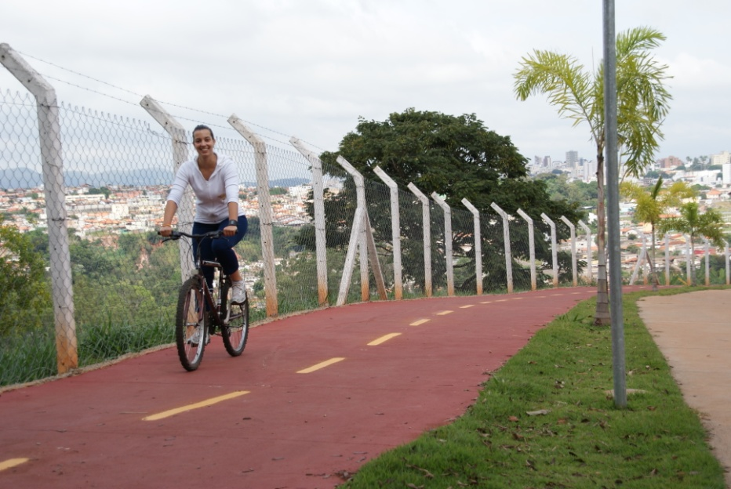
Transportation
Bike lanes and Eco-parking lots

Slide 11
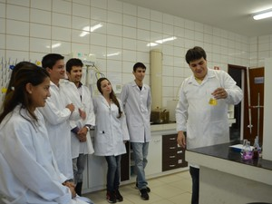
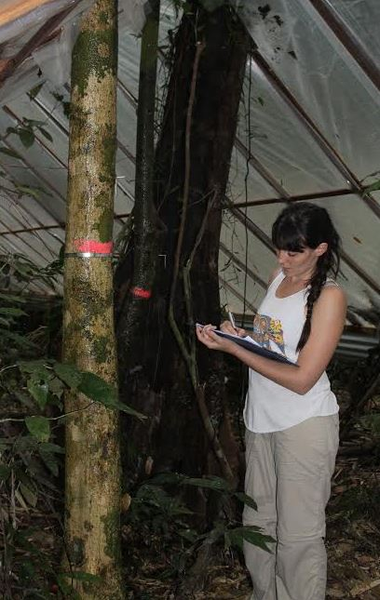
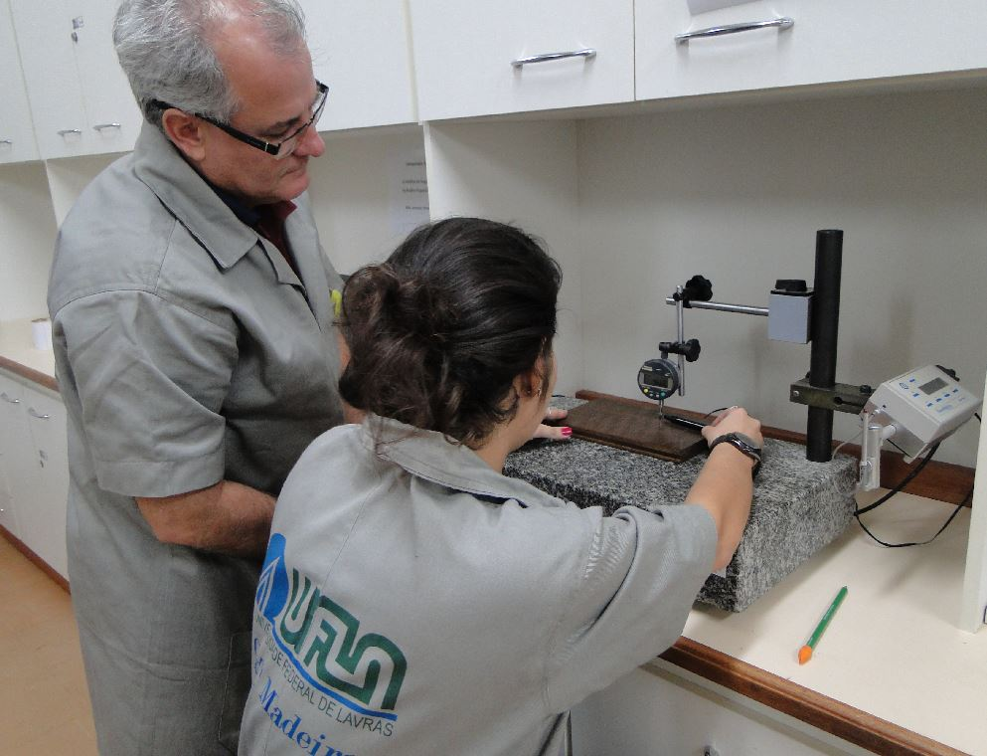
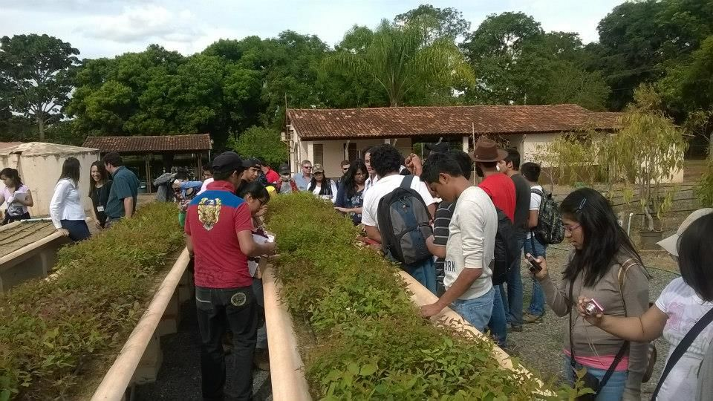
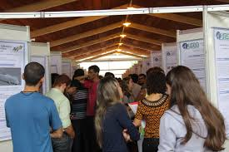
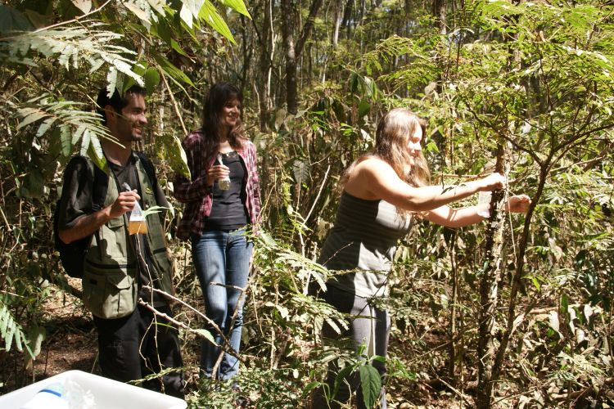
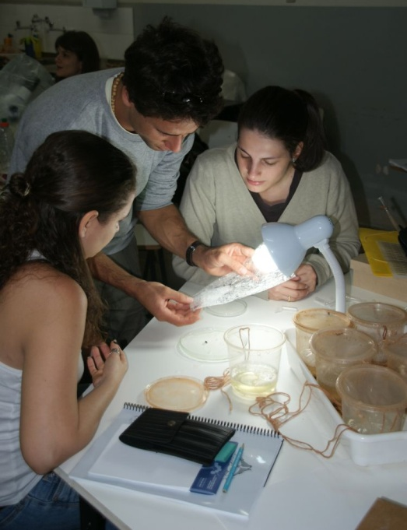
Environmental Education

Slide 12
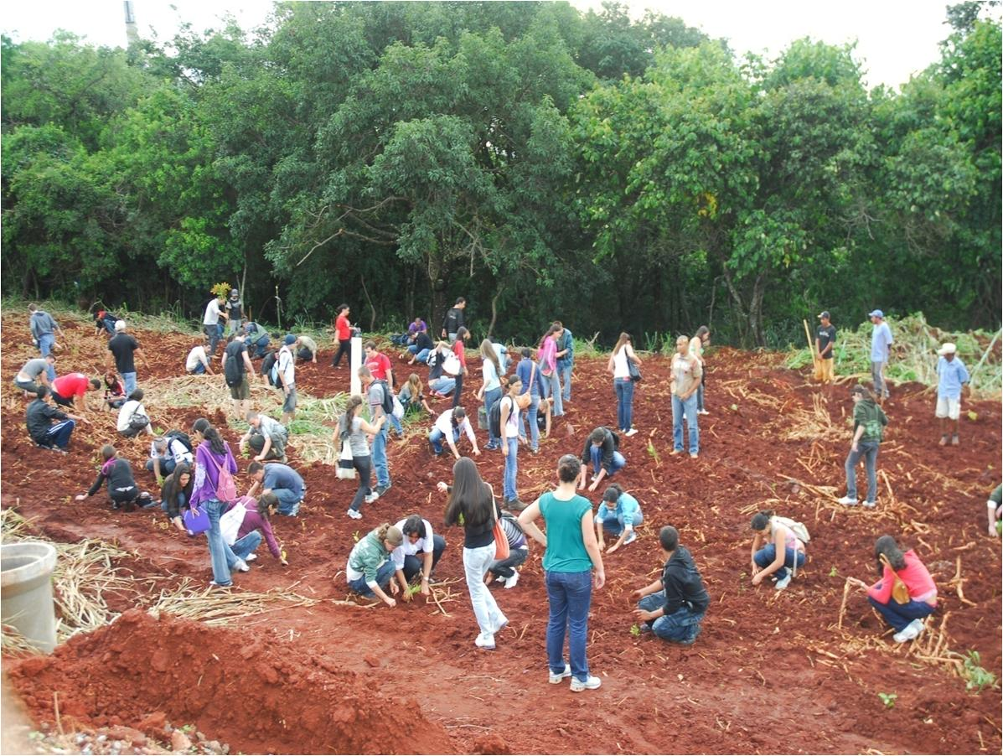

Slide 13
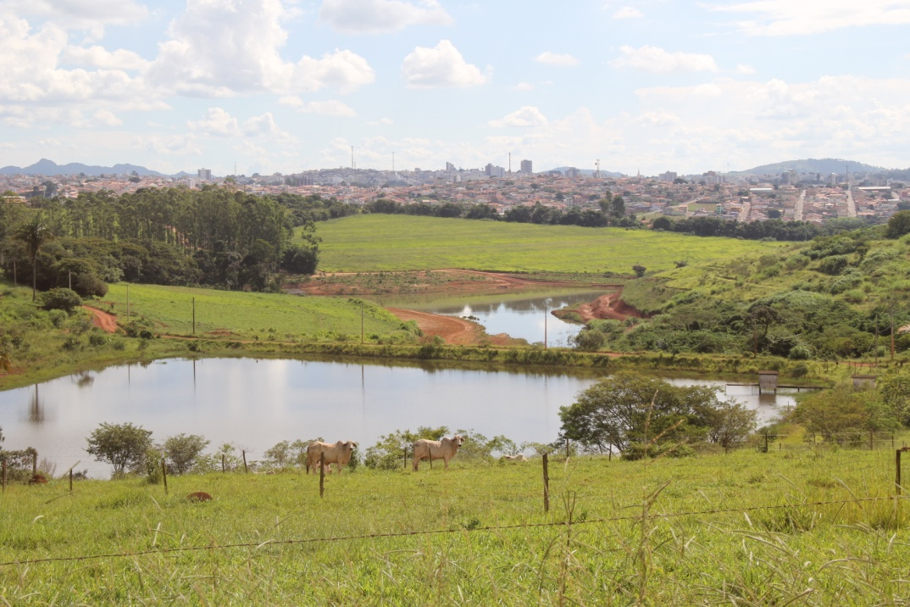
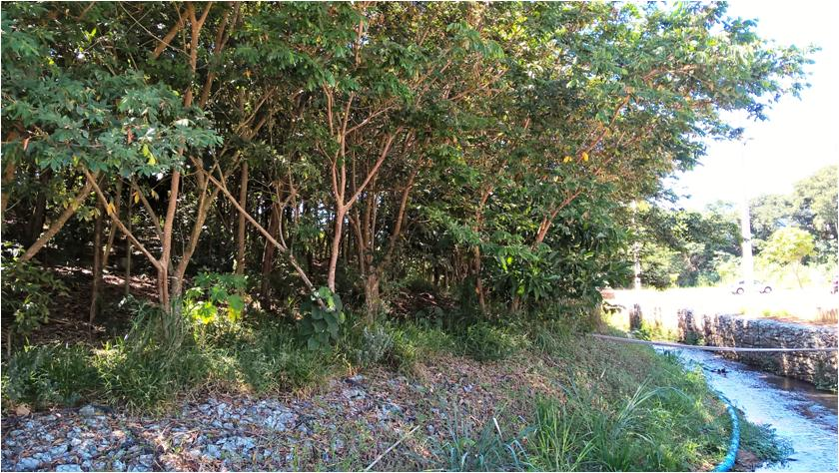
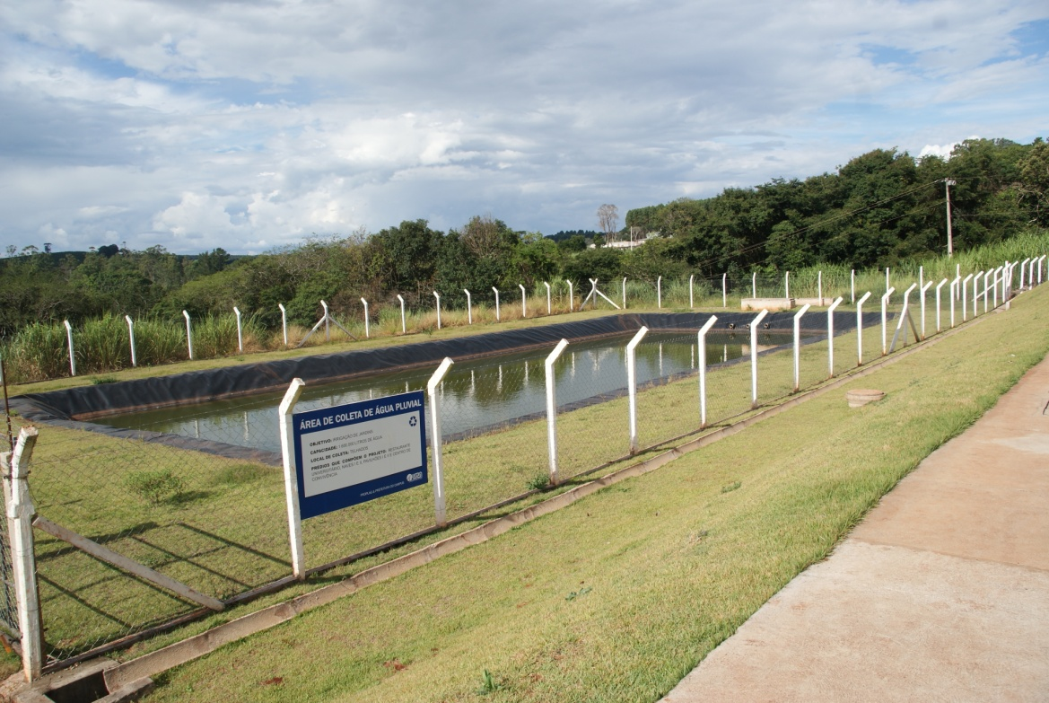
Main Actions on
Water Usage
Preventing streambank erosion

Slide 14
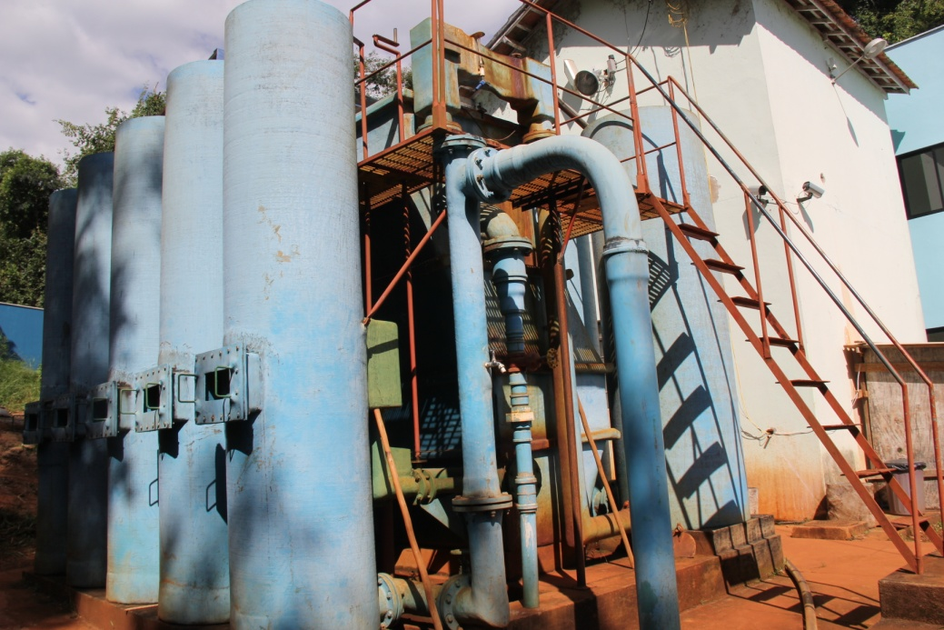
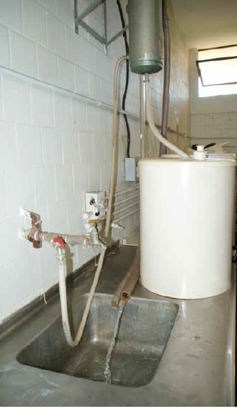
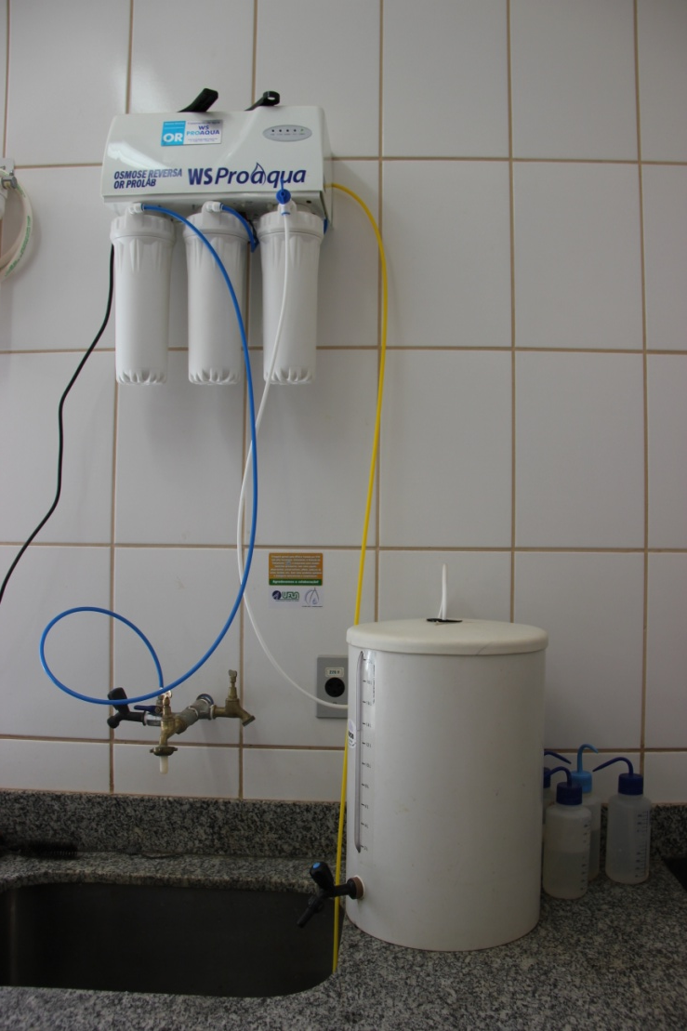
Water – Action 1: Improving our Water Treatment Plant with a capacity of treating 1.4 million L/day.
We “produce” our water!!!
Water – Action 2: Distillers have been replaced by Reverse Osmosis.
Water consumption in Lab. activities droppped from 100,000 to 10,000 L/day.

Slide 15
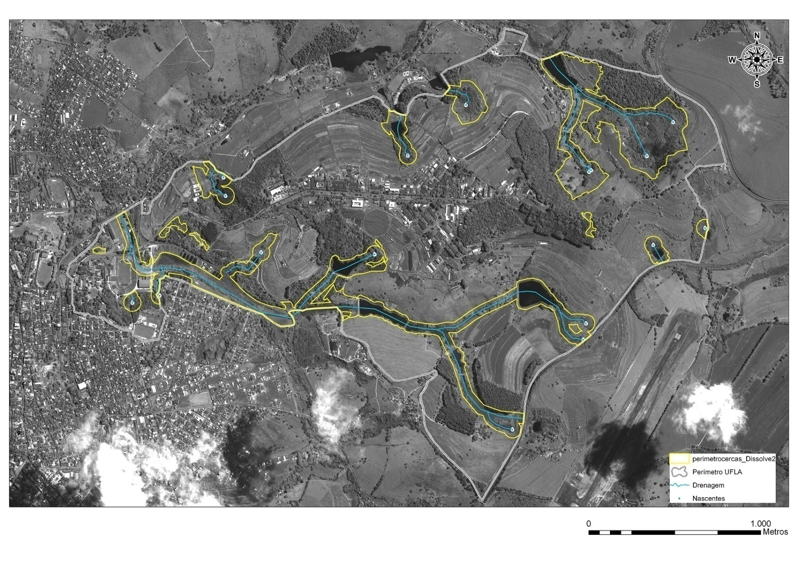
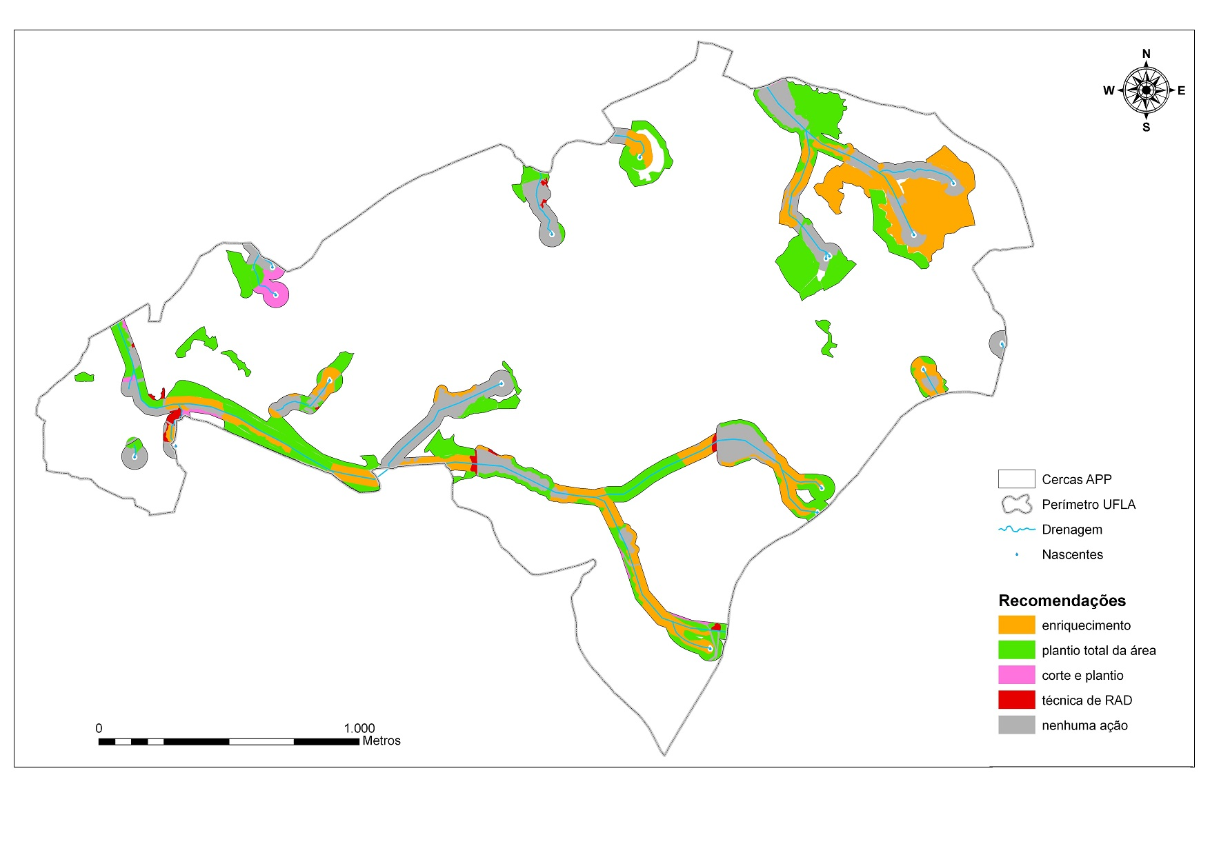
Water – Action 3: Planting trees for recovering Degraded Areas and protecting Water Springs and Riparian Zones
Campus Area ~ 500 hectares, 12,300 m of perimeter
Different techniques for protection of ~ 60 ha

Slide 16
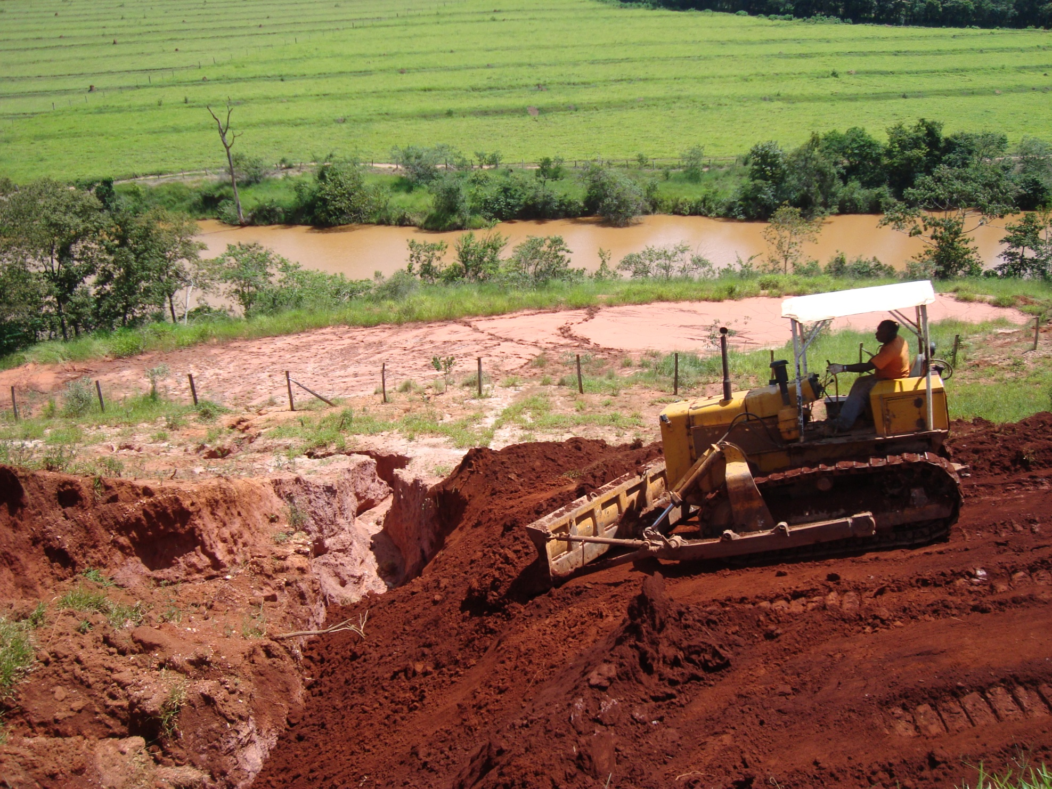

Slide 17
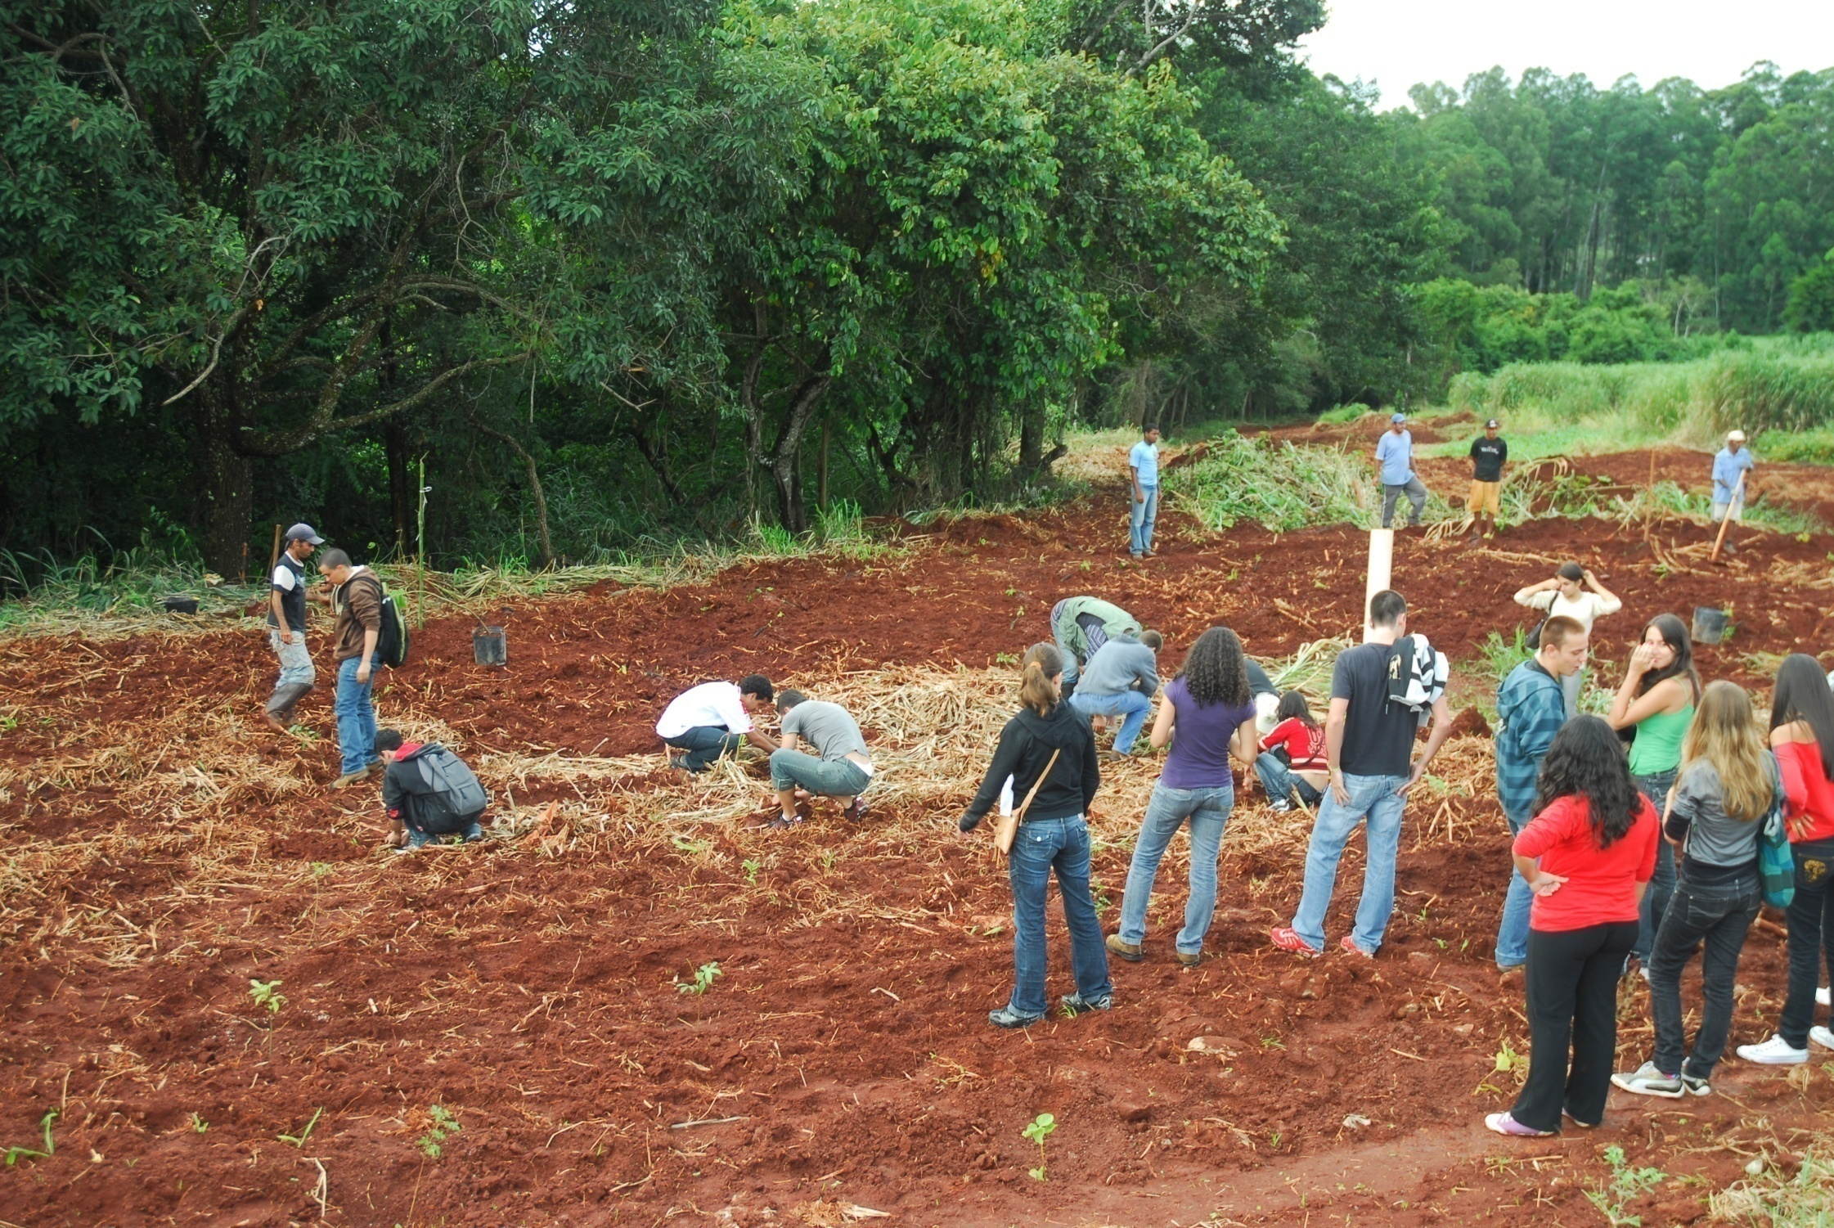
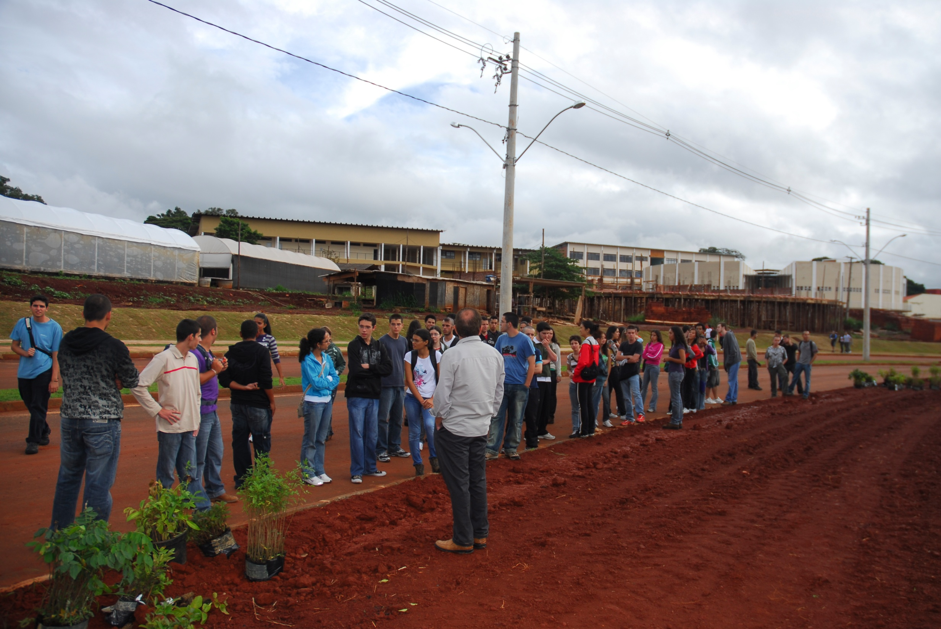
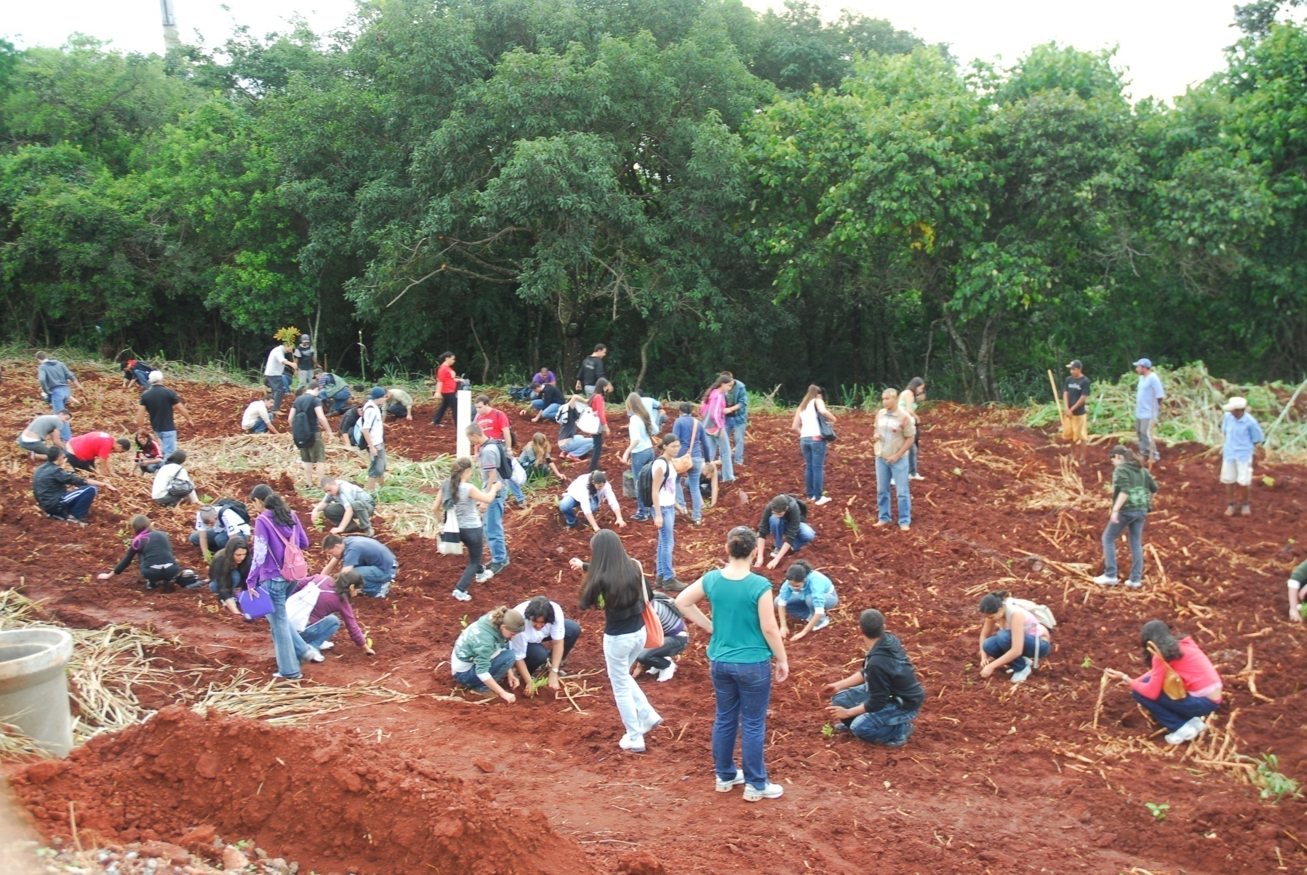
DMA
DIRETORIA DE MEIO AMBIENTE

Slide 18
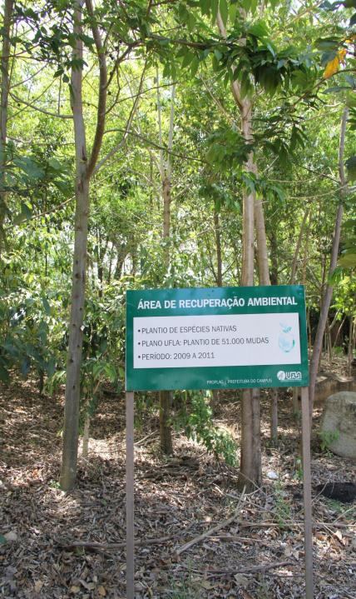
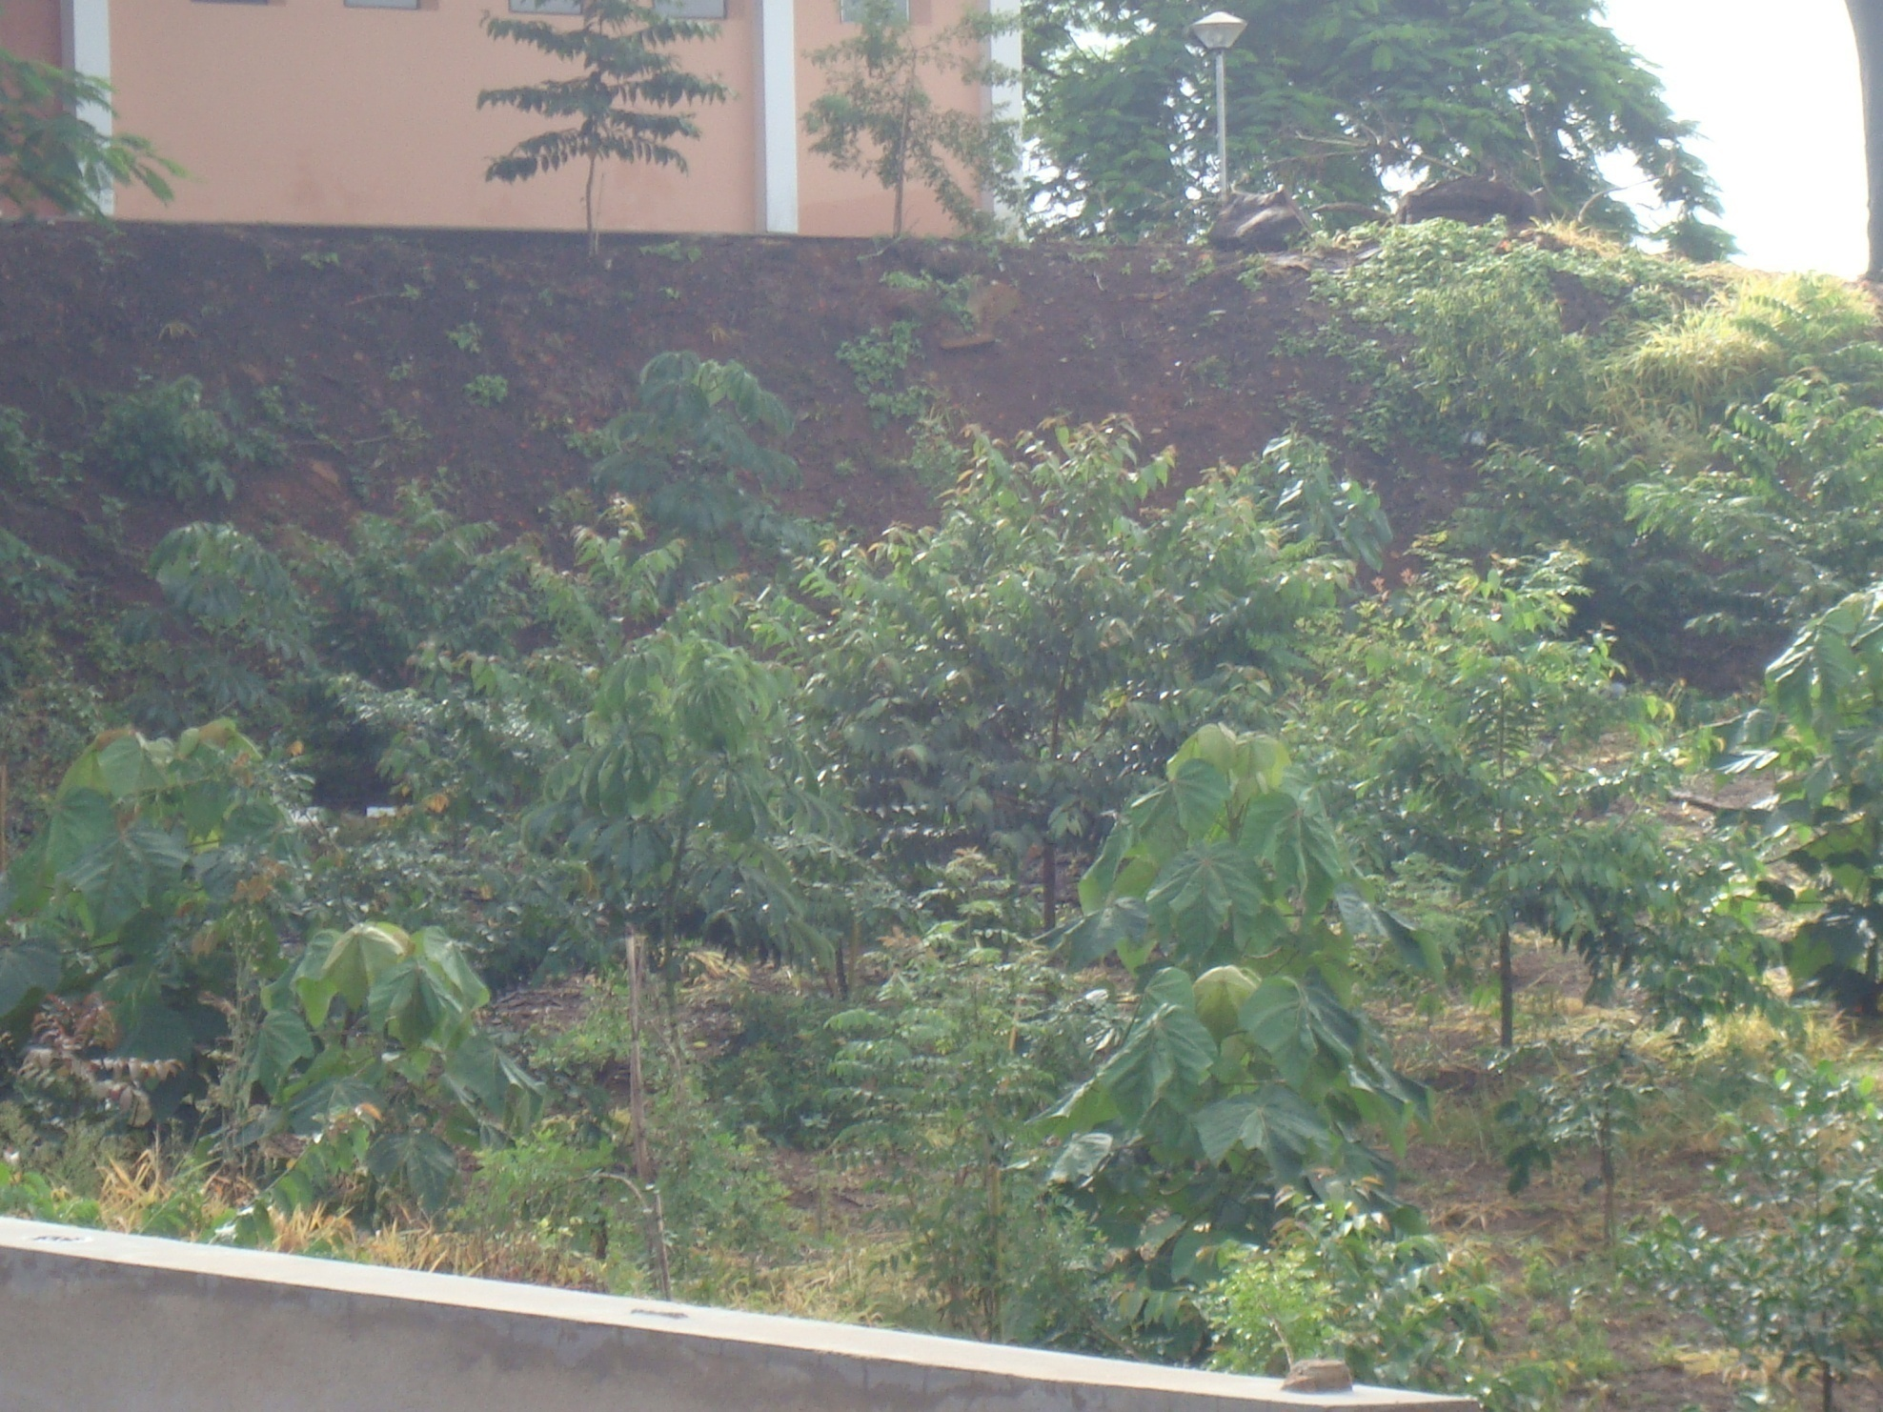
94,500 trees
(53 native species)
2009 to 2015

Slide 19
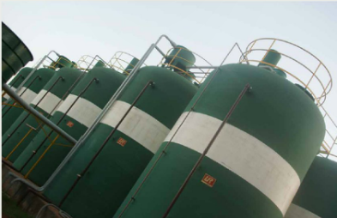
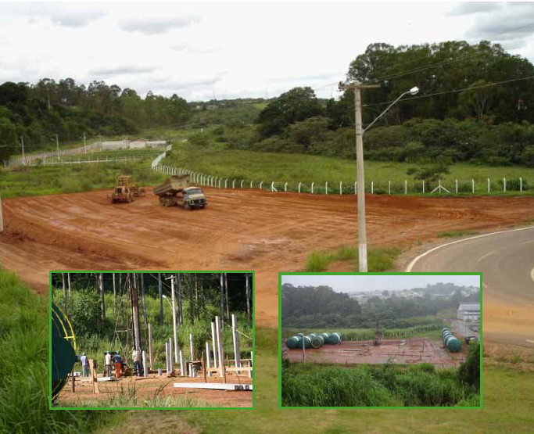

Water – Action 4: Buiding a Sewage Treatment Plant with a capacity of treating 800,000 L/day.
Treated water used for toilets flushing, external cleaning and irrigation

Slide 20



Water – Action 5: Water collecting systems to increase water infiltration and promote groundwater recharge
Infiltration basin

Slide 21

Water – Action 6: Roofs of new buildings, including all classrooms, are now designed for rooftop rainwater harvesting and the water is stored in a reservoir with a capacity of 1.6 million liters

Slide 22



Water – Action 6: Roofs of new buildings, including all classrooms, are now designed for rooftop rainwater harvesting and the water is stored in a reservoir with a capacity of 1.6 million liters
Recovered water is used for irrigation and external cleaning

Slide 23

Thanks to its
Water Management Practices, UFLA is now
saving ~US$ 1.5 million/year
on its budget
Spare money = Better use of resources on Teaching, Research and Extension Activies

Slide 24

Where We Want to Go

Slide 25


Slide 26



Slide 27


reitoria@reitoria.ufla.br, scolforo@dcf.ufla.br, zuy@deg.ufla.br, anacarlamp@dca.ufla.br, jmlima@dcs.ufla.br, cibele.aguiar@ascom.ufla.br, guilherm@dcs.ufla.br
THANK YOU!

