Slide 1
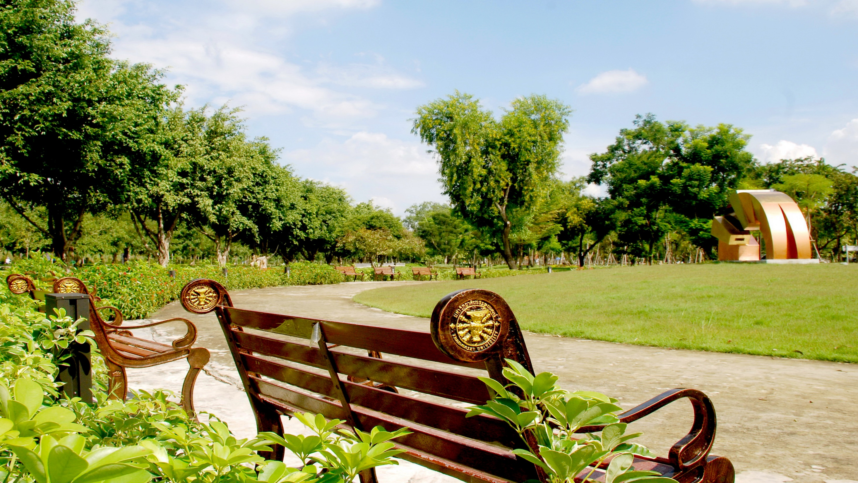
International Workshop on UI GreenMetric on Waste and Transportation Management
April 21, 2016
The Margo Hotel
Depok, Indonesia
by
Asst. Prof. Chanan Phonprapai, PhD
Assistant to the Rector for Administration (Rangsit Centre)
Thammasat University
Thailand

Slide 2
International Workshop on UI GreenMetric on Waste and Transportation Management
April 21, 2016
The Margo Hotel
Depok, Indonesia
by
Asst. Prof. Chanan Phonprapai, PhD
Assistant to the Rector for Administration (Rangsit Centre)
Thammasat University
Thailand

Slide 3
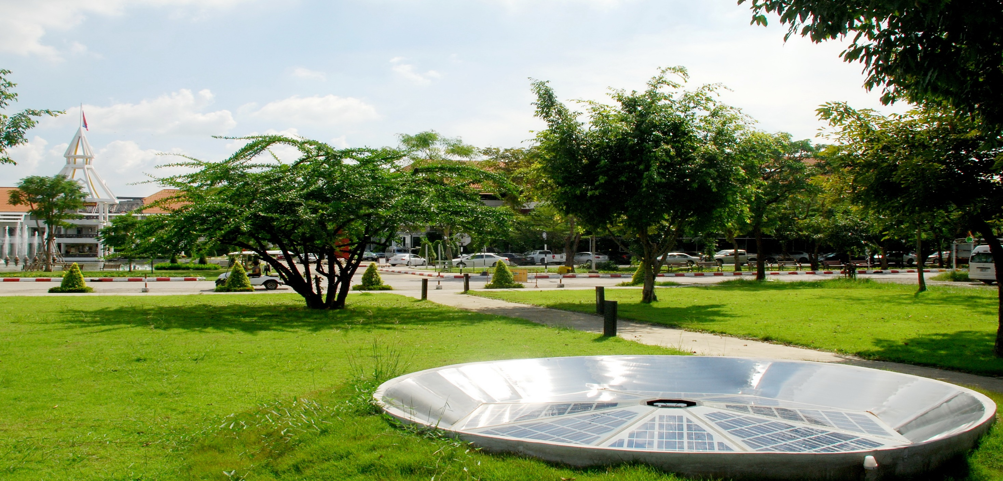
Outline of Presentation
Thammasat University in Brief
Action Plan for Green and Sustainable Campus
Waste Management
Transportation Management
Conclusion

Slide 4
THAMMASAT UNIVERSITY in Brief
Second University in Thailand
Established on June 27,1937. Will be 82 years old this June.
Four Campuses ; Prachan, Rangsit, Pattaya, Lampang
7,221 Staffs and 36,184 Students
58.71 m² of green area per head
16 Faculties in Art and Social Science, 4 Faculties in Science and Technology,
and 7 Faculties in Health Science
12% of Courses offered each year
related to Green & Sustainability
Policies on Energy Conservation and
Climate Change are being Implemented

Slide 5
Action Plan for Green and Sustainable Campus (2014 – 2017)
Category | Target | Project
1. Energy | Save more energy | 1. Replace old electrical appliances with energy saving ones 2. Implement a policy of 5% reduction in electricity bills
 | Use renewable energy | 1. Solar rooftop project at Rangsit Campus 2. Use biogas
2. Green Building | New building | All buildings built since 2015 have to comply with Green Building Standard and Energy Saving Standard
 | Renovated building | All renovated buildings have to promote energy saving and environmental conservation.
3. Waste Management | Reduce solid waste and garbage | 1. Campaign on behavior changing
 | Waste separation | 2. Improve and rebuild Waste Separating System and its building
 | Toxic waste management | Setting up an appropriate toxic waste management system for university

Slide 6
Action Plan for Green and Sustainable Campus (2014 – 2017)
Category | Target | Project
4. Water Management | Reduce piped water loss | Campaign on behavior changing
 | Increase the ratio of natural and piped water usage | Use rain water and canal water
 | Waste water treatment | Improve the waste water treatment plant
5. Transportation | To be “Bicycle University” | 1. Improve bicycle lane 2. Install bicycle signpost 3. Implement bike sharing system 4. Open bike café 5. Campaign on behavior changing
 | Pedestrian and bicycle lanes extension | Improve and build more cover way
 | Transportation system improvement | Bus terminal project
 | Having safe and environmentally friendly transportation system | 20 seater biking Minibus
 | Car park building links to internal transportation system | 1. Aquatic Center car park project 2. Hospital car park project

Slide 7
Action Plan for Green and Sustainable Campus (2014 – 2017)
Category | Target | Project
6. Natural Area Conservation and Management | Green reservation area | 1. 900 meters long garden covering around 27,000 m² 2. Natural conservation plants in university
 | Plants and big trees | Campus in the park project
7. Health and Wellness | Good health | Sport centre improvement
 | Food safety | 1. Organic food canteen 2. Organic produces shop 3. Organic central market
8. Academic and Research | Teaching | 1. TU 100 2. Service Learning
 | Research | Increasing budget for research related to sustainability
9. Social Justice |  | Improve welfare system in university
 |  | Community and social service

Slide 8
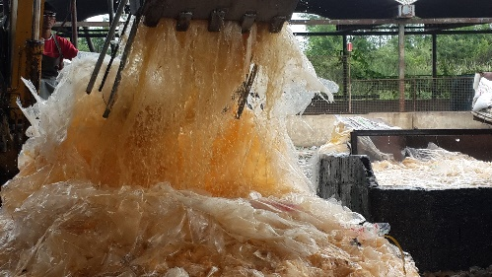
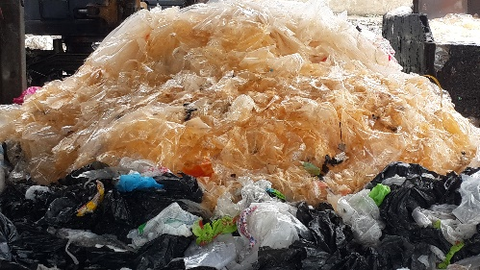
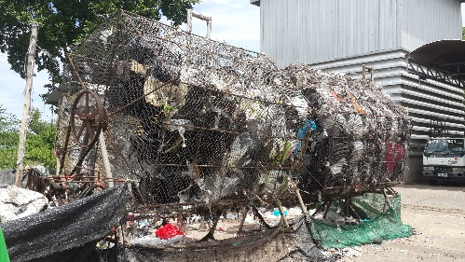
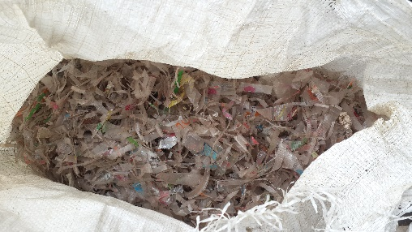
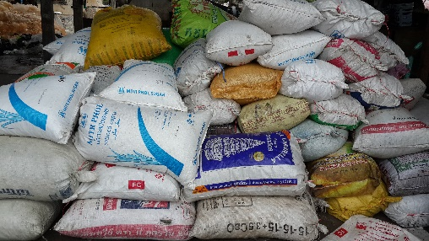
Waste Management
General Waste : Mixed waste, collected from public area, are brought to Garbage Separating House, to collect and clean plastic bags before sending to Recycle Factory. The others left will be collected by local authority. (Seen from Steps)
(1) (2) (3)
(4) (5)

Slide 9
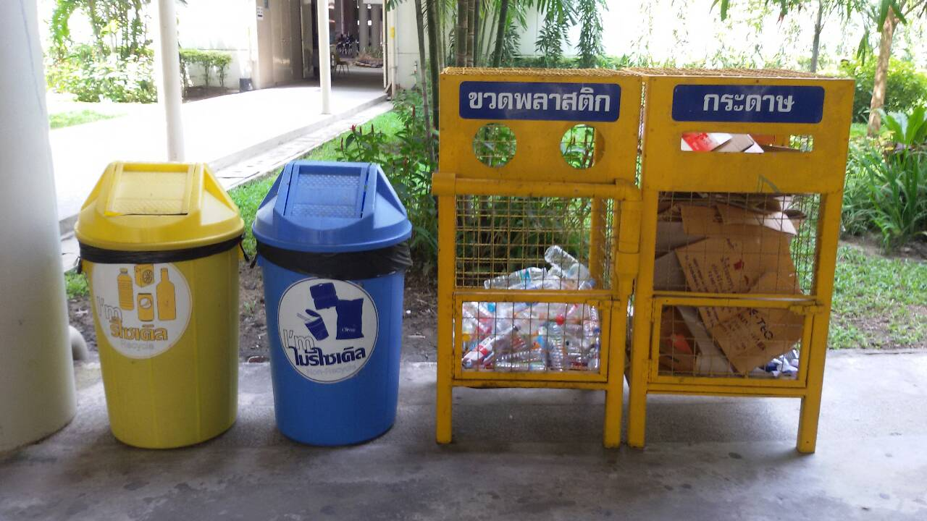
Waste Management
Mixed Recycle Waste : Mixed Recycle Waste collected from recycle bins in public area, will be sorted at Recycle Waste Bank before sending to Recycle Factory.
Recycle Non-Recycle Plastic bottle Paper

Slide 10
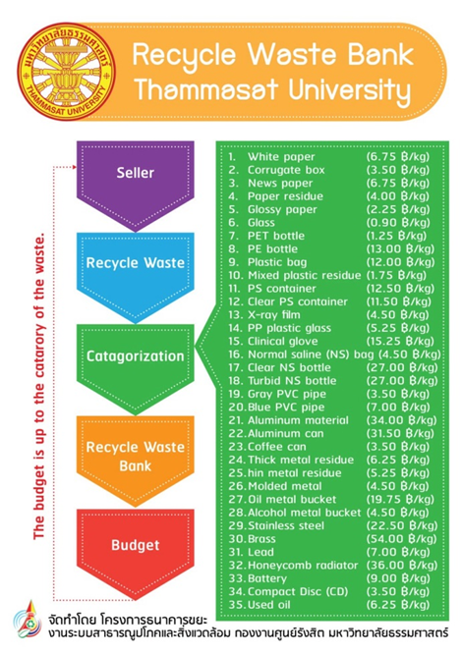
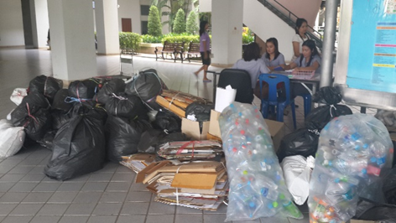
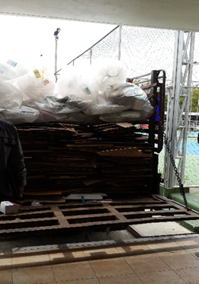
Waste Management
University staffs, students, and organizations in university can be the member of Recycle Waste Bank. There are 35 categories of garbage that can be deposited to the Recycle Waste Bank in return for money. The price per unit weight of each category will be revised every month depending on the market price.
Recycle Waste Bank operates five days a week.
For two days a week, members can come to the
bank to turn in garbage in exchange for money. The other three days the bank staffs go to collect garbage from large recycle waste producers.

Slide 11
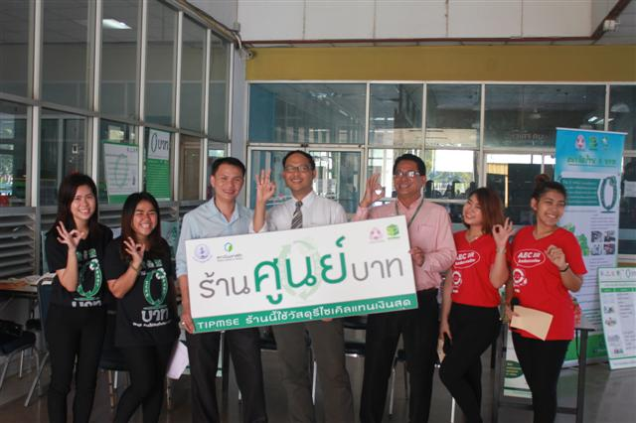
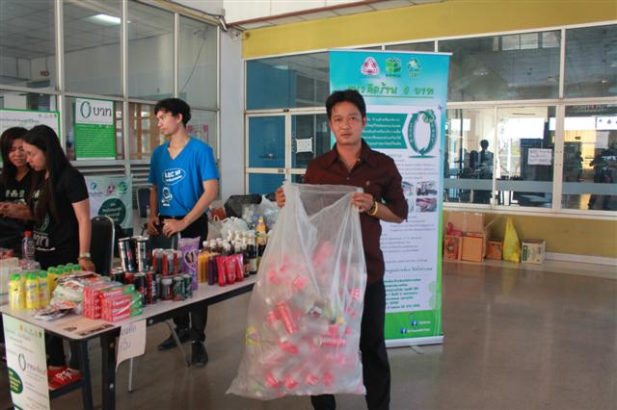
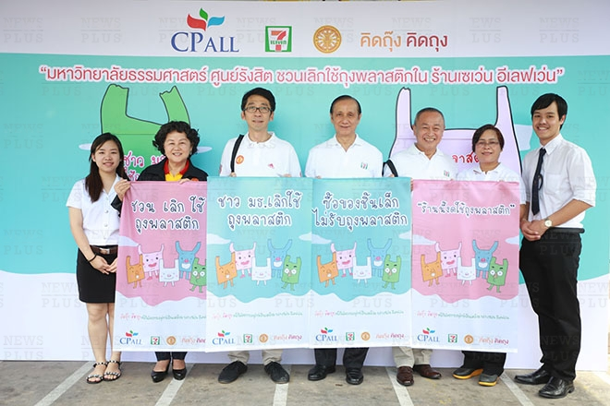
Waste Management
More recently, we have established Zero Baht Shop where recycle items can be exchanged for certain consumer products.
The setting up of the Recycle Waste Bank and Zero Baht Shop are supported by TIPMSE*
At the same time, we campaign for reducing the use of plastic bags in 7-11 Shops in the campus. The campaign has been successful.
* TIPMSE : Thailand Institute of Packaging and Recycle Management for Sustainable Environment, Federation of Thai Industries

Slide 12
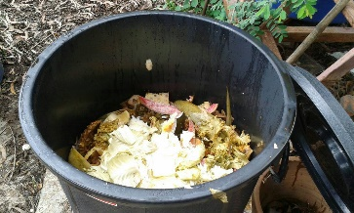
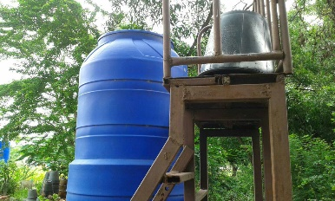
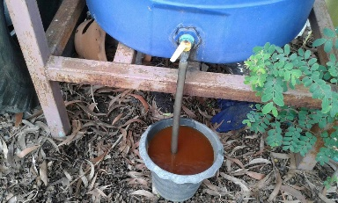
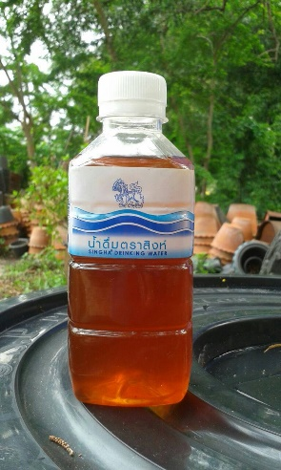
Waste Management
3. Organic Waste: Organic Waste comes from 2 sources, canteen and gardening.
From Canteen : Food waste is taken to the nearby farms for animal feed. Some organic waste is used to produce Enzyme Ionic Plasma production for soil enrichment, and also used in biogas production.
(1) (2)
(3) (4)
< Process of producing Enzyme Ionic Plasma Liquid >

Slide 13
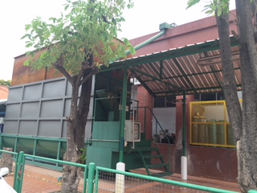
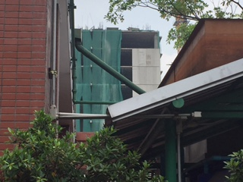
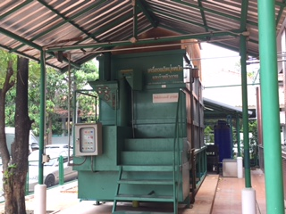
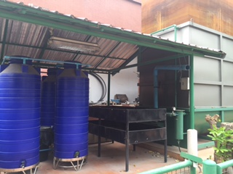
Waste Management
3. Organic Waste: Organic Waste comes from 2 sources, canteen and gardening.
From Canteen : Food waste is used in biogas production, this helps to reduce petroleum gas consumption in the kitchen.
(1) (2)
(3) (4)
From Gardening : Leaves and small branches are used in producing fertilizer, while big branches will be chopped and used in gardening.

Slide 14
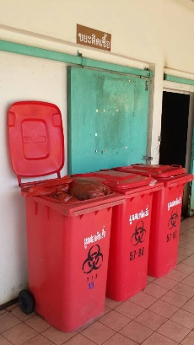
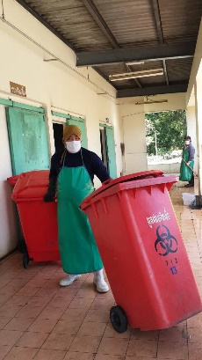
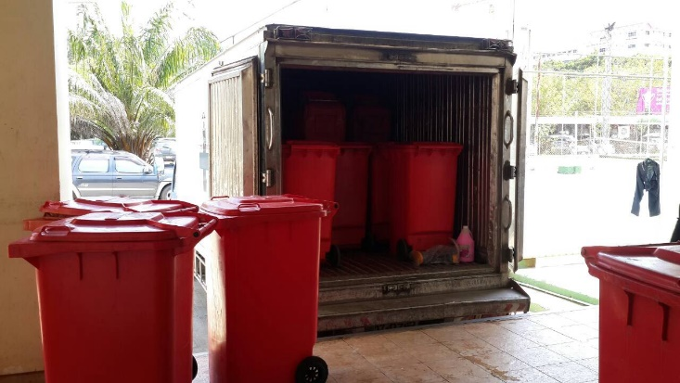
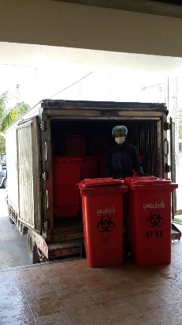
Waste Management
4. Hazardous Waste : There are two types of hazardous waste management, Light bulbs & battery and Chemical Waste from laboratory.
Light bulbs & battery : University has launched a campaign asking staffs and students to bring used bulbs and batteries to the arranged boxes rather than put them in the bin.
Chemical Waste : From April 2015 to February 2016, Thammasat had participated in ESPReL Project, Enhancement of Safety Practice of Research Laboratory in Thailand, organized by National Research Council. This project has enabled 36 laboratories to obtain a better Chemical Safety and Chemical Waste Management System.
5. Clinical Waste : Thammasat hospital has a responsibility for managing and collecting the clinical waste from hospital and 7 faculties in health science, consist of, two faculties of Medicine and faculties of Allied Health Science, Nursing, Dentistry, Public Health, and Pharmacy.

Slide 15
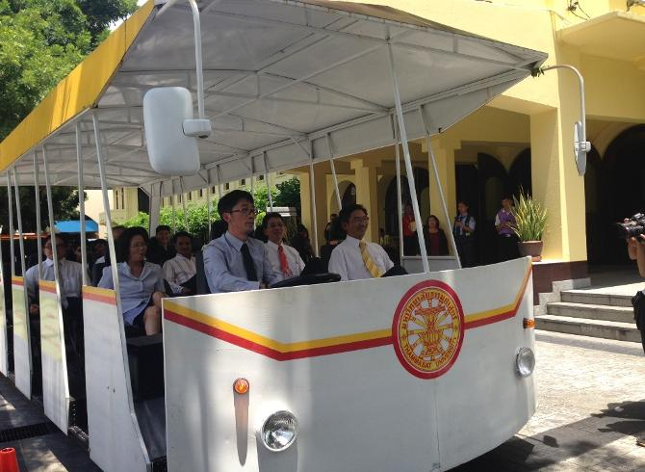
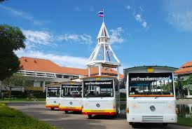
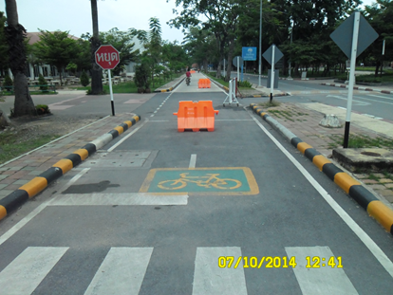
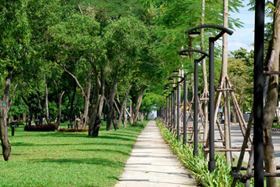
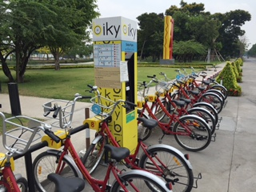
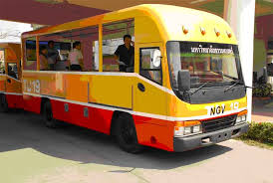
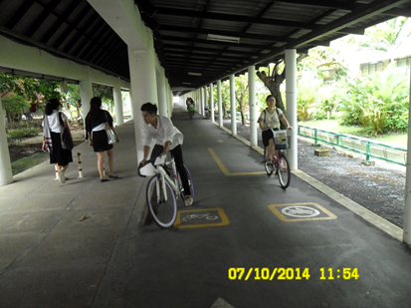
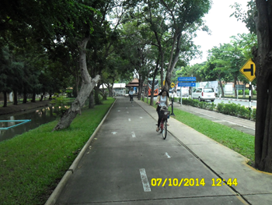
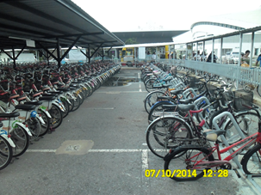
Transportation Management
The purpose of improving transportation system relates to energy conservation & climate change mitigation.
1. Reduce the number of cars entering the campus by providing car park buildings and transportation hub
2. Provide enough NGV buses for transporting people into the campus
3. Campaign on behavior changing from driving to biking
4. Provide bicycles for staffs and students free of charge for their use in the campus
5. Bicycle lane extension for both outdoor and cover way to connect all area in campus
6. Support innovation for alternative energy by inventing 20 Seater Biking Tram

Slide 16
Conclusion
The action plan revealed that Thammasat University has put major efforts in implementing Green and Sustainable policies.
In waste management, we were one of the first institutions to successfully establish Recycle Waste Bank, which became a model for many other organizations.
In transportation management, although we are happy with increasing popularity of NGV bus service in the campus, we still have to do more on promoting bicycle use.

Slide 17
THANK YOU
www.sustainable.tu.ac.th

