Slide 1
Reduction of water resources consumption and the student-led environmental management system of Chiba University
Sakiko Okayama
Chiba University Environmental ISO Secretariat

Slide 2
Contents
Overview of Chiba University and its EMS
Water resource conservation effect →Waste emission effect
Student-led EMS at Chiba University
Results after 10 Years of Chiba University’s Student-led EMS
Notes:
At first I’ll explain about ISO14001 acquisition in university of Japan
Secondly Chiba University and the 10 years history of the EMS.
Thirdly I’ll talk about “Chiba University Method” that is the best feature of Chiba University EMS.
Last I’ll report about the results of the 10 years

Slide 3

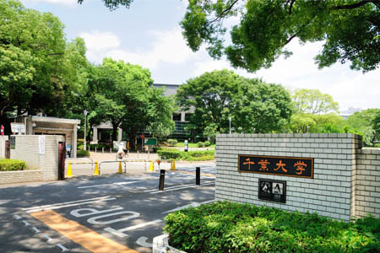
１
Overview of Chiba University and its EMS
Notes:
First, I’ll explain about Chiba University

Slide 4
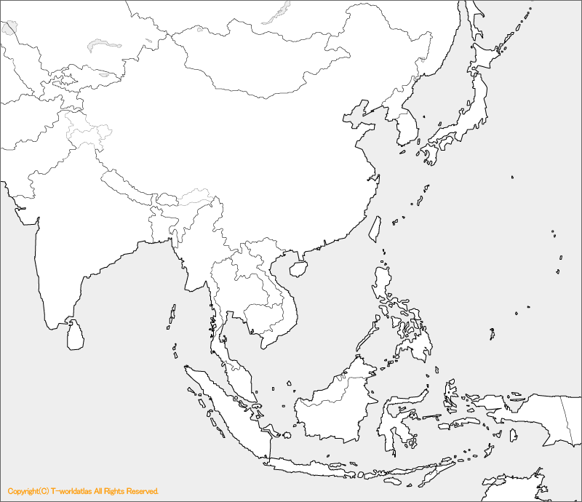
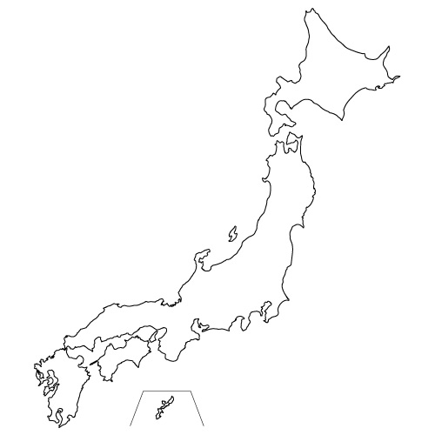
Chiba University location
JAPAN
Tokyo
Chiba prefecture
Here
Notes:
Do you know where the Chiba University is?
This is Japan, ●here is Tokyo, ●here is Sapporo
Chiba prefecture is here●.

Slide 5

Chiba University (National University)
four main campuses in Chiba prefecture
Established in 1949
14,700 students
3,350 faculty members
10 faculties
11 graduate schools
13 research centers
Kashiwa-no-ha
Matsudo
Nishi-Chiba
Inohana
Notes:
Chiba University was established in 1949 as national university and was incorporated in 2004. Currently, it has around 18,000 people.
Chiba University is one of the leading comprehensive universities in Japan.
There are four main campuses.
.

Slide 6
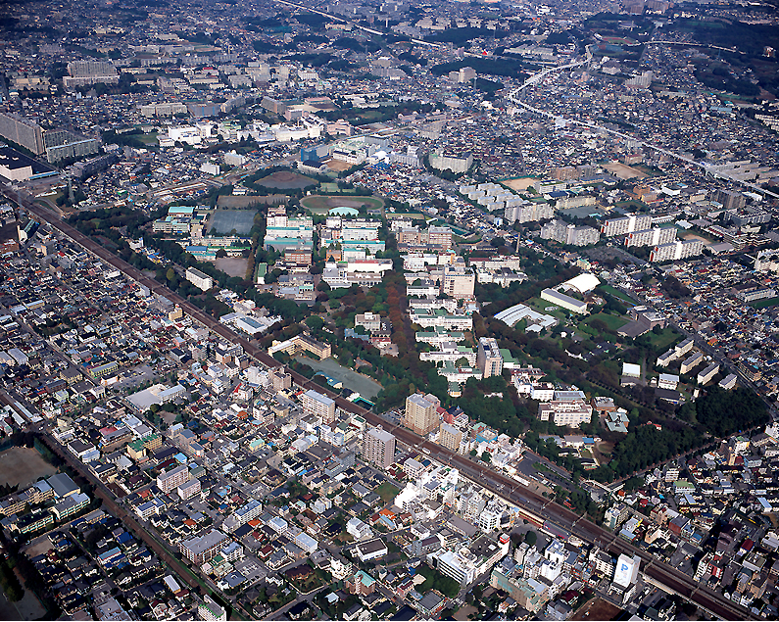
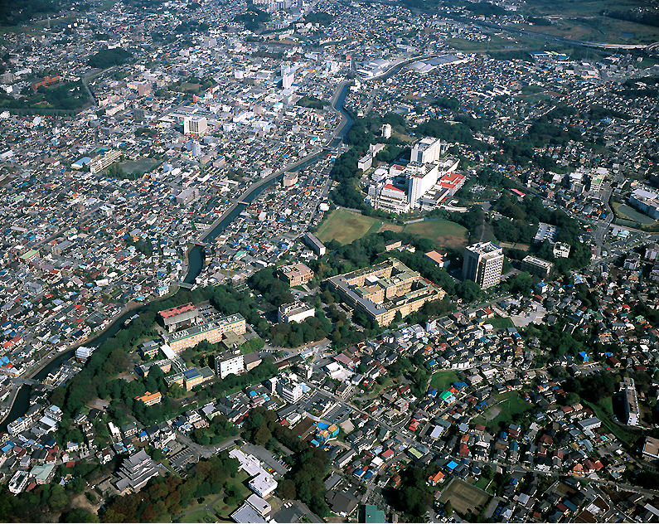
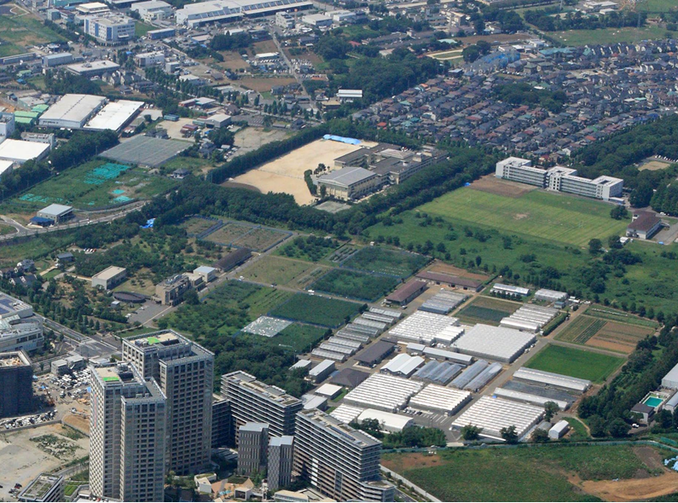
Nishi-chiba
Inohana
Matsudo
Kashiwa-no-ha
Notes:
We have four main campuses. Here is the Nishi-chiba campus. It is the flagship campus. At the Inohana campus, University Hospital and Madical related faculties are located. Faculty of Horticulture located at the Matsudo campus. At the Kashiwa-no-ha campus, we have research center on the Environmental issues and Health related issues.

Slide 7
Chiba University’s
ISO Acquisition Process
2013
Acquire the ISO50001
2007
All of the four main campuses are operating the ISO 14001-compliant EMS
2005
Nishi-Chiba Campus acquired ISO 14001.
2003
  Environmental ISO Student Committee founded
7
Notes:
●The Chiba University president officially declared the start to acquire ISO in 2003.
He said that Chiba University had to introduce a new type of EMS in the form of student-led.
So, before the declaration, the Environmental ISO Student Committee was established.
The students were involved in almost every aspect of the EMS.
●In 2005, the Nishi-Chiba Campus acquired ISO14001. Then, the scope of application was expanded to the other Campuses. ●And then all of the four main campuses acquired in 2007.
●In 2013, the university acquired ISO50001 as the first university in Japan.
It is specified in energy management system.

Slide 8
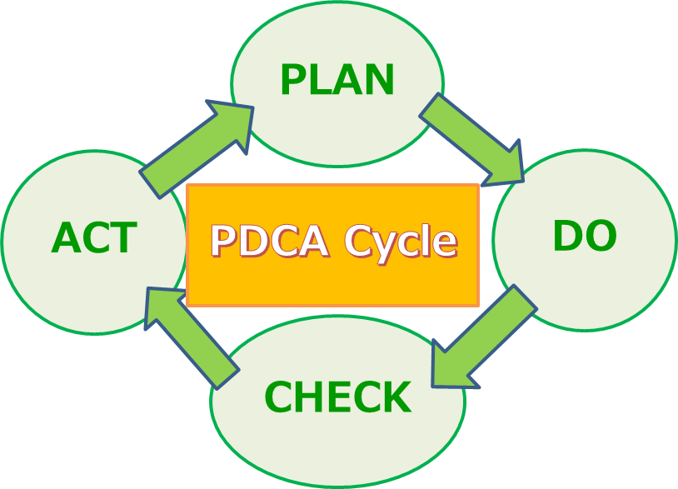
About ISO14001/ISO50001
ISO: International Organization for Standardization
ISO14001 : EMS for organizations.
ISO50001 : energy management system.
They are based on the
Plan-Do-Check-Act cycle.
Notes:
Before entering the subject, I will shortly explain the ISO.
ISO is the International Organization for Standardization.
The ISO14001 is specified in the requirements of the environmental management system (EMS) for organizations. The EMS is a systematic approach to handling environmental issues within an organization.
It is based on the PDCA cycle.
The ISO50001 is specified in energy management system.

Slide 9
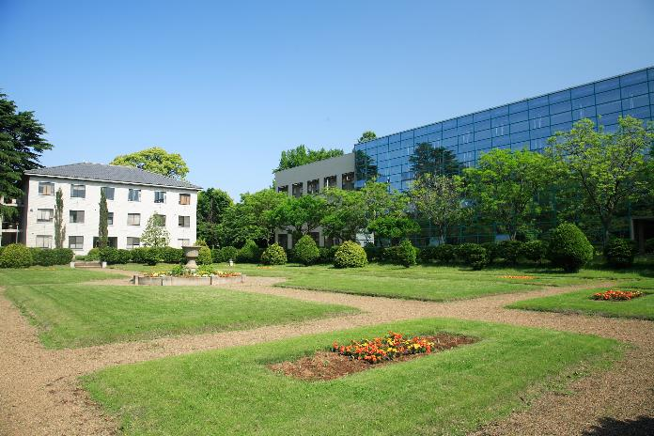
2
Water resource conservation effect
→Waste emission
Notes:
Next, I’ll talk about Student-led EMS “Chiba University Method” in detail.

Slide 10
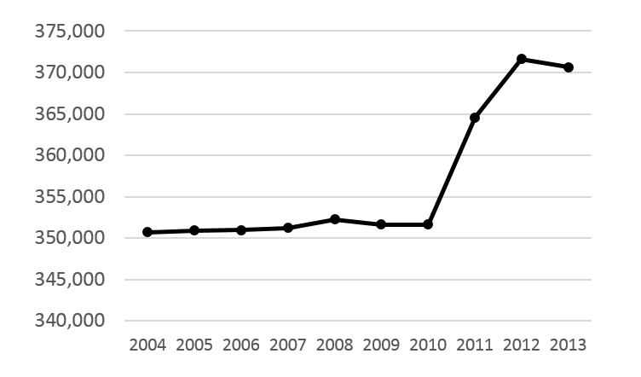
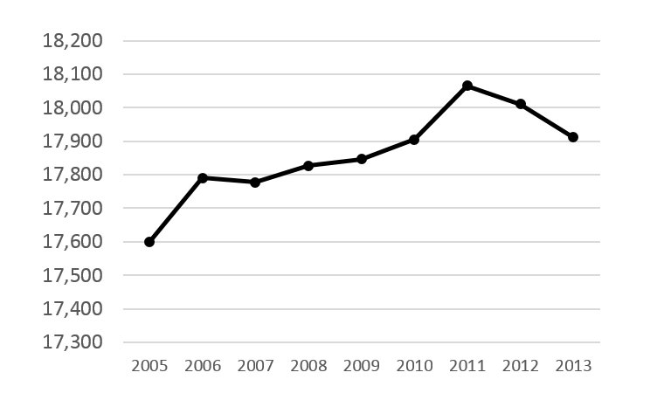
Floor area and people
Floor area（㎡）
Number of members
＋19,921㎡
（106％）
＋312
Source: Materials of the Chiba University Department of Facilities and Environment
Source: Materials of the Chiba University Environmental Report
Notes:
First, Energy and resource conservation effect
Look at these graphs. The university’s floor area and the number of its members are increased in 10 years.

Slide 11
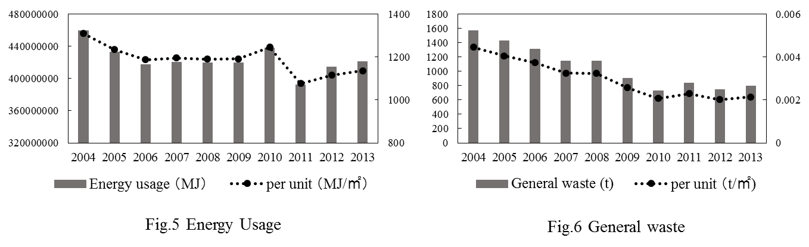
Total amount of energy decreased
-8% (-38, 247,109 MJ)
-13% (174 MJ/m²）
Source: Materials of the Chiba University Department of Facilities and Environment
Notes:
Despite this, the overall amount of energy input decreased. ●Moreover, energy consumption declined sharply over three years from the year of acquisition 2004, showing a direct impact from ISO.

Slide 12
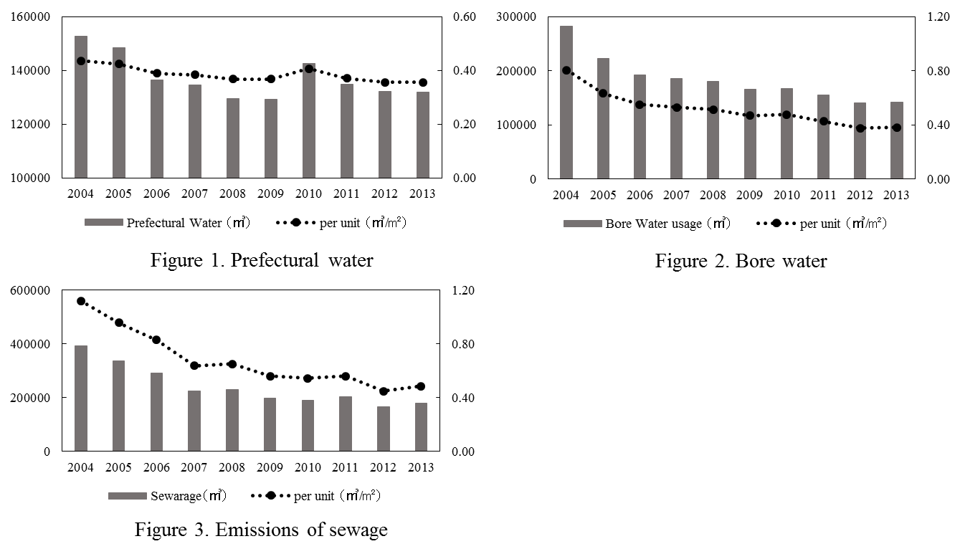
1. Energy and resource conservation effect
Tap water
-37% (-161,530m³)
Emissions of sewage
-54% (-212,324 m³)
Source: Materials of the Chiba University Department of Facilities and Environment
Notes:
Despite this, the overall amount of energy input decreased. ●Moreover, energy consumption declined sharply over three years from the year of acquisition 2004, showing a direct impact from ISO.

Slide 13
General waste decreased
-50% (-771t）
Source: Materials of the Chiba University Department of Facilities and Environment
Notes:
General waste was also significantly reduced.
Thus, in the case of Chiba University, the acquisition of ISO has had the effect of reducing energy usage, as well as reducing waste emission.

Slide 14
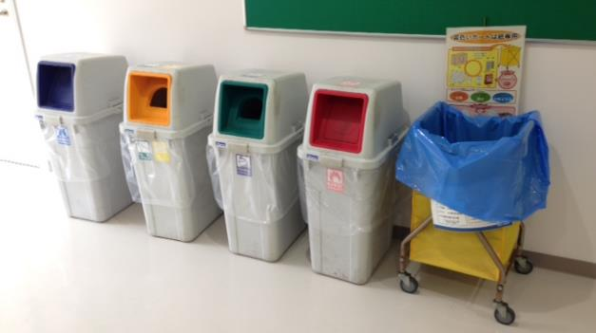
Waste separation・collection
Cans
Bottles
PET bottles
Combustible waste
→Collecting cost 28yen/kg
Resource recovery used paper →０yen/kg
Mix used paper →０yen/kg
Notes:
To reduce waste, various activities are held. For example abandoned bicycles, used book market, and make the compost by the fallen leaves.

Slide 15
The reason
The EMS continued.
It is supported by the students.
Incorporated into the curricula.
As a “practical education.”

Slide 16
3
Student-led EMS at Chiba University
Notes:
Next, I’ll talk about Student-led EMS “Chiba University Method” in detail.

Slide 17
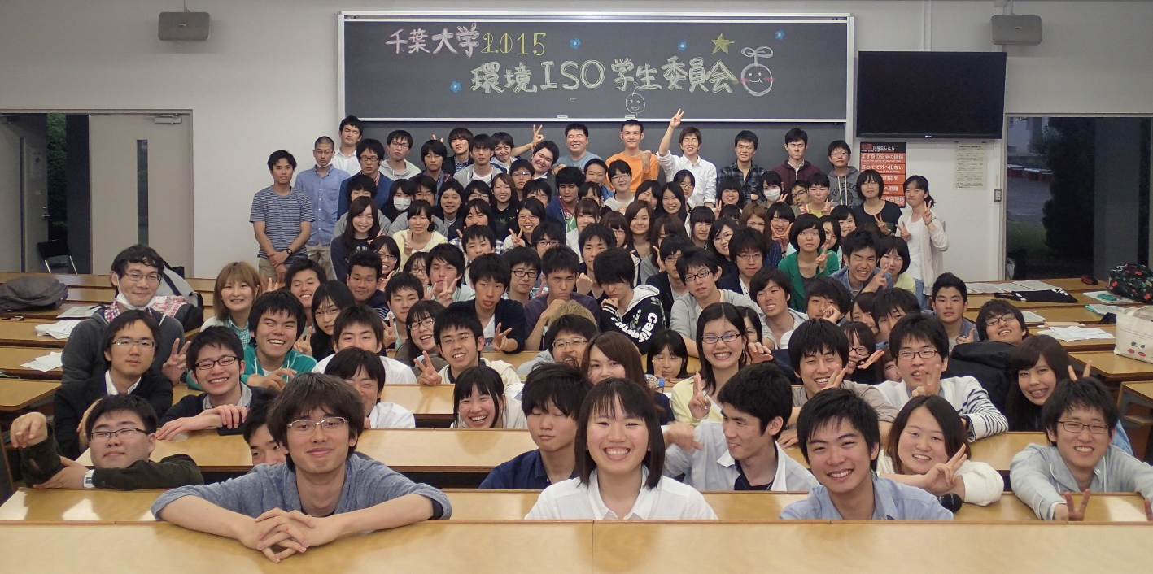
Student-led EMS
Environmental ISO Student Committee
Notes:
The Committee was established with 40 members. Now there are about 200.

Slide 18
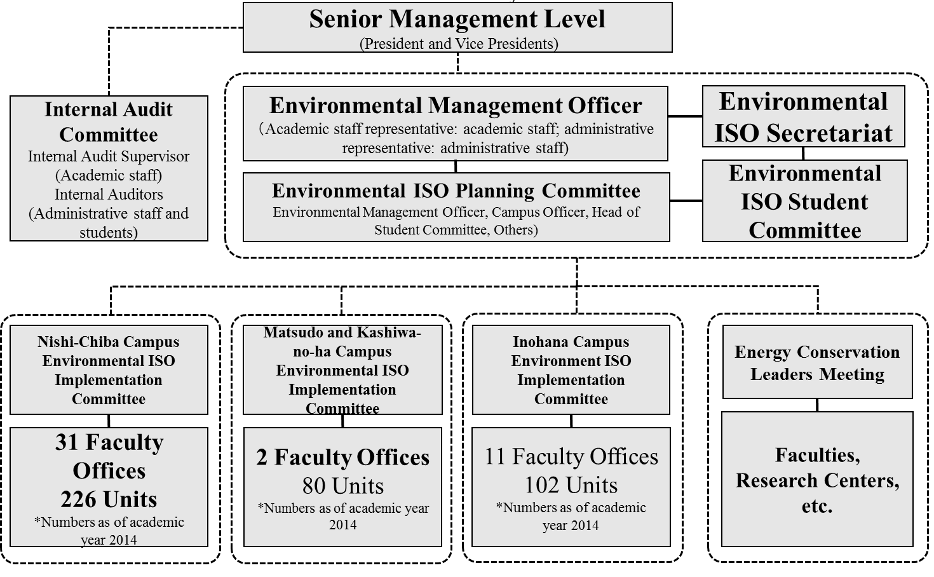
Three characteristics
① The positioning
Notes:
The Student Committee is not a student club but an organization of the university EMS operation framework. The Student Committee performs the duties of ●the ISO Secretariat as a “practicum” and also ●submits proposals and reports to the Planning Committee.

Slide 19
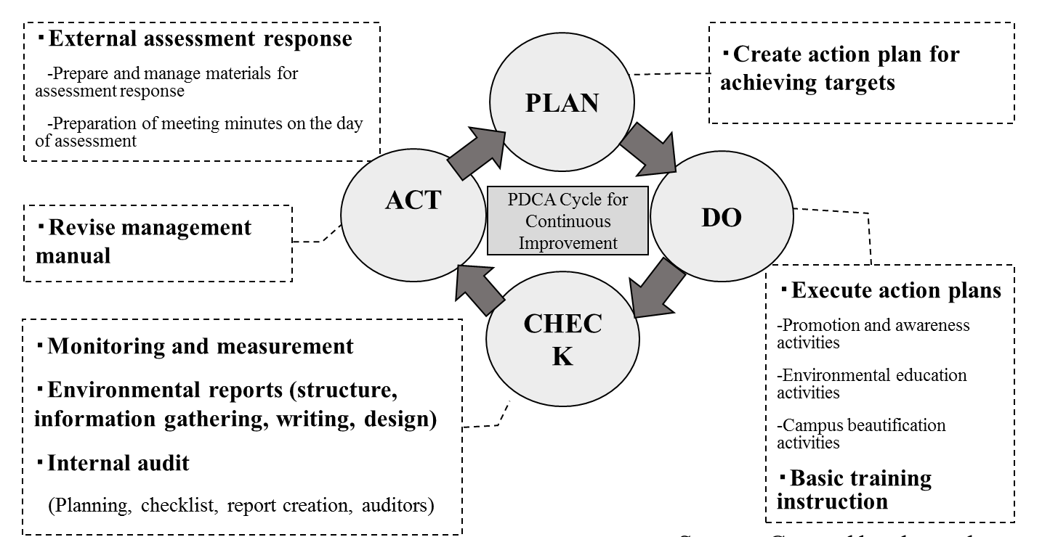
Three characteristics
②Tasks
The core of the EMS
Notes:
The Committee was established with 40 members. Now there are about 200.

Slide 20
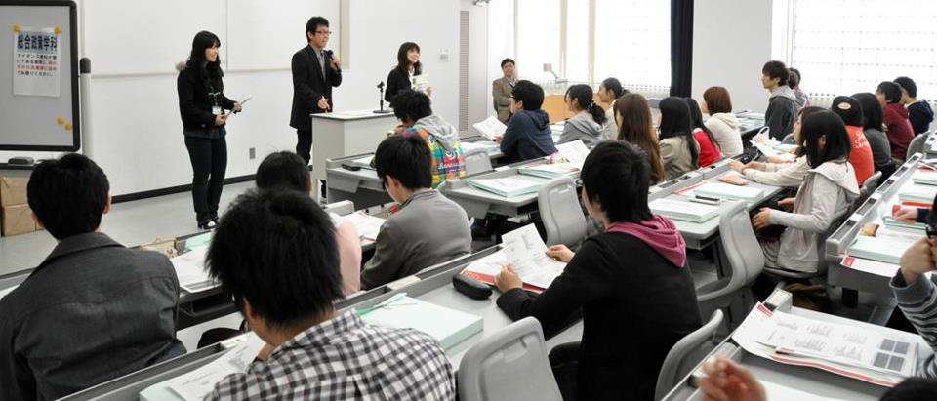
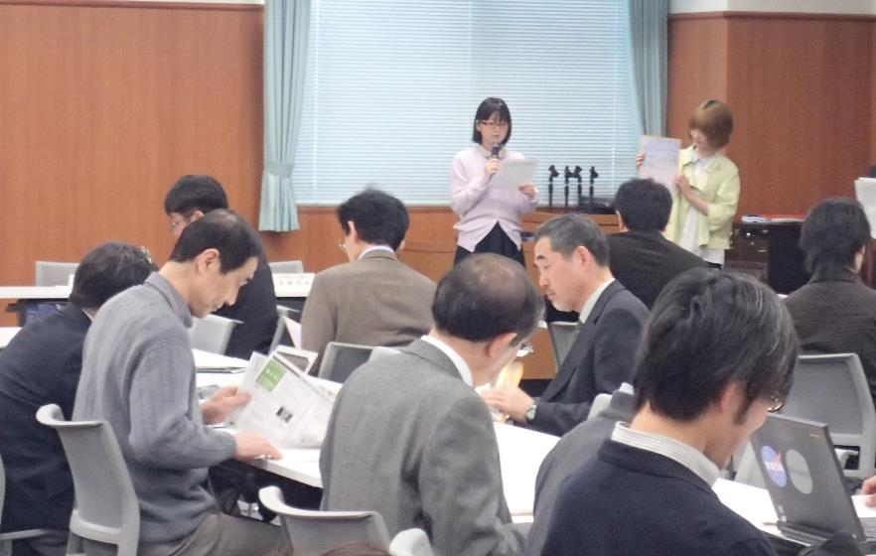
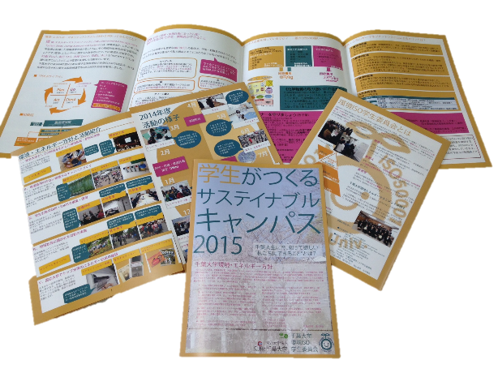
Basic training instructors
Environmental ISO knowledge training to be performed on all students, teachers and staff in every year in April.
Notes:
At the first student’s orientation and professors meeting of the academic year, the committee members serve as instructors for the training on the EMS.

Slide 21
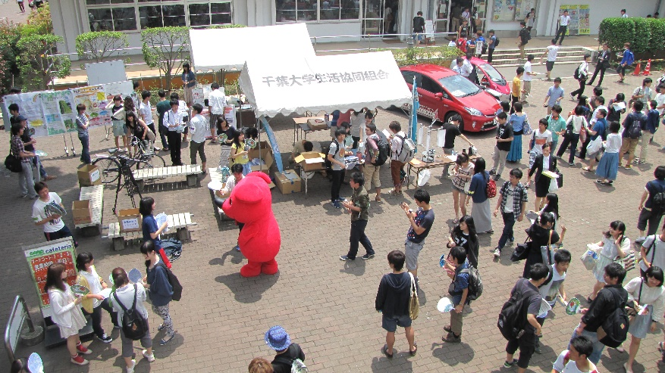
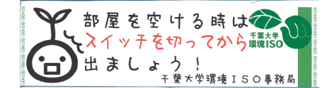
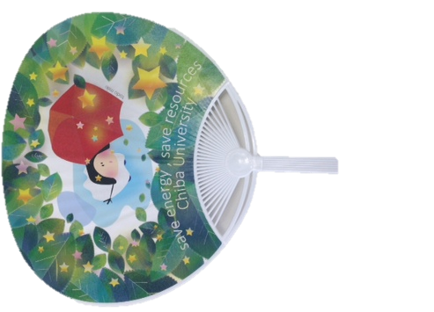
Promotion and awareness activities
Notes:
They post the posters and stickers or hold an events to raise awareness of saving energy and waste separation

Slide 22
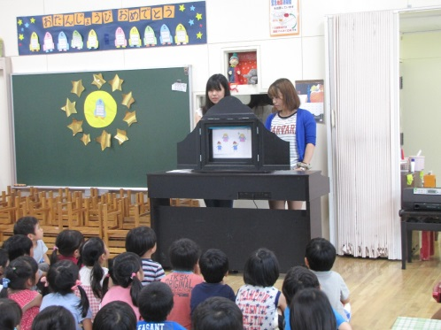
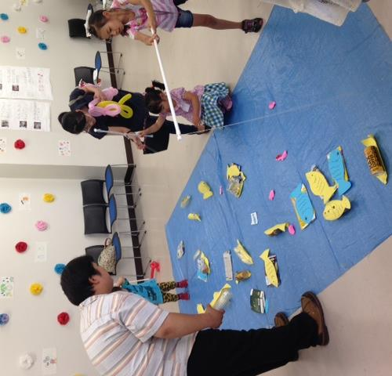
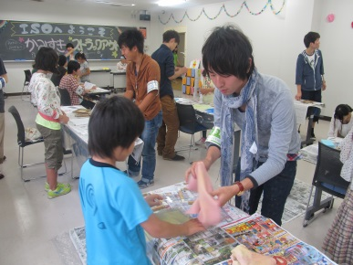
Environmental education activities
Notes:
They provide the environmental lessons or events for children at the kindergarten and elementary and junior high schools.

Slide 23
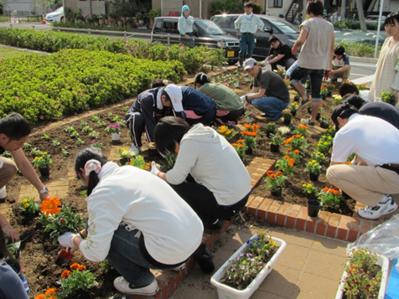
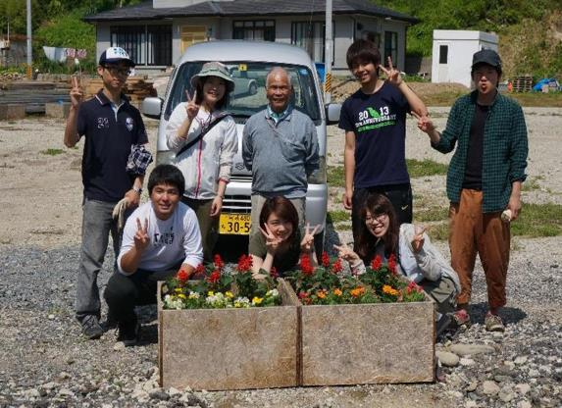
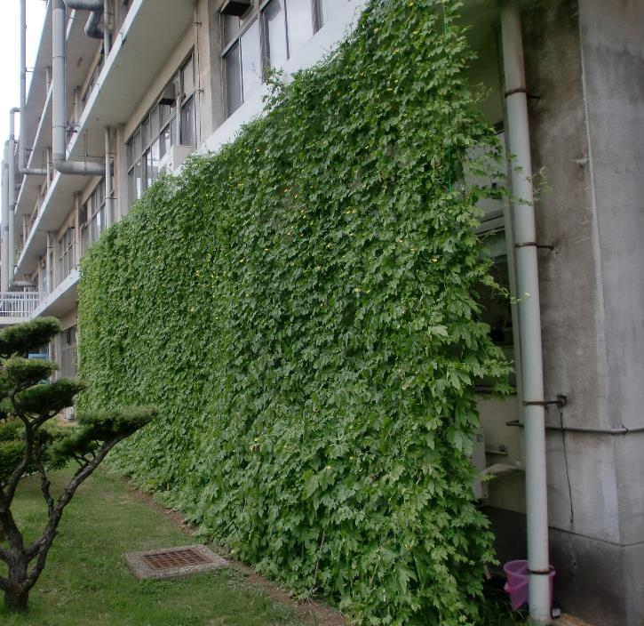
Greening and beautification activities
Community Garden
Green curtains
Support the affected areas of the Great East Japan Earthquake
Notes:
Student committee and local residents sometimes plant flowers together.
Student make green curtains.
Since 2011, students in faculty of Horticulture have supported the people in the affected areas of the Great East Japan Earthquake by planting flowers.

Slide 24
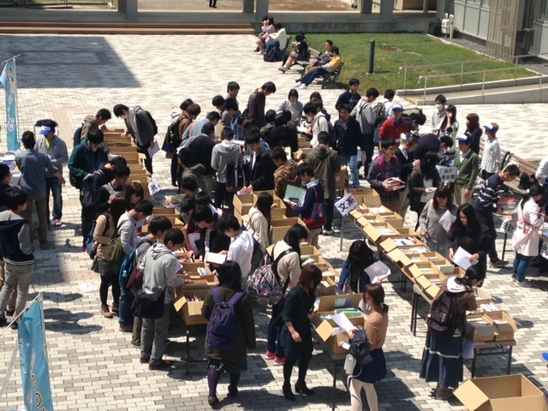
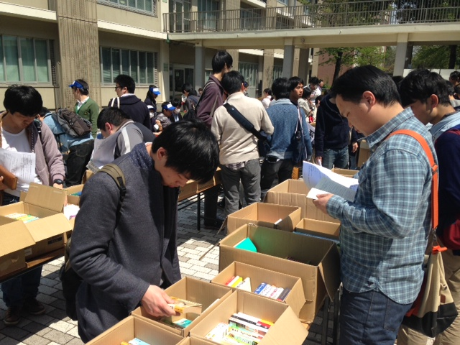
Waste reduction
～The used book market
Holding the used book market on campus every year.
In 2015
About 2,000 books collected
About 600 books sold
About 500 people came the market
Notes:
About three years ago, the student committee launches new event., the used book market. The size of the market grows every year. This year this market is reported nationally on the Asahi newspaper, on of the major newspapers in Japan.

Slide 25
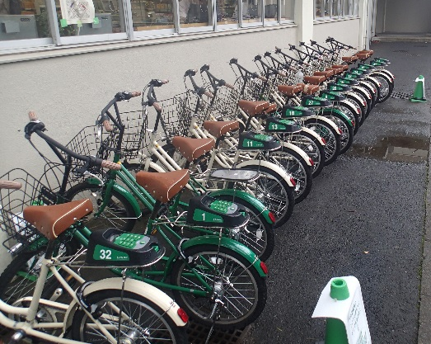
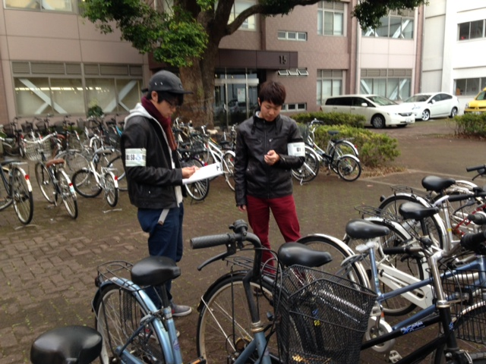
Waste reduction
～Reduction of abandoned bicycles
・Investigating of bicycle number
・Receiving a bicycle from graduates and to transfer to foreign students after repair
・Promotion of utilization of bicycle-sharing system on campus
Notes:
In Nishi-chiba campus, we have a lot of bicycles. We decided to reduce the number of bicycles in the campus, so introduced share-cycle system, collaborated with a private share cycle company, COGOO..

Slide 26
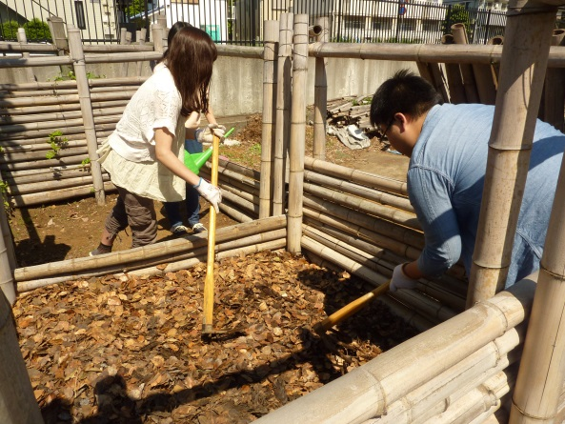
Waste reduction
～Conposting
Composting fallen leaves and garbage of cafeteria on campus.
Distribution of compost to local residents.
Notes:
We also have many trees in campus. To reduce and utilize the fallen leaves, we gather and compost them. And the fertilizer made from fallen leaves are distributed to local residents. It is named keyaki-no-ko, children of Zelkova tree.

Slide 27
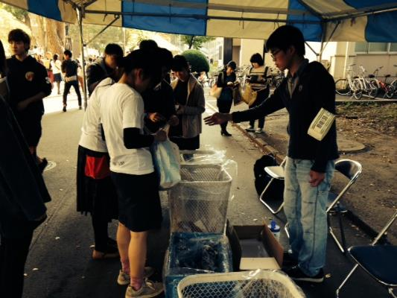
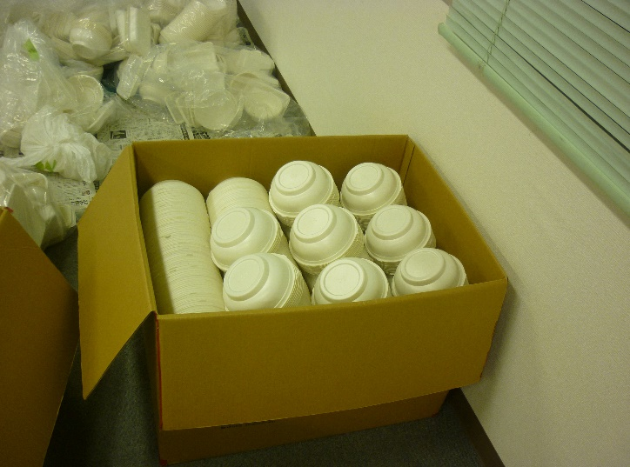
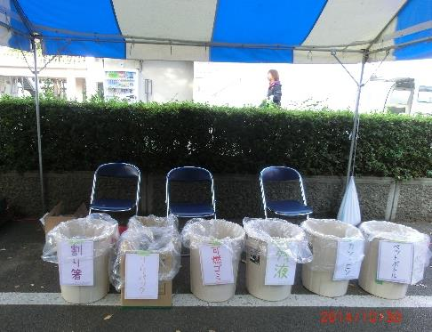
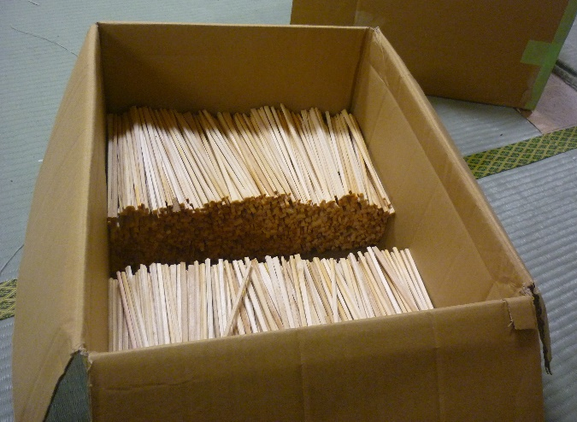
Waste reduction
～University festival
・Separation guidance of garbage
・Recovery of recycling container
・Cleaning and recycling of disposable chopsticks
Notes:
At the University festival in November, the committee members lead the waste separation activities and recyling..

Slide 28
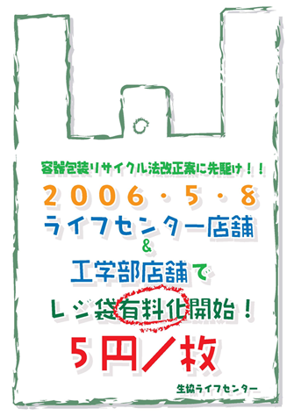
Waste reduction
~Reduction of Package Waste
Charging for plastic bags at the co-op shops 5 JPY per bag
Environmental Fund: the co-op provides price(300,000JPY) which was supposed to buy the plastic bag and plastic bag charge(about 50,000JPY) to the Chiba University every year.
Fund used to make Eco goods.
Plastic Bag Rejection Rate is 99.4% （1 million or more bags）
Notes:
This is a typical student-led project.
The students realized to charge plastic bags of Chiba University’s co-op in 2006.
Then they made an Environmental Fund from the charge and use it to make Eco goods every year.
Now Chiba University’s Plastic Bag Rejection Rate is 99.4%

Slide 29
Three characteristics
②Tasks
Notes:
●Next, I’ll explain students operations in the Check section.

Slide 30
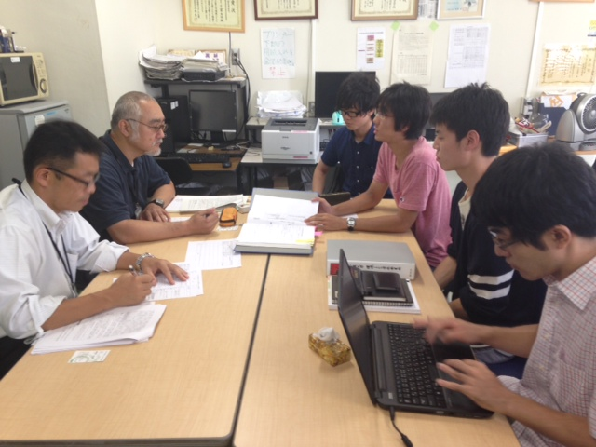
Internal audits
・Prepare the plan, checklist and report
・Team up with teaching staff and serve as auditors
・Student committee is audited by the teaching staff.
Notes:
For the internal audit of EMS operations in each section, they prepare the plan, checklist and report. They also team up with teaching staff on the day of the audit and serve as auditors.

Slide 31
Three characteristics
②Tasks
Notes:
●In ACT section, when the Environmental Management Manual requires revisions, students prepare the draft proposals.
●Other, at the external assessment

Slide 32
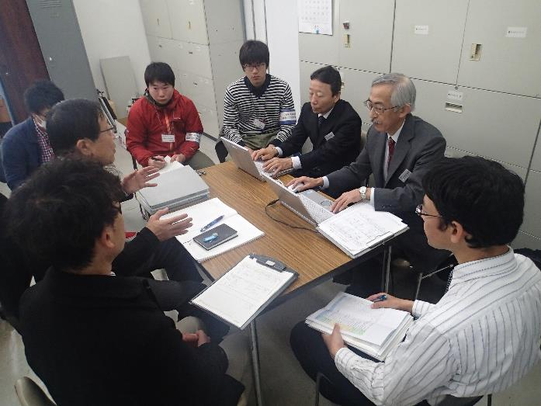
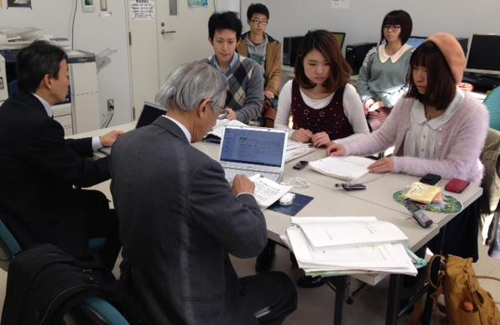
External assessment
・Prepare the required documents.
・Create a record of the proceedings.
・Also student committee is the subject of assessment.
Notes:
Students prepare the documents for external assessment. They also accompany the assessors and create a record of the proceedings.

Slide 33
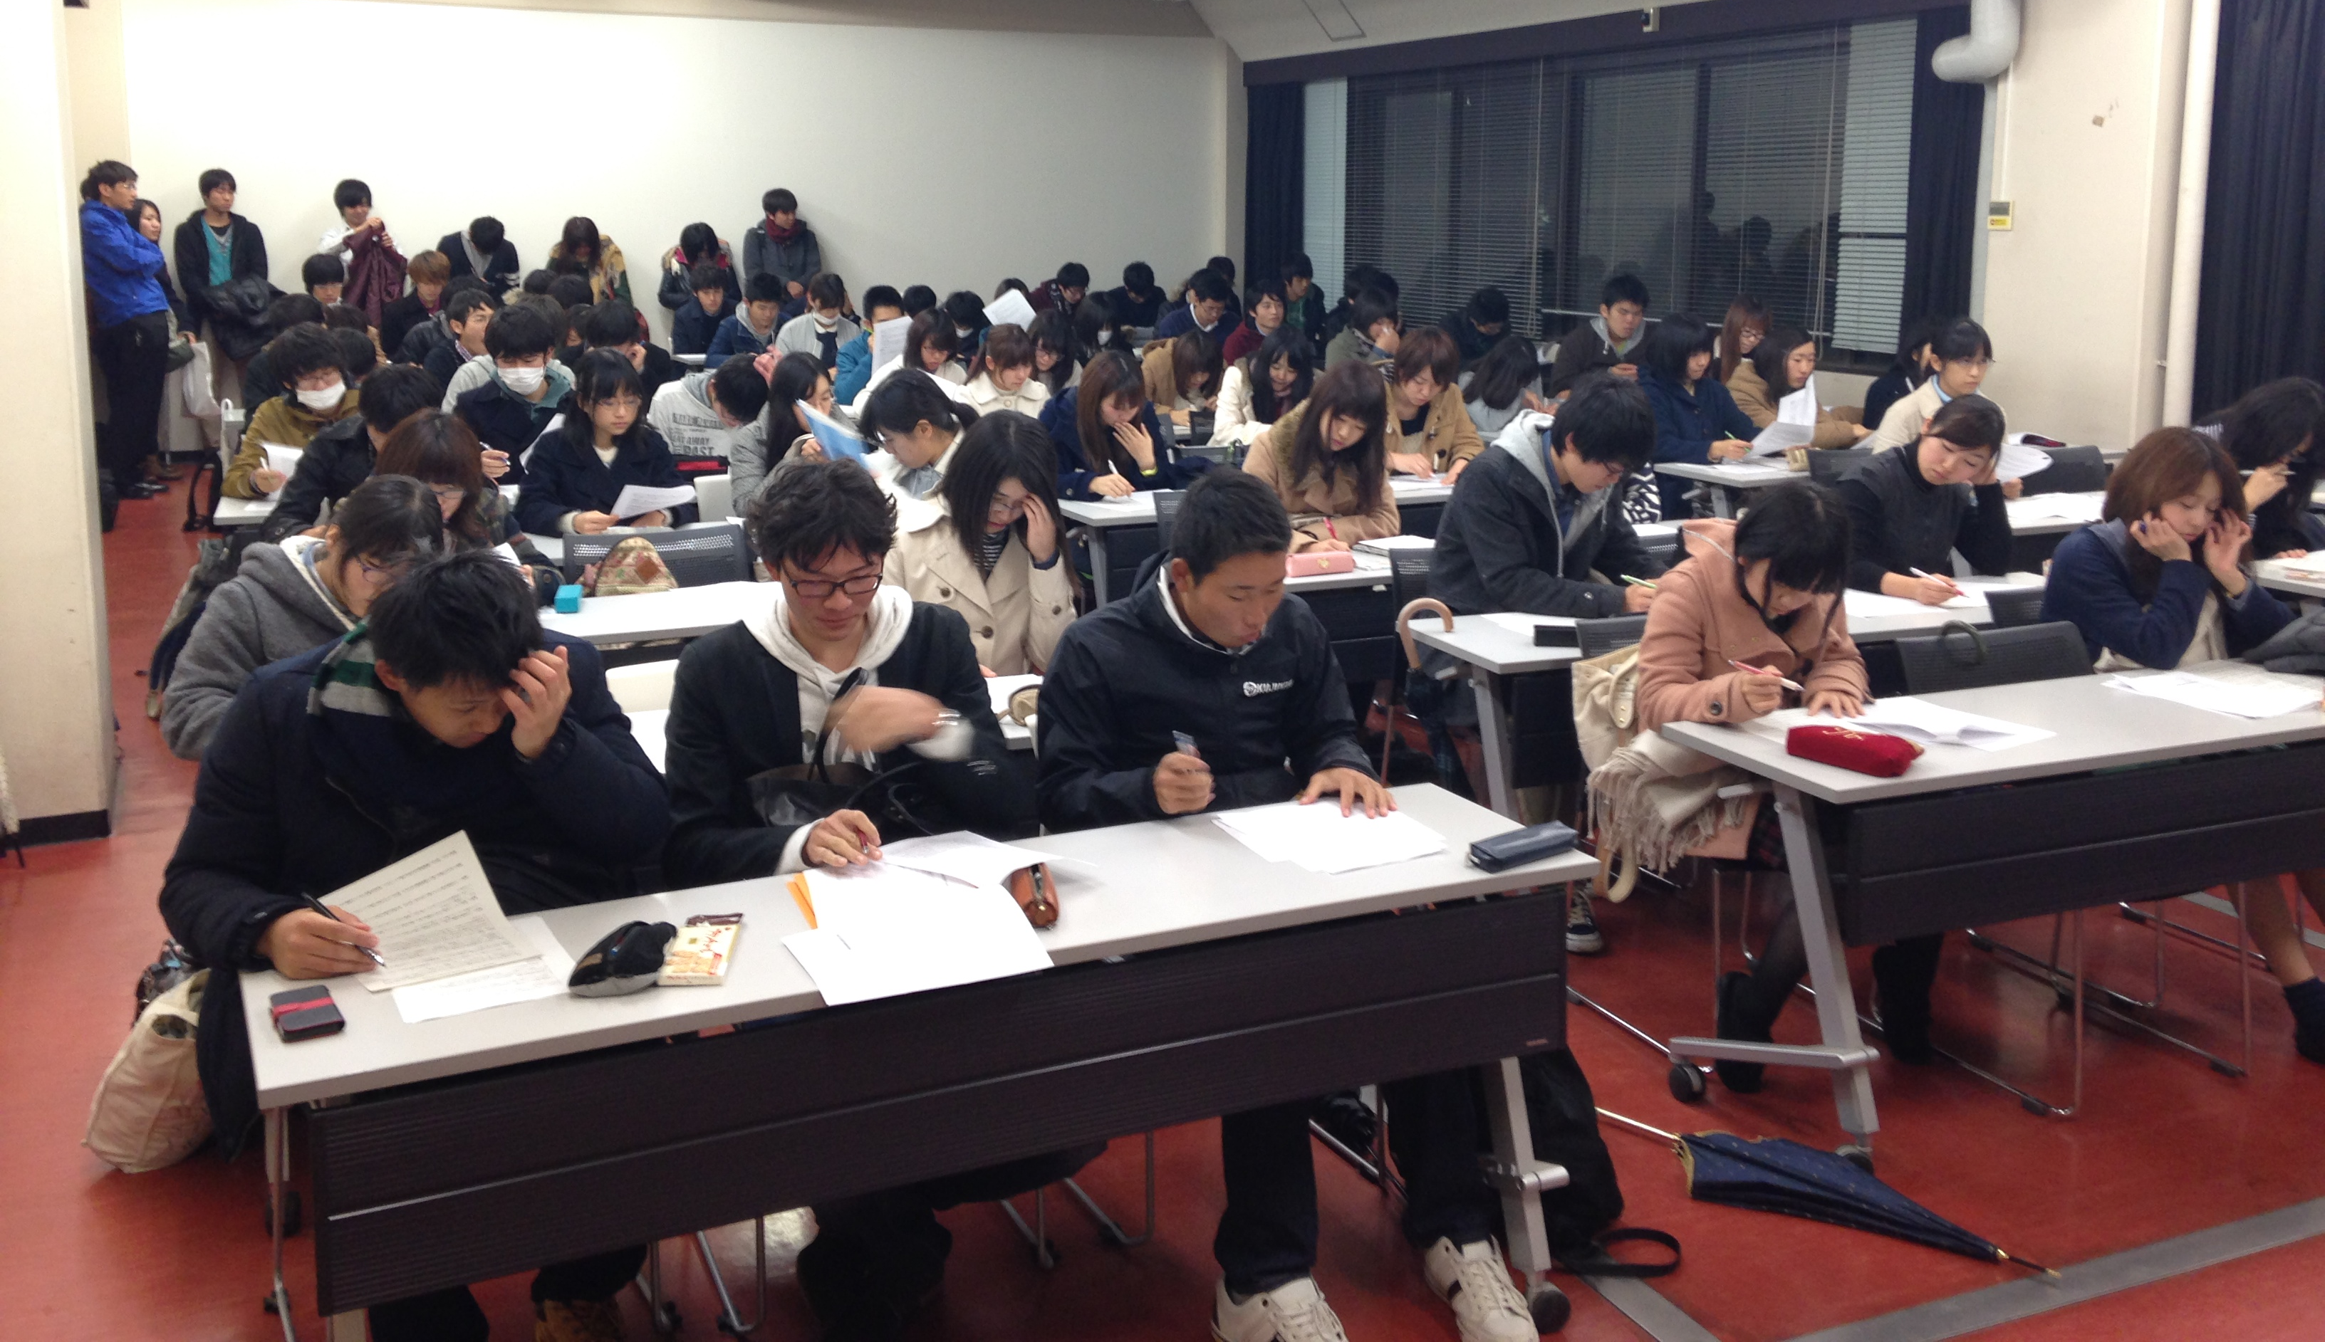
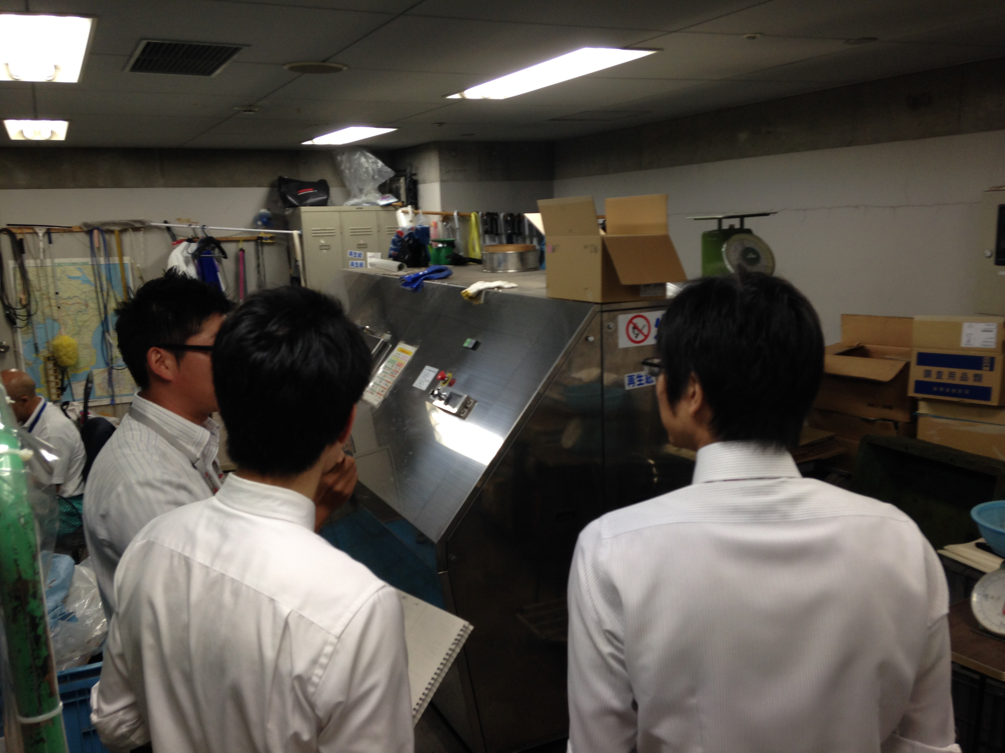
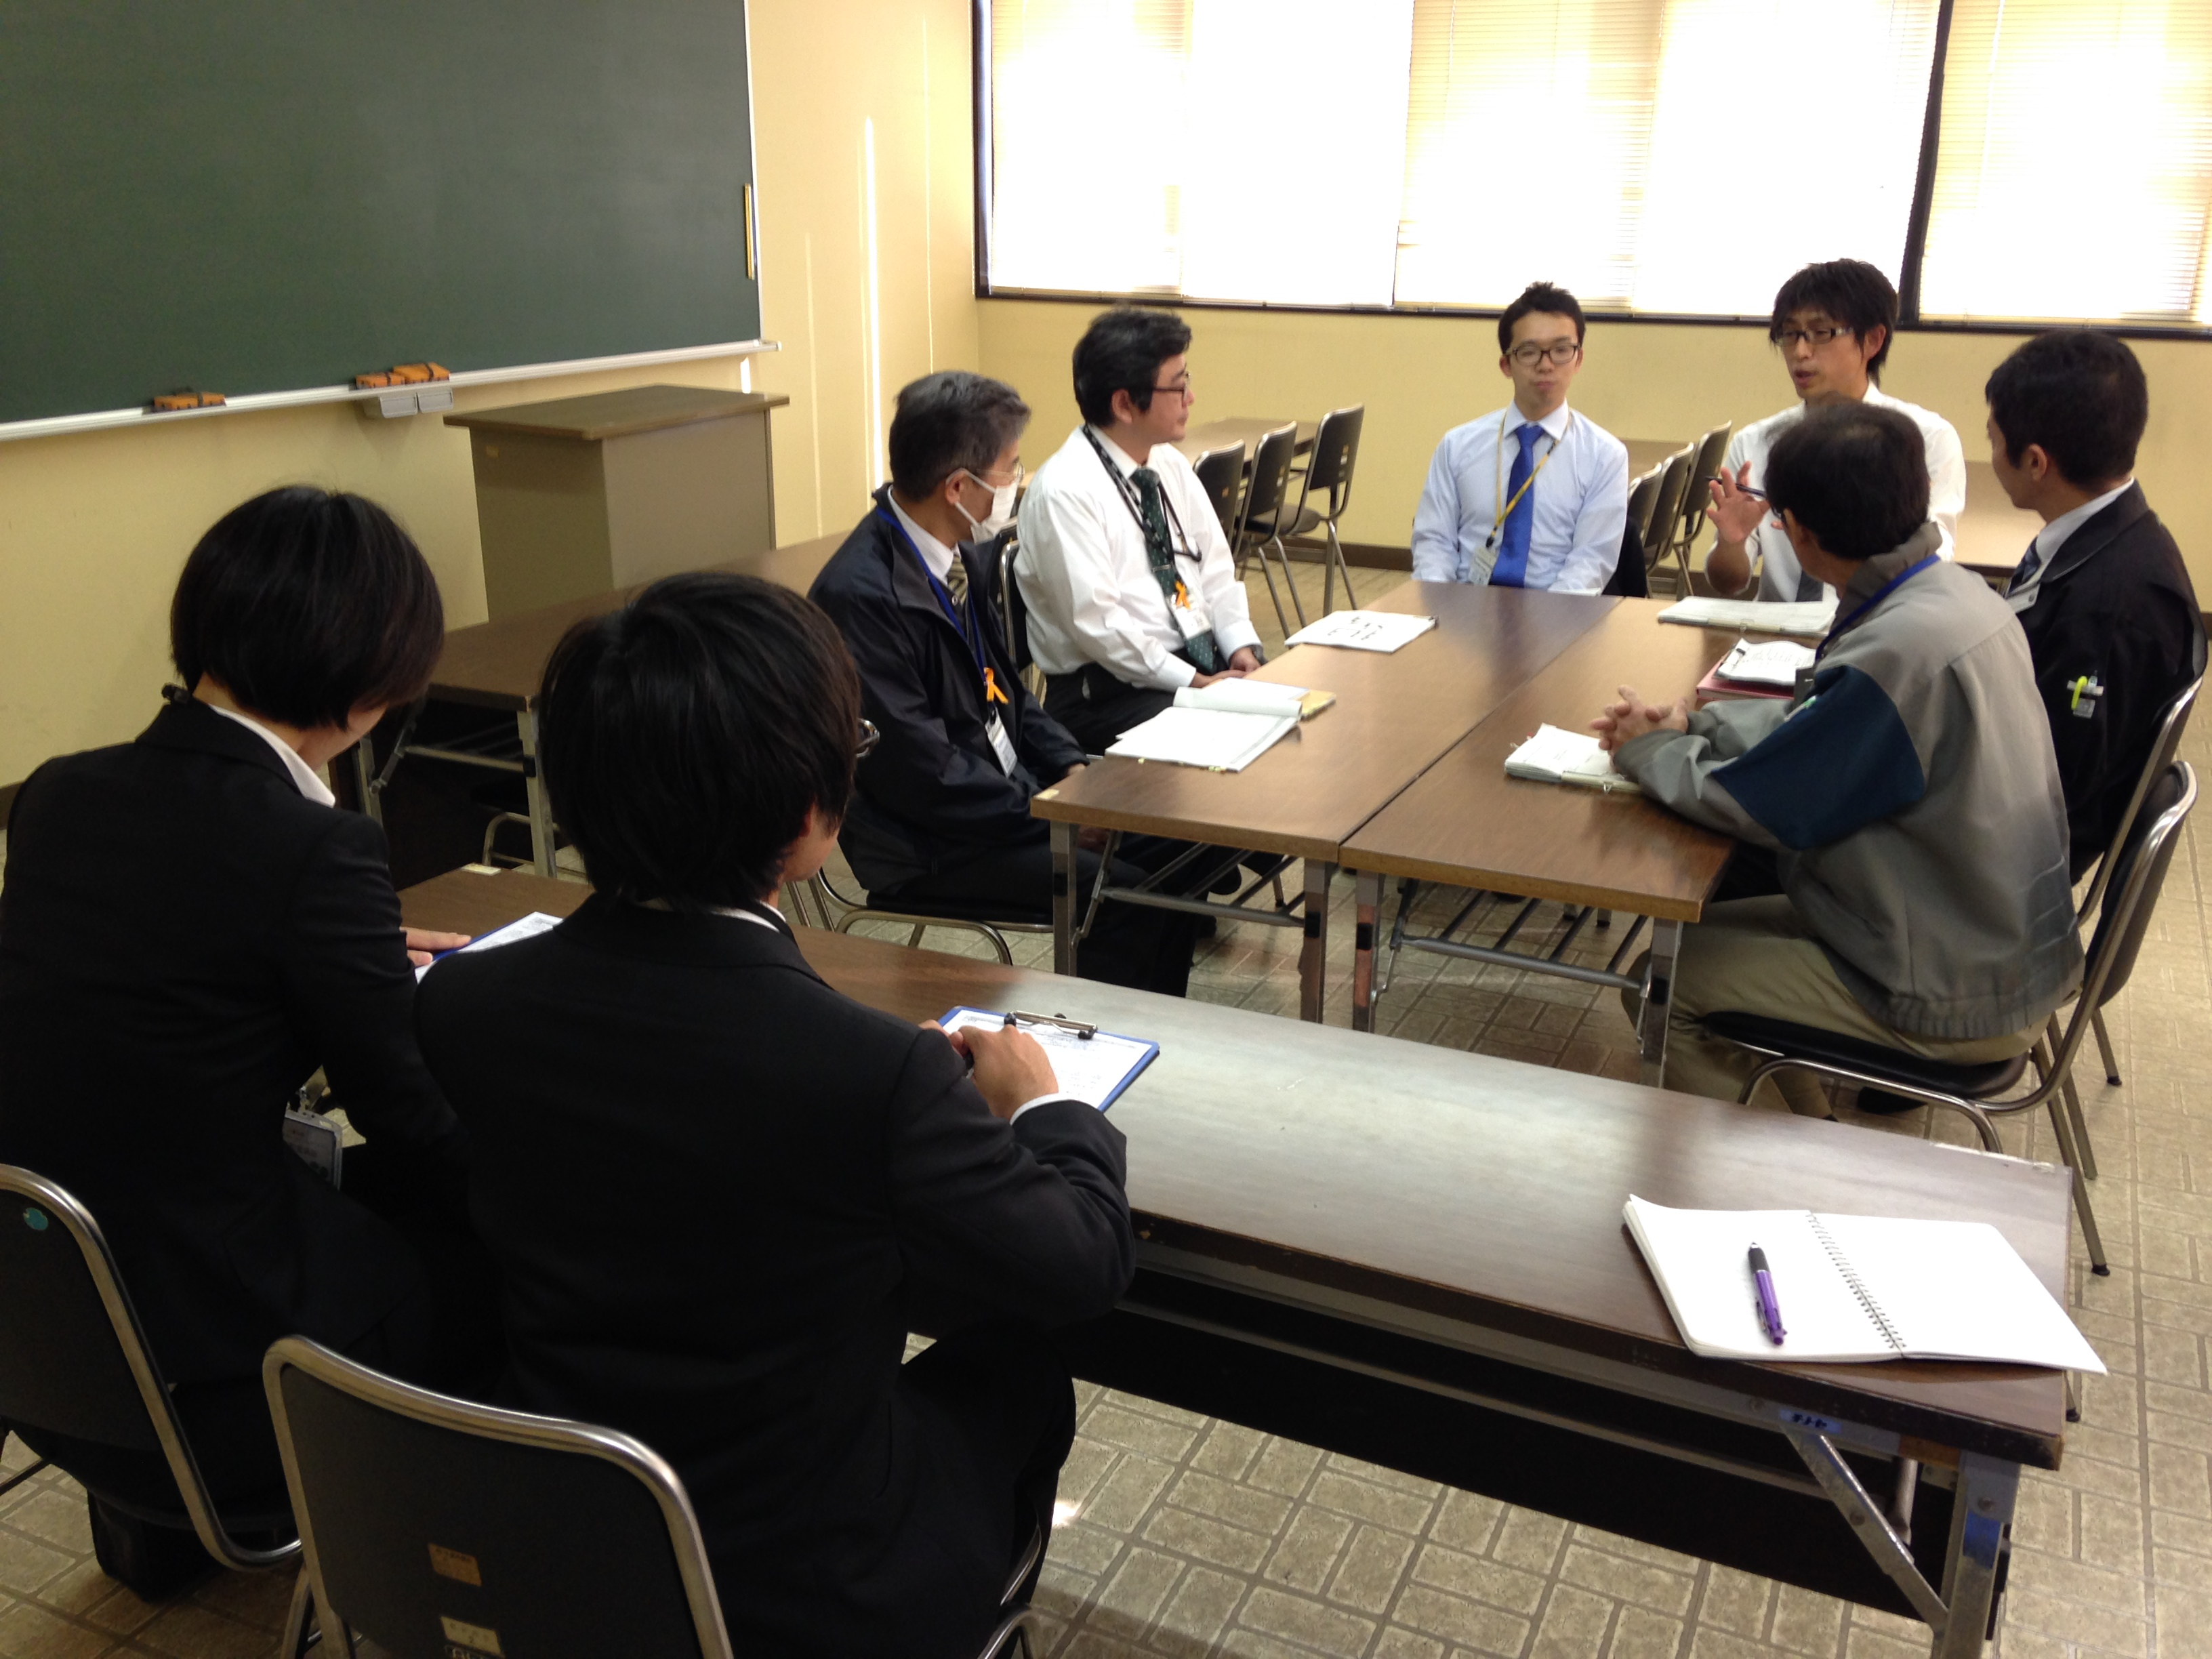
Three characteristics
③Accreditation and qualification
Job hunting, etc.
Internship subjects
Practicum III
(Mainly 3rd year undergraduates)
Student Committee Executive
(Mainly 3rd year undergraduates)
Practicum I holders only
…Team activity (mainly team leader) and EMS basic operations
EMS Practicum II
(Mainly 2nd year undergraduates)
Open to all undergraduates
…Acquire basic knowledge and expertise through participation in internal EMS activities; participation in team activities.
EMS Practicum I
(Mainly 1st year undergraduates)
Notes:
Chiba University considers the construction and operation of the EMS as an opportunity for students’ practical education. The activities are treated as credit of the course.
●First, the course “Environment Management System Practicum I” is for freshman. These students acquire an understanding of the EMS, as well as knowledge of trial internal audits and so on. They also participate in team activities with senior students. All students who attend Practicum I become members of the Student Committee.
●In “Practicum II,” students who have passed Practicum I become Team Leaders and lead several members in various activities. They also do basic training instructor, internal auditor, and record keeper of the external assessment.
●The third year course “Practicum III” includes a five-day internship component where students demonstrate the knowledge and experience they have acquired over two years in an external organization or local government.

Slide 34
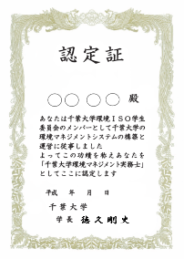
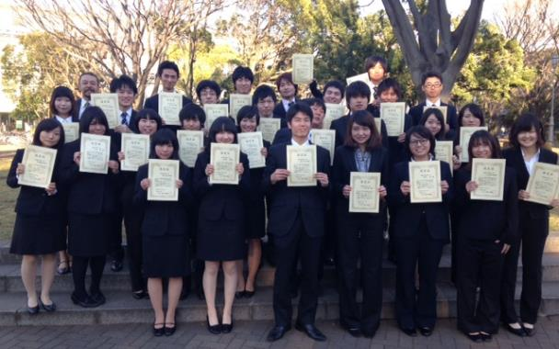
Three characteristics
③Accreditation and qualification
Job hunting, etc.
Practicum III
(Mainly 3rd year undergraduates)
Student Committee Executive
(Mainly 3rd year undergraduates)
“Chiba University Environment and Energy Management Practitioner” qualification
EMS Practicum II
(Mainly 2nd year undergraduates)
EMS Practicum I
(Mainly 1st year undergraduates)
Notes:
Then students who have contributed to the university’s EMS for 3 years, are conferred the university’s internal qualification “Chiba University Environment and Energy Management Practitioner” by the university president. This qualification may be entered on job application forms.

Slide 35
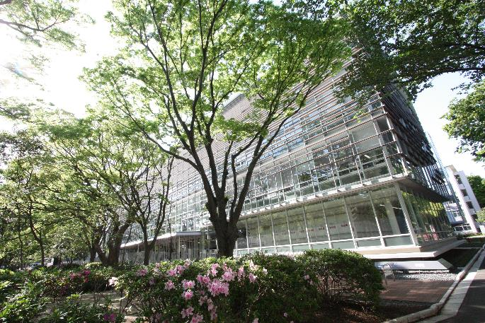
4
Results after 10 Years of Chiba University’s Student-led EMS
Notes:
The last part is “Results after 10 Years of Student-led EMS”

Slide 36
3 effects of student-led EMS
Energy and resource conservation
External evaluation
Educational effect on students
Notes:
Chiba University has seen three main effects.

Slide 37
3 effects of student-led EMS
Energy and resource conservation
External evaluation
Educational effect on students
Notes:
Chiba University has seen three main effects.

Slide 38
3 effects of student-led EMS
~External evaluation
Reference
Media exposure
Awards
Notes:
Since Chiba University acquired ISO, it has received inquiries and requests from other universities throughout Japan and overseas for observing “Chiba University Method”.
Mie University and Iwate University constructed and implemented an EMS based on Chiba University’s approach to acquire ISO in 2007 and 2010.
And Chiba University has received various awards for these 10 years
Since 2003, Chiba University has been featured in the media several times every year.
In light of these results, the external impact of Chiba University’s student-led EMS deserves recognition.

Slide 39
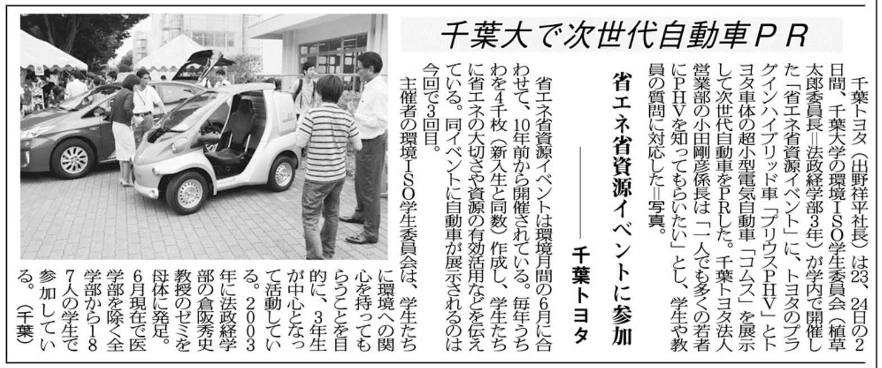
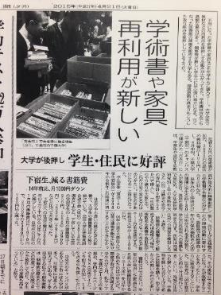
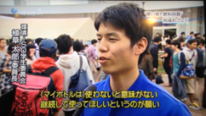
3.External evaluation of Chiba University ~ Media exposure

Slide 40


Slide 41

3 effects of student-led EMS
~External evaluation
Reference
Media exposure
Awards
Notes:
Since Chiba University acquired ISO, it has received inquiries and requests from other universities throughout Japan and overseas for observing “Chiba University Method”.
Mie University and Iwate University constructed and implemented an EMS based on Chiba University’s approach to acquire ISO in 2007 and 2010.
And Chiba University has received various awards for these 10 years
Since 2003, Chiba University has been featured in the media several times every year.
In light of these results, the external impact of Chiba University’s student-led EMS deserves recognition.

Slide 42
3 effects of student-led EMS
~Educational effect on students
Energy and resource conservation
External evaluation
Educational effect on students
Notes:
Since Chiba University acquired ISO, it has received inquiries and requests from other universities throughout Japan and overseas for observing “Chiba University Method”.
Mie University and Iwate University constructed and implemented an EMS based on Chiba University’s approach to acquire ISO in 2007 and 2010.
And Chiba University has received various awards for these 10 years
Since 2003, Chiba University has been featured in the media several times every year.
In light of these results, the external impact of Chiba University’s student-led EMS deserves recognition.

Slide 43
Questionnaire survey to alumni of Practitioner
Time : July-September 2014
Subject : alumni who have graduated from the environment ISO student committee
Method : WEB
Number of respondents : 112 people
Respondents breakdown : working people 85 people
Notes:
In 2014, I did a questionnaire survey to 85 alumni, who hold the qualification and now work in the community.

Slide 44

3 effects of student-led EMS
~Educational effect on students
Were Student Committee Activities Helpful in Your Career?
Students who found it helpful
81.2%
Notes:
More than 80% said Student Committee Activities were helpful in their career.

Slide 45

3 effects of student-led EMS
~Educational effect on students
What specific experiences were helpful?
Notes:
Further, when the respondents who replied in the affirmative were asked “What specific experiences were helpful?,” about half of them responded that the experience of “document creation”, “exchanges with teaching staff and external people”, “operating an organization”, and “chairing meetings” were useful when they started their working lives.

Slide 46
Conclusion
Effects of student-led EMS
Reduction of its energy consumption and waste emissions
Raising its positive external assessments
Generating practical educational effects for the students
Notes:
As I have explained so far, the student-led EMS at Chiba University not only led to the reduction of energy usage and waste emission but also improved the university’s external evaluation and generated practical education effects for the students.
So, “Chiba University method” and its effects are the reasons why Chiba University have continued the ISO for 10 years.

Slide 47
Thank you ありがとう！
Terima kasih
Notes:
That’s all. Thank you for your attention.

