Slide 1
SUSTAINABLE INITIATIVES TO IMPROVE HIGHER EDUCATION PERFORMANCE
By:
Prof. Dr. Werry Darta Taifur
Faculty of Economics
Andalas University
The 2th International Workshop on UI GreenMetric
The Margo Hotel Depok, West Java
Indonesia, 21 April 2016

Slide 2
Outline
Introduction
Developing Campus Sustainability Plan
Establishing Control Mechanism
Implementation
Taking Bold Act to Save Campus
Involving Many Stakeholder in the Greeting of Campus.
Proposed Assessment
Closing

Slide 3
1. Introduction
Established in September 13th 1956, Andalas University is the first and the oldest Indonesian public university ever established outside Java
The University's main campus of 500 hectares is located about 12 km East of Padang, the capital of West Sumatera Province, Indonesia

Slide 4
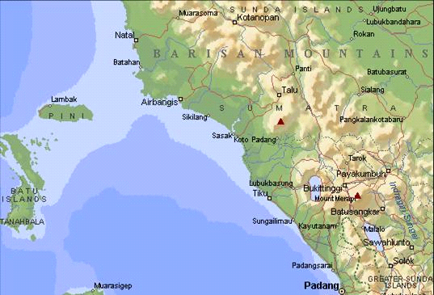
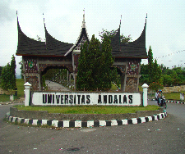
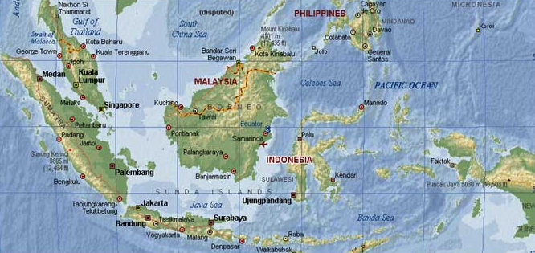
LOCATION OF ANDALAS UNIVERSITY

Slide 5
Higher education institutions in Indonesia can be divided based on location and the legal status
In term of location:
Java
Outside Java
In term of the legal status (only state universities):
Autonomous Universities (PTN BH)
Public Service Universities (PTN BLU)
Regular Universities (PTN Reguler)

Slide 6
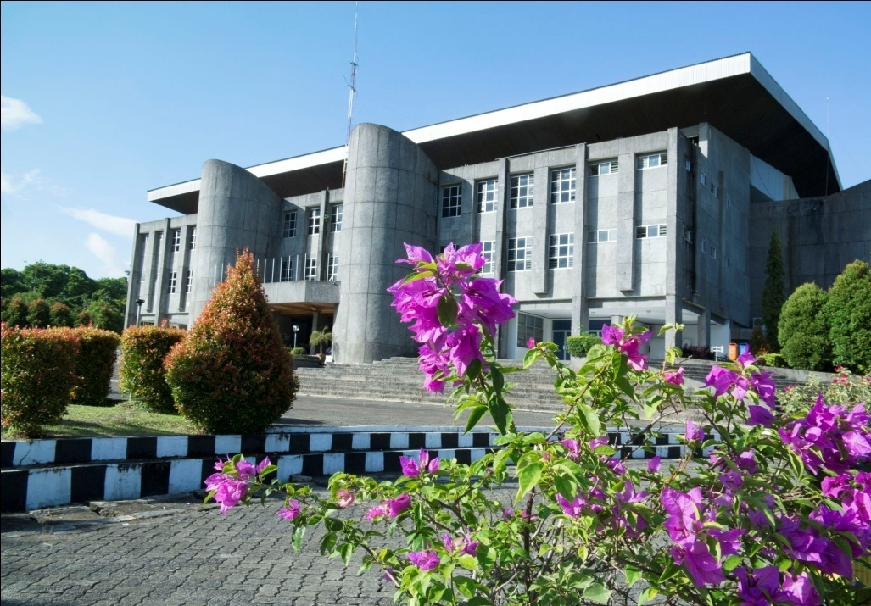
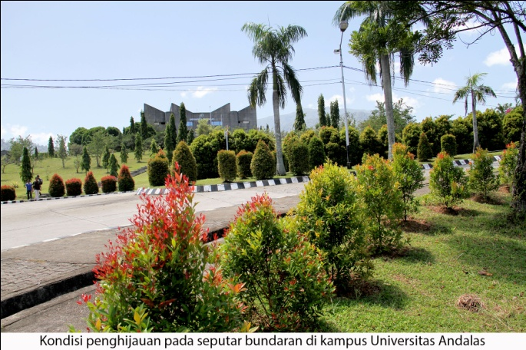
Ten top universities such as UI, ITB, IPB, UGM, Airlangga University and others are entirely in Java.
Hasanuddin University and Andalas University are the universities outside Java succeeding in reaching 11th and 12th ranking out of more 3,666 universities across the country
In term of national accreditation, publications, only Hasanuddin University, Andalas University, Syiah Kuala University outside Java have hold A accreditation.

Slide 7
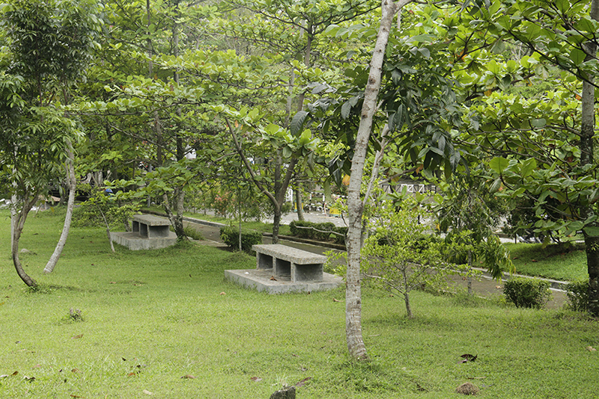
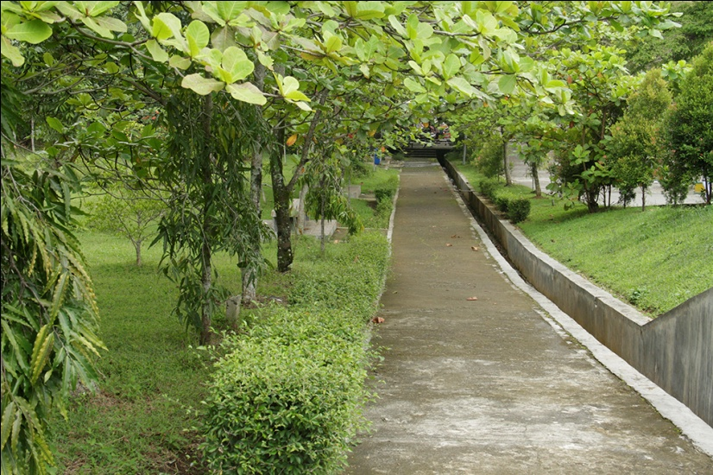
Regarding UI Green Metric rating, on Andalas University got the top in Indonesia in 2014 and tool 7th ranking in 2015
Up to 2015, only Hasanuddin University and Andalas University represented universities outside Java able to show good performance consistently.
It should be remembered that the Andalas University’s infrastructures suffered heavy due to an earthquake on September 2009

Slide 8
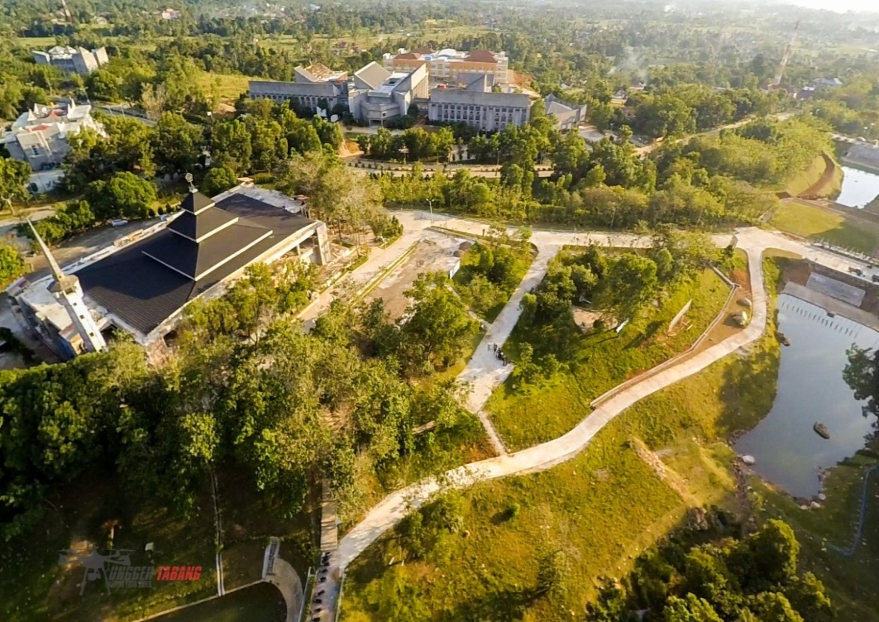
Andalas University has struggled harder then University of Hasanuddin to reach present performance.
Focus on some aspects that affect the progress of Andalas University progress during 2011-2015 period and
Proved necessary inputs into better the rating of UI Green Metric based on Andalas University experiences

Slide 9
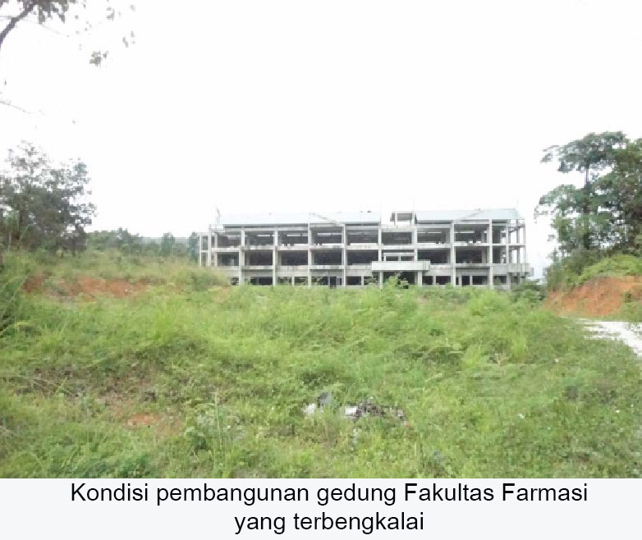
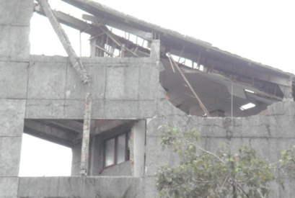
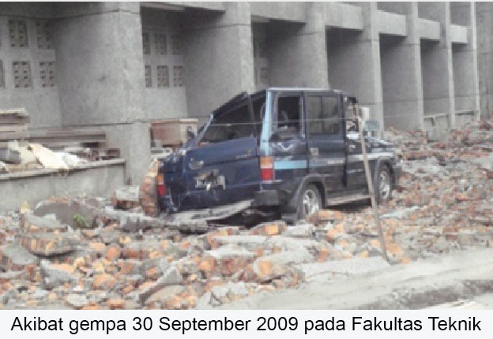
Andalas University Before 2011

Slide 10
Let’s see the Andalas University from Aerial

Slide 11
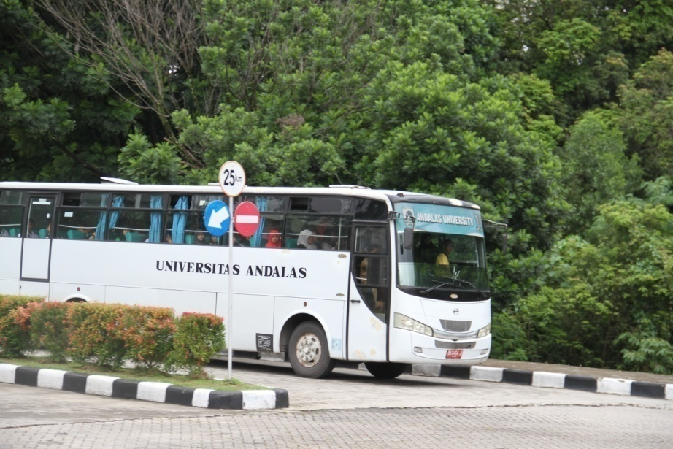
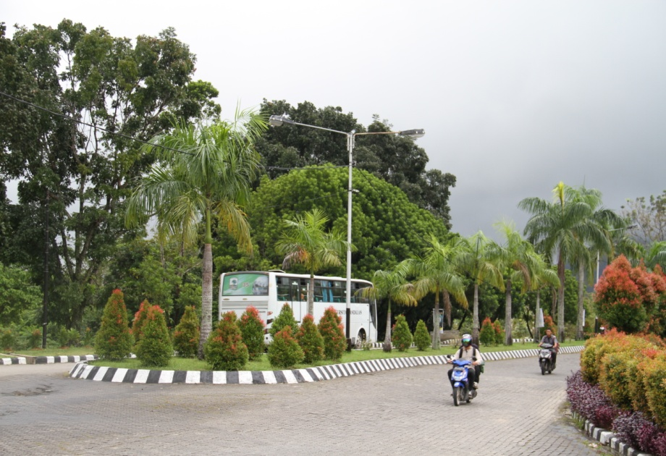
2. Developing Campus Sustainablity Plan
Prepare all document planning to consummate its vision as a excellent and dignified university (2009-2028)
Anticipating the needs and standards of the future campus
On all planning documents confirm that Andalas University is green campus

Slide 12
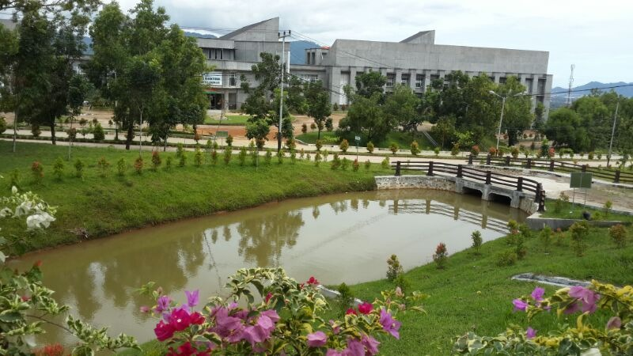
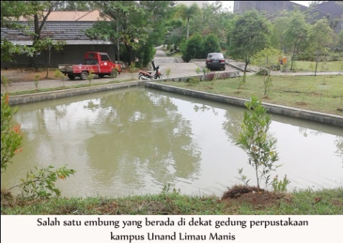
In an attempt to achieve this objective, various policies, program, activities, events have been formulated on planning documents.
Including agenda related to sustainable development compatible with guide books of UI Green Metric issued in 2010
Andalas University has a clear agenda on sustainable development.
This factor contributes to the success of Andalas University in taking fourth ranking of UI Green Metric

Slide 13
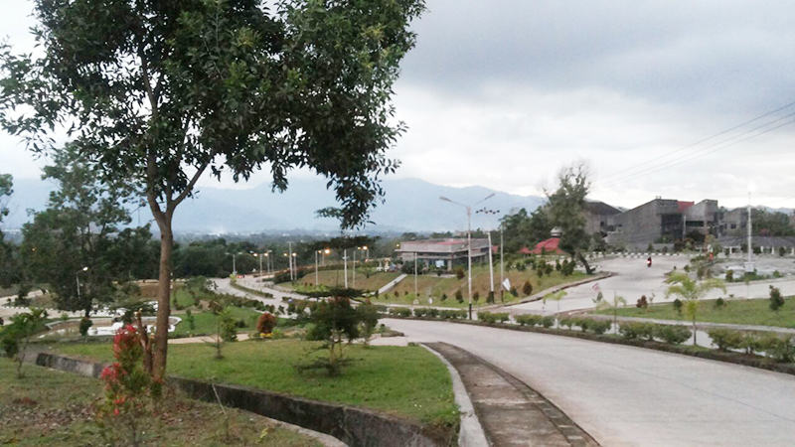
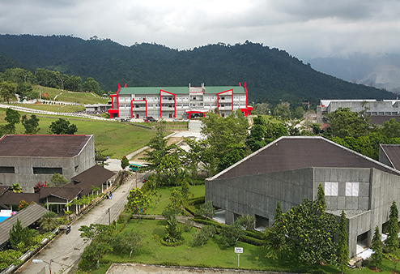
3. Establishing Control Mechanism
There is no guarantee that good planning on sustainable development will be run under budgetary constraint faced by university.
Rector has to establish control mechanism to ensure all program and activities related to sustainable development be implemented at a fixed time

Slide 14
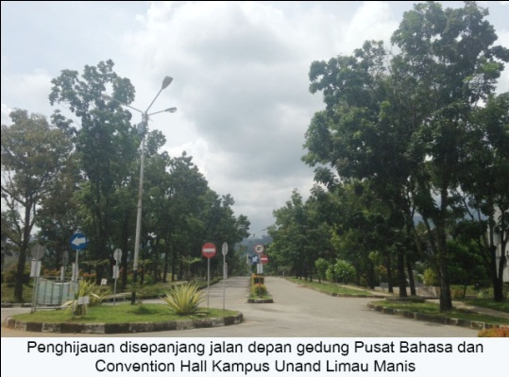
Andalas University had had the control mechanism to ensure that each unit of work is able to implement the programs truly relevant to realize its vision since 2011

Slide 15
4. Implementation
Various stages of university development in Indonesia
Universities which are equivalent to Andalas University‘s stage development, the rector can not just rely on his staff report or simply sit in the office.
Rector needs to make impromptu visit around the campus
It is still necessary, because not all system have been running well

Slide 16
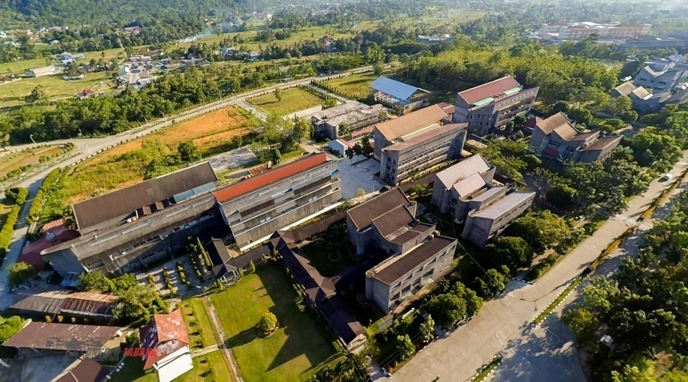
Diadakan workshop hasil audit internal dengan menghadirkan semua Ketua Prodi, Pimpinan Fakultas dan Rektorat dan Rektor hadir mengikutinya
Rekomendasi untuk masing-masing Ketua Prodi untuk menindaki hasil audit.
Diperlu minimal 10 Peraturan Rektor untuk Kebijakan, Pedoman, dan 16 Manual yang terkait dengan SPMI

Slide 17
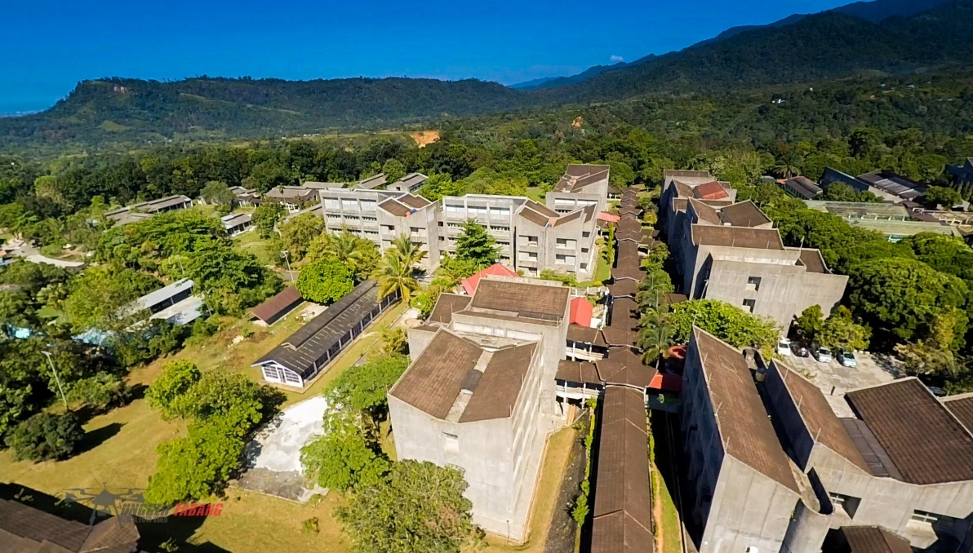
Memerlukan dua 200 auditor internal
Memerlukan beberapa kali latihan auditor internal
Sekarang auditor digunakan oleh perguruan tinggi lain, terutama binaan Unand
Sebagian terlibat dalam persiapan akreditasi internasional dengan Arizona State University

Slide 18
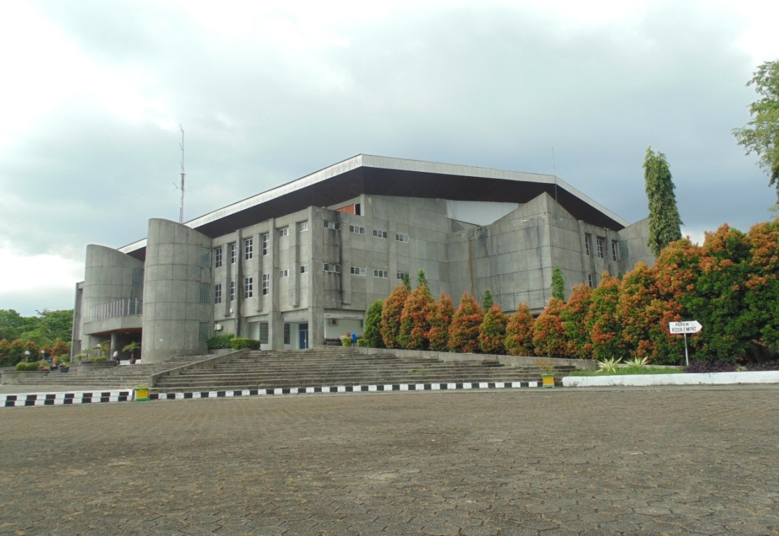
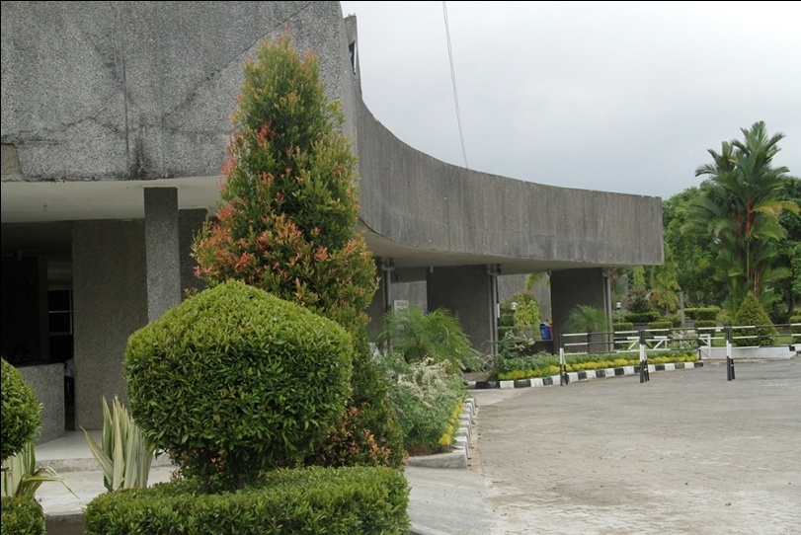
5. Taking Bold Act to Save Campus
Public universities in Indonesia, especially outside Java, will still struggling with fundamental problems
It is not easy to get out the vicious circle
Under these conditions, rector has to take unpopular policies and leave comfort zone
Andalas University’s own experiences indicated that unpopular policies and programs can get out the vicious circle

Slide 19
6. Involving Many Stakeholders in the Greening of Campus
University can not allocate a large sum of money for campus greening and sustainable development programs
Rector has to seek external sources funding and approach various stakeholders to choos Andalas University as the location of event
University should have a grand design of the greening campus
Make proposals as mach as possible

Slide 20
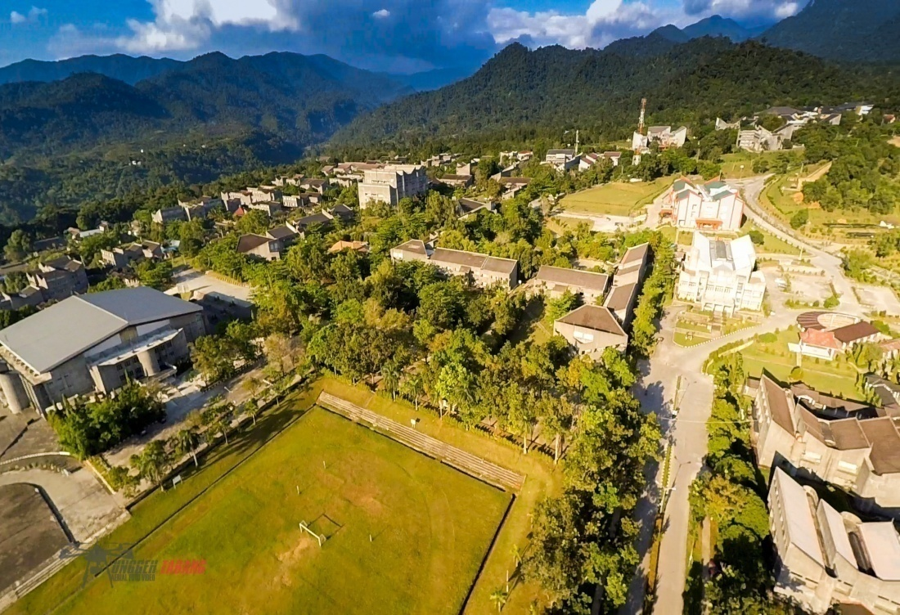
Send it to the various institutions, state owned enterprises and big private companies to participate in campus greening program

Slide 21
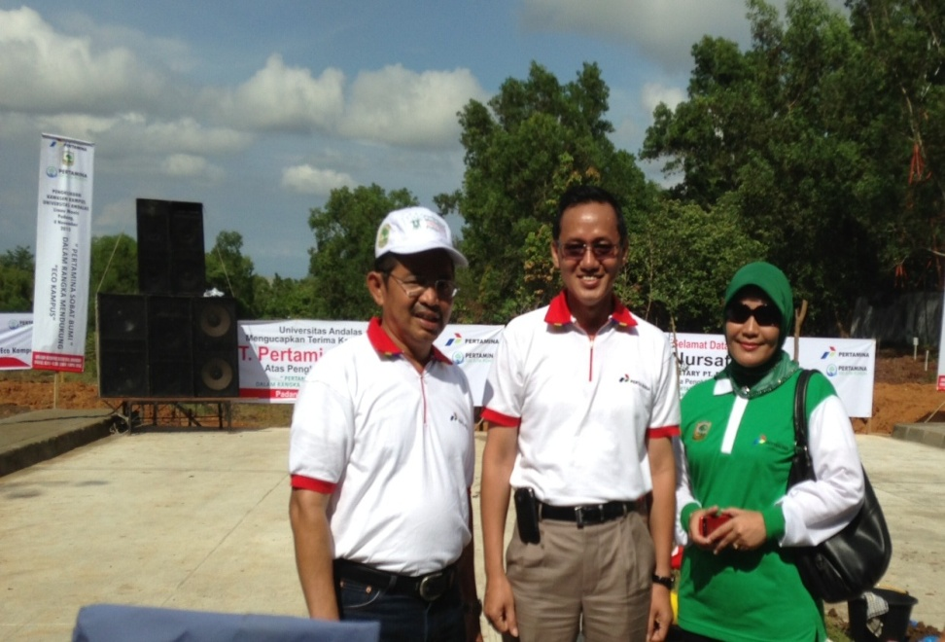
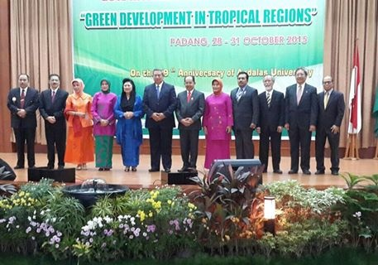
Many parties Involve on Universitas Andalas Green Campus Porgram

Slide 22
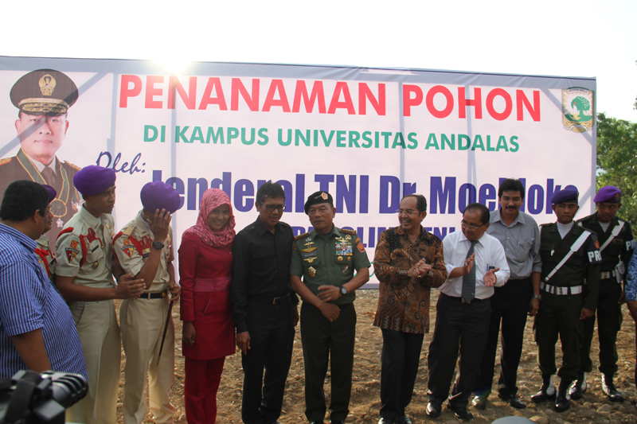
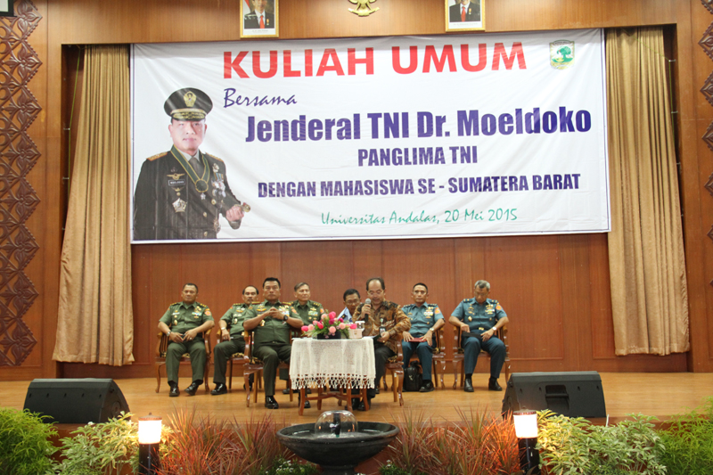
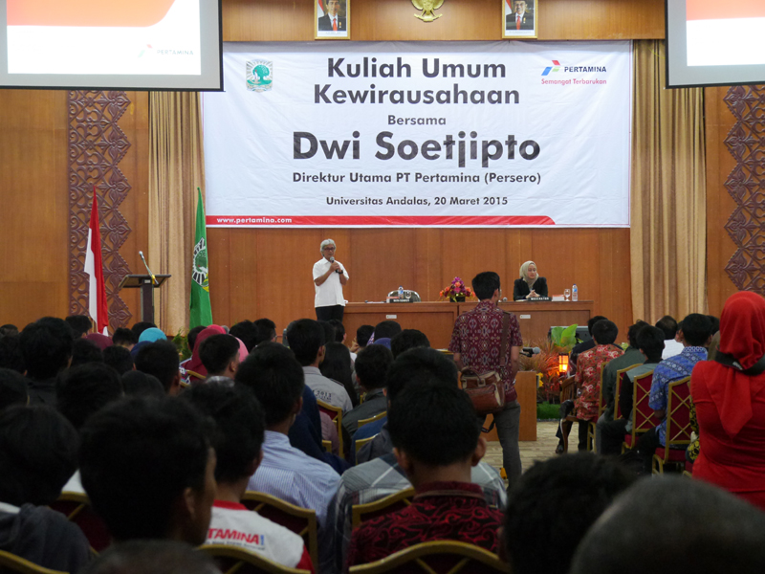

Slide 23
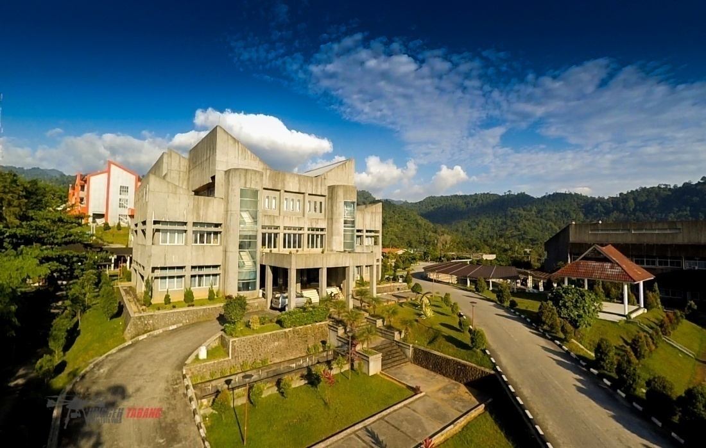
7. Proposed Assessment Criteria
Needs to be considered for assessment:
The geographic location and topography of campus
Campus which is undergoing physical development concerning the campus infrastructures
It is necessary to balanced and alternative figures for any campus located in the highlands or mountain and undergoing infrastructure deelopoment

Slide 24
8. Closing
Each university faces different problems to achieve high quality education and to participate in international rankings
Rector should have appropriate policies and steps to get out the problem so as to bring his or her university to receive international credit from global rating agencies
Andalas University has made a wide renge of policies to get out of the vicious circle to achive better performance

